Slide 1
Supplemental figures
figure S1: Viability of Abf1 constructs assessed by 5-FOA plasmid shuffling assay.
Strains harboring both pRS416-ABF1 plasmid (URA3 marker) and pRS315-”abf1 construct name” (LEU2 marker) in the strain background with deleted abf1 chromosomal gene were re-streaked from patches from YNB w/o ura, leu plates onto 5-FOA w/o leu plates. Only constructs discussed in the paper are labeled in plate schemes, where names of viable strains are in blue, names of inviable ones in black. Viability on 5-FOA plates was visually scored by comparison to known viable or inviable strains on the same plate. Inviable strains were distinguished from viable strains because they did not show growth of a contiguous patch after at most three days of incubation at 30 °C but only a smeary appearance or at most sparse single colonies, whereas viable strains grew as a contiguously dense patch. If few individual colonies grew instead of a contiguous patch, we tested some of them by colony PCR with the primers listed in Table S18. In all cases, these individual colonies contained plasmids of a wrong size or sequence reflecting recombination between pRS416-ABF1 and pRS315-”abf1 construct name”.
For each construct, independent clones after transformation were tested. On each slide, a table summarizes the result of the shown plate and in brackets the total result obtained for this construct if all tested clones on all plates were considered. If the same clone showed conflicting results in technical replicates, it was not counted as viable or inviable, but included in the total number of tested clones. The final categorization of each construct as viable or inviable followed the majority of tested clones excluding the clones with ambiguous results in technical replicates.

Slide 2
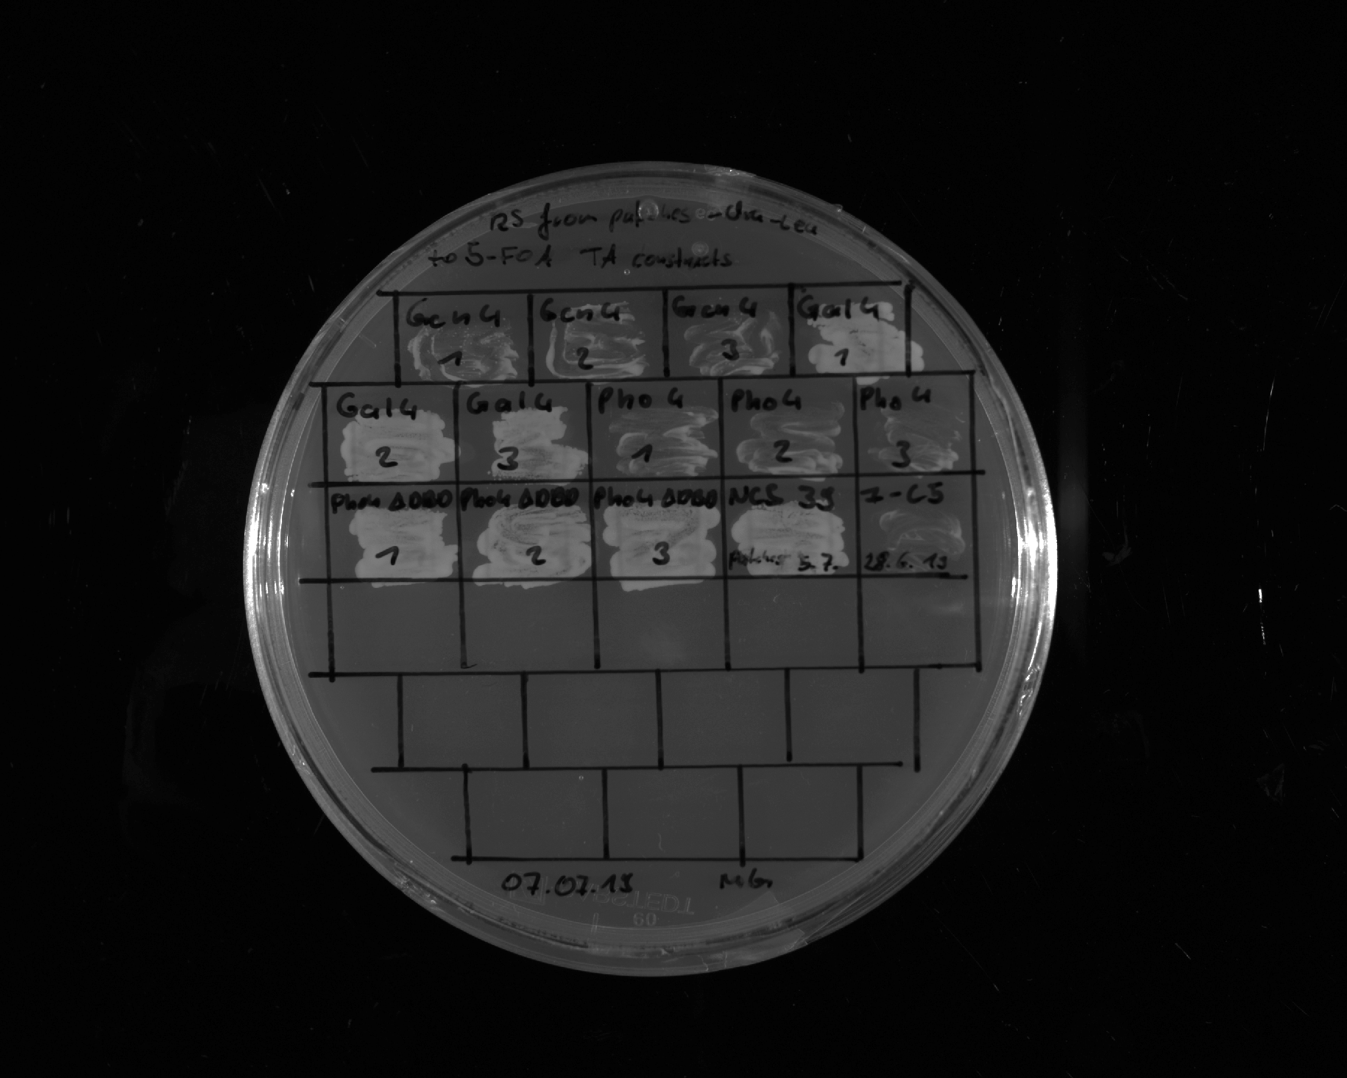
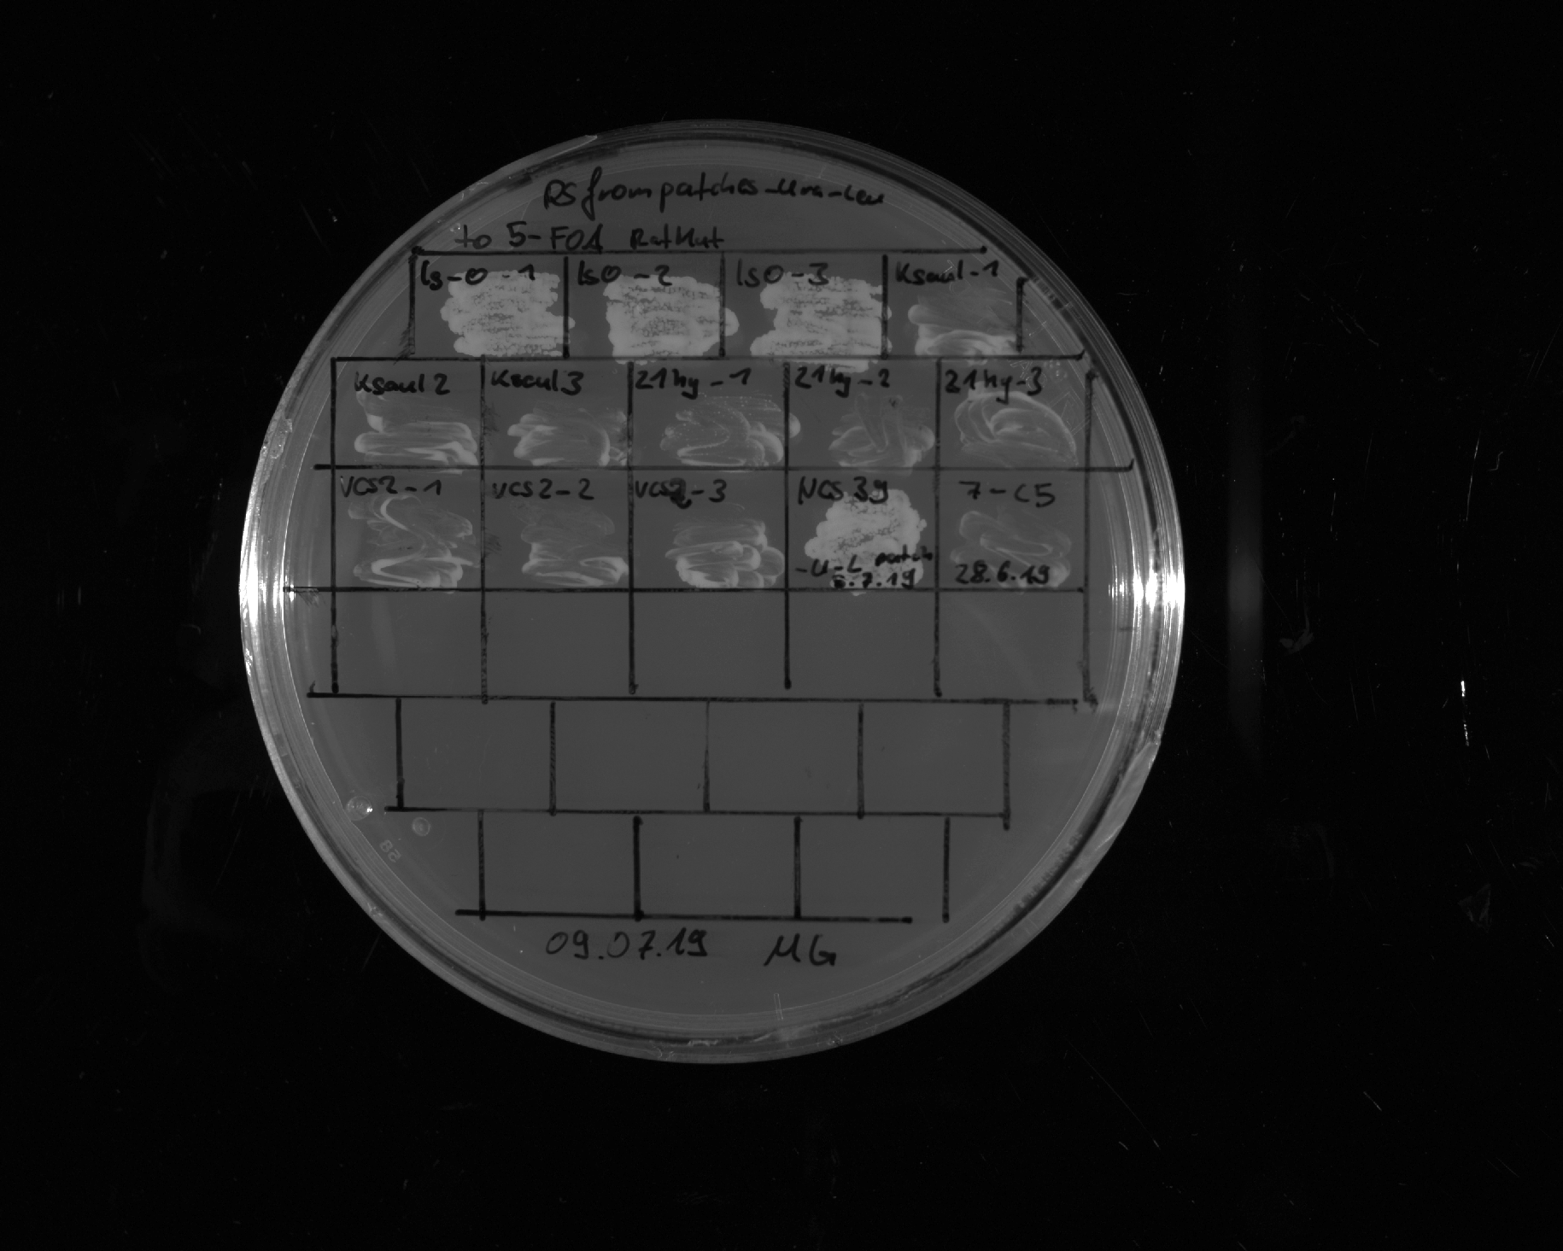
Gcn4
IDR
1
Gcn4
IDR
2
Gcn4
IDR
3
Gal4
IDR
1
Gal4
IDR
2
Gal4
IDR
3
Pho4
1-249
1
Pho4
1-249
2
Pho4
1-249
3
+ control
- control
Restreak from YNB –ura –leu to 5-FOA –leu
Construct | Result regarding viability on 5-FOA | Number of (in)viable clones / total number of clones
Gcn4¹⁷⁻¹⁵⁰ | inviable | 3 out of 3
Gal4⁷⁶⁸⁻⁸⁸¹ | viable | 3 out of 3
Pho4¹⁻²⁴⁹ | viable | 3 out of 3
LS-1
1
LS-1
2
LS-1
3
Shuffle 2
1
Shuffle 2
2
Shuffle 2
3
+ control
- control
Restreak from YNB –ura –leu to 5-FOA –leu
Construct | Result regarding viability on 5-FOA | Number of (in)viable clones / total number of clones
LS-1 | viable | 3 out of 3
Shuffle 2 | inviable | 3 out of 3

Slide 3
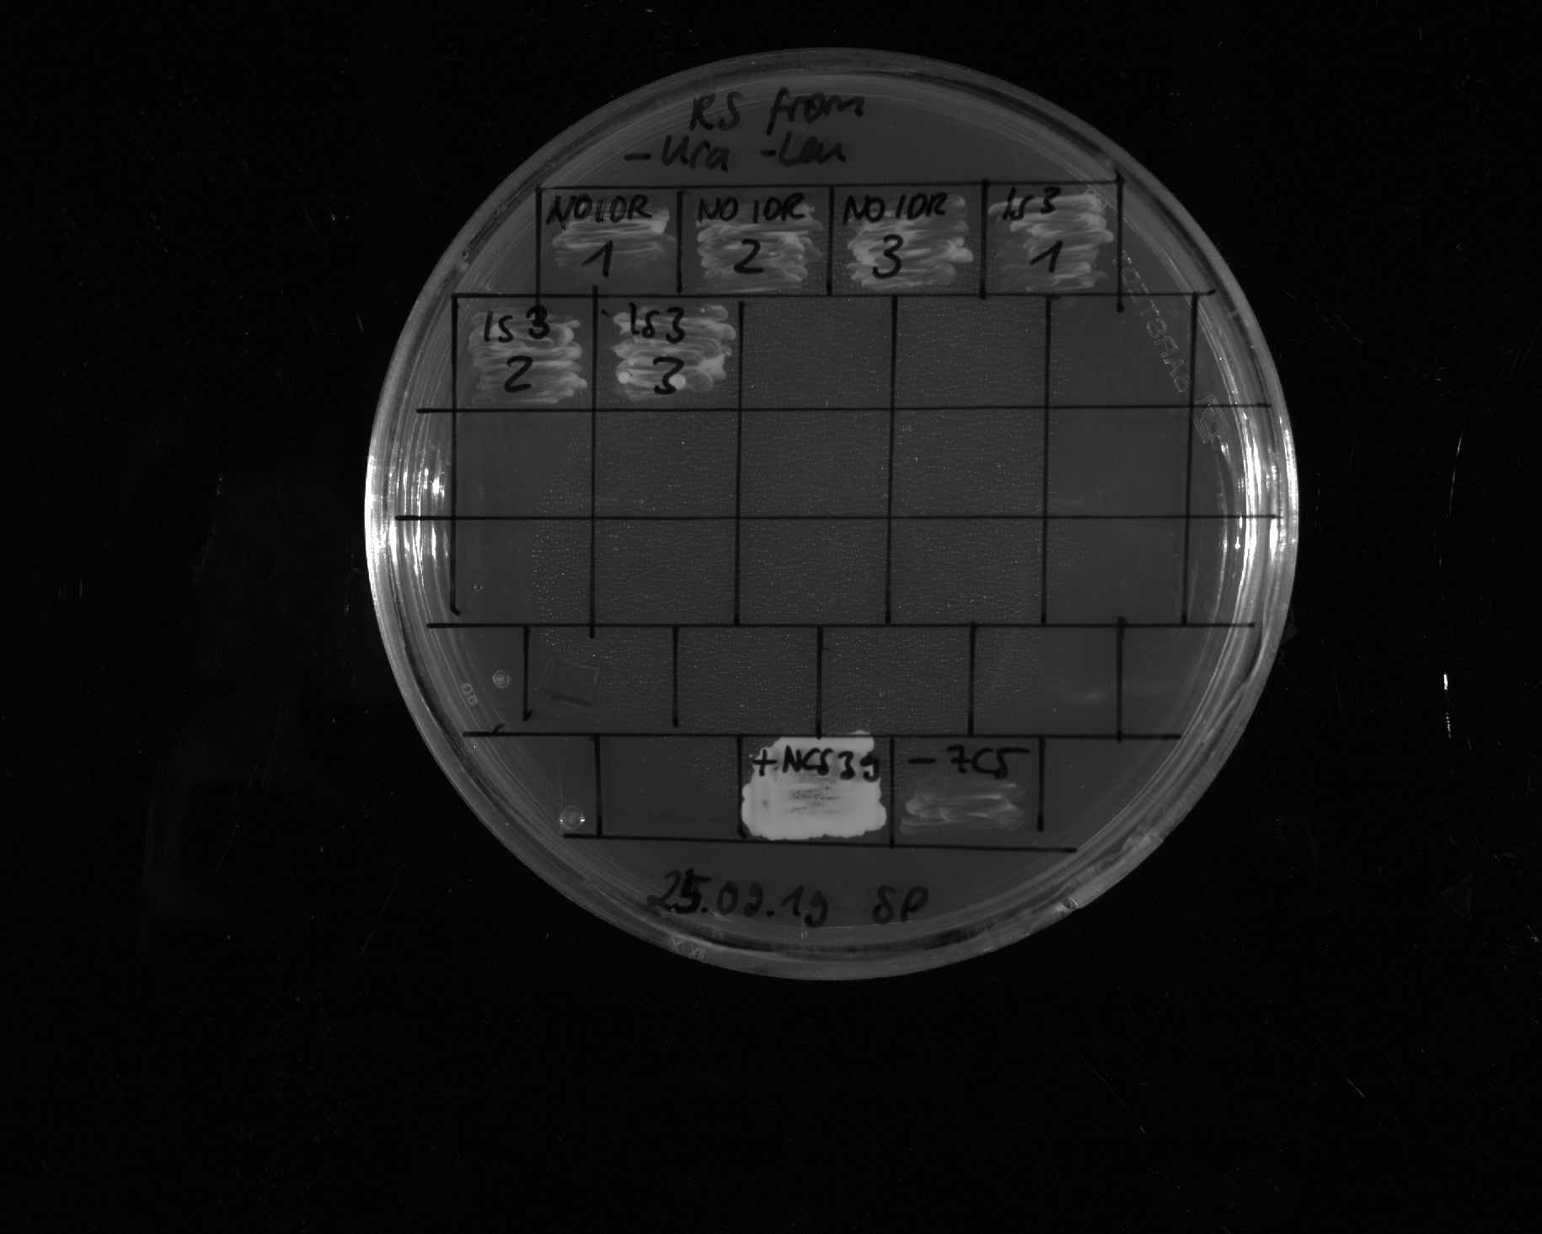
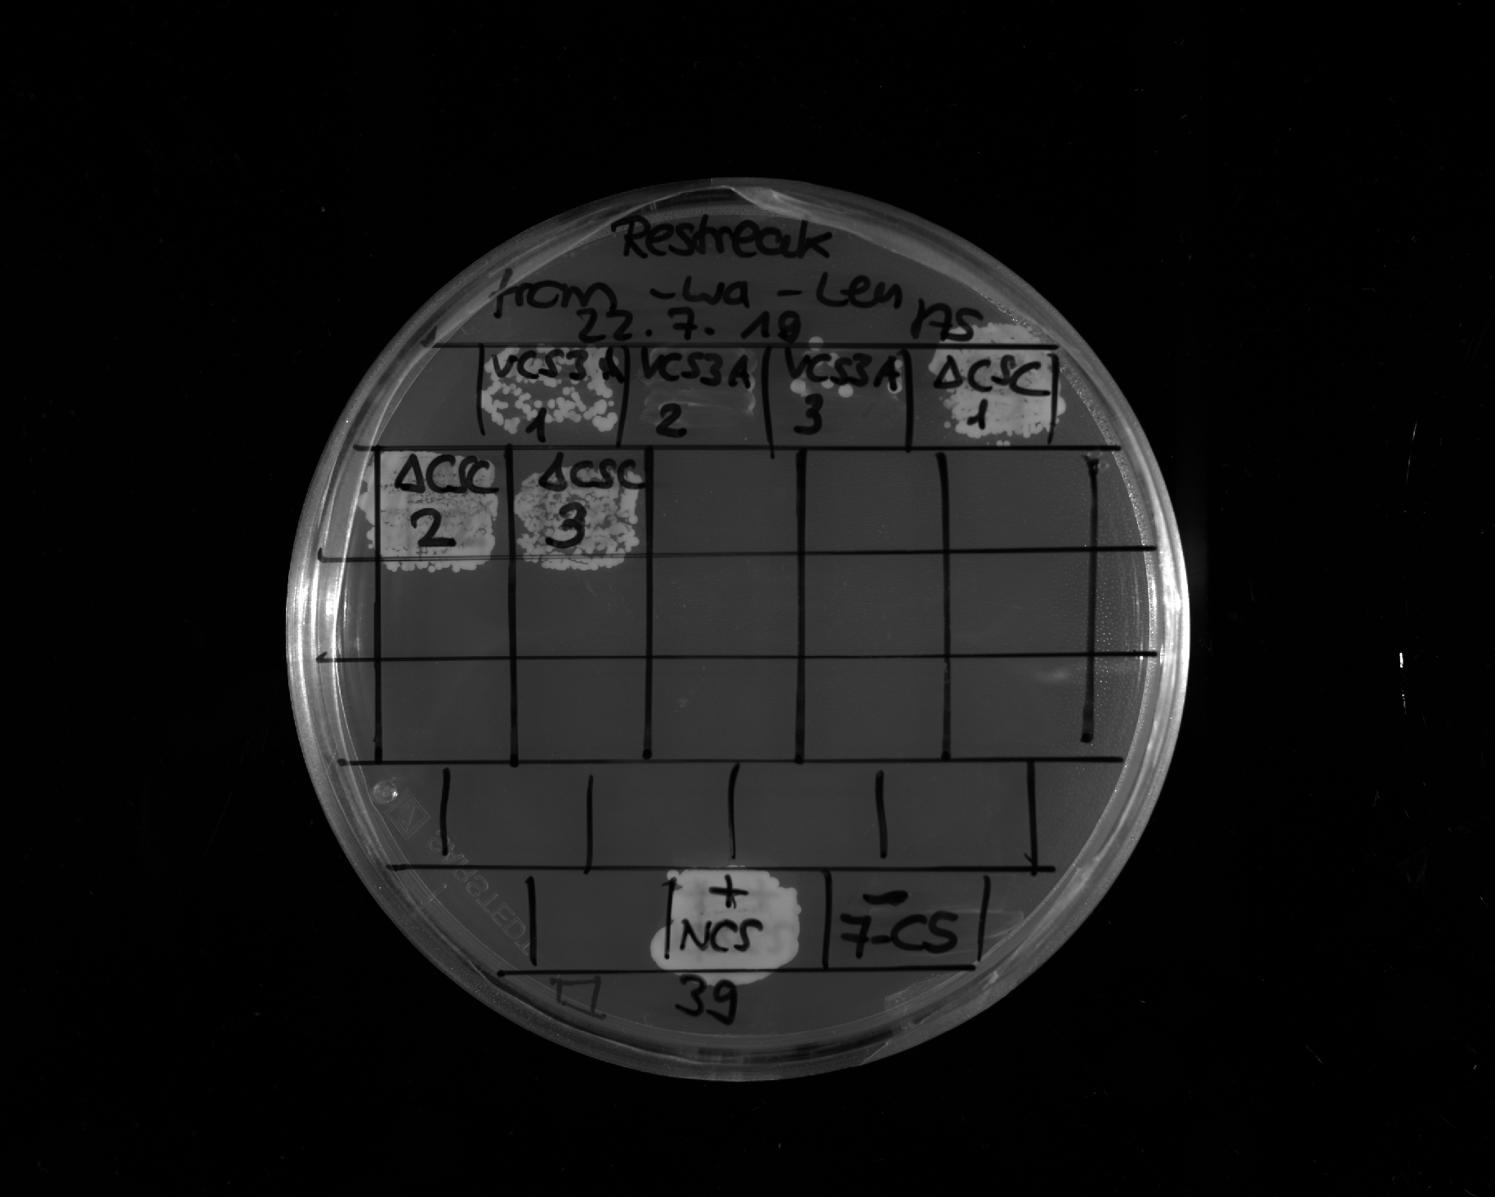
ΔIDR1/2
1
ΔIDR1/2
2
ΔIDR1/2
3
LS-4
1
LS-4
2
LS-4
3
Restreak from YNB –ura –leu to 5-FOA –leu
Construct | Result regarding viability on 5-FOA | Number of (in)viable clones / total number of clones
ΔIDR1/2 (NLS-FLAG) | inviable | 3 out of 3
LS-4 | inviable | 3 out of 3
+ control
- control
Shuffle 3
1
Shuffle 3
2
Shuffle 3
3
ΔIDR1 IDR2 449-623
1
ΔIDR1 IDR2 449-623
2
ΔIDR1 IDR2 449-623
3
Restreak from YNB –ura –leu to 5-FOA –leu
+ control
- control
Construct | Result regarding viability on 5-FOA | Number of (in)viable clones / total number of clones
Shuffle 3 | inviable | 2 out of 3 (in total 5 out ot 6, see also slide 4)
ΔIDR1 & IDR2⁴⁴⁹⁻⁶²³ | viable | 3 out of 3

Slide 4
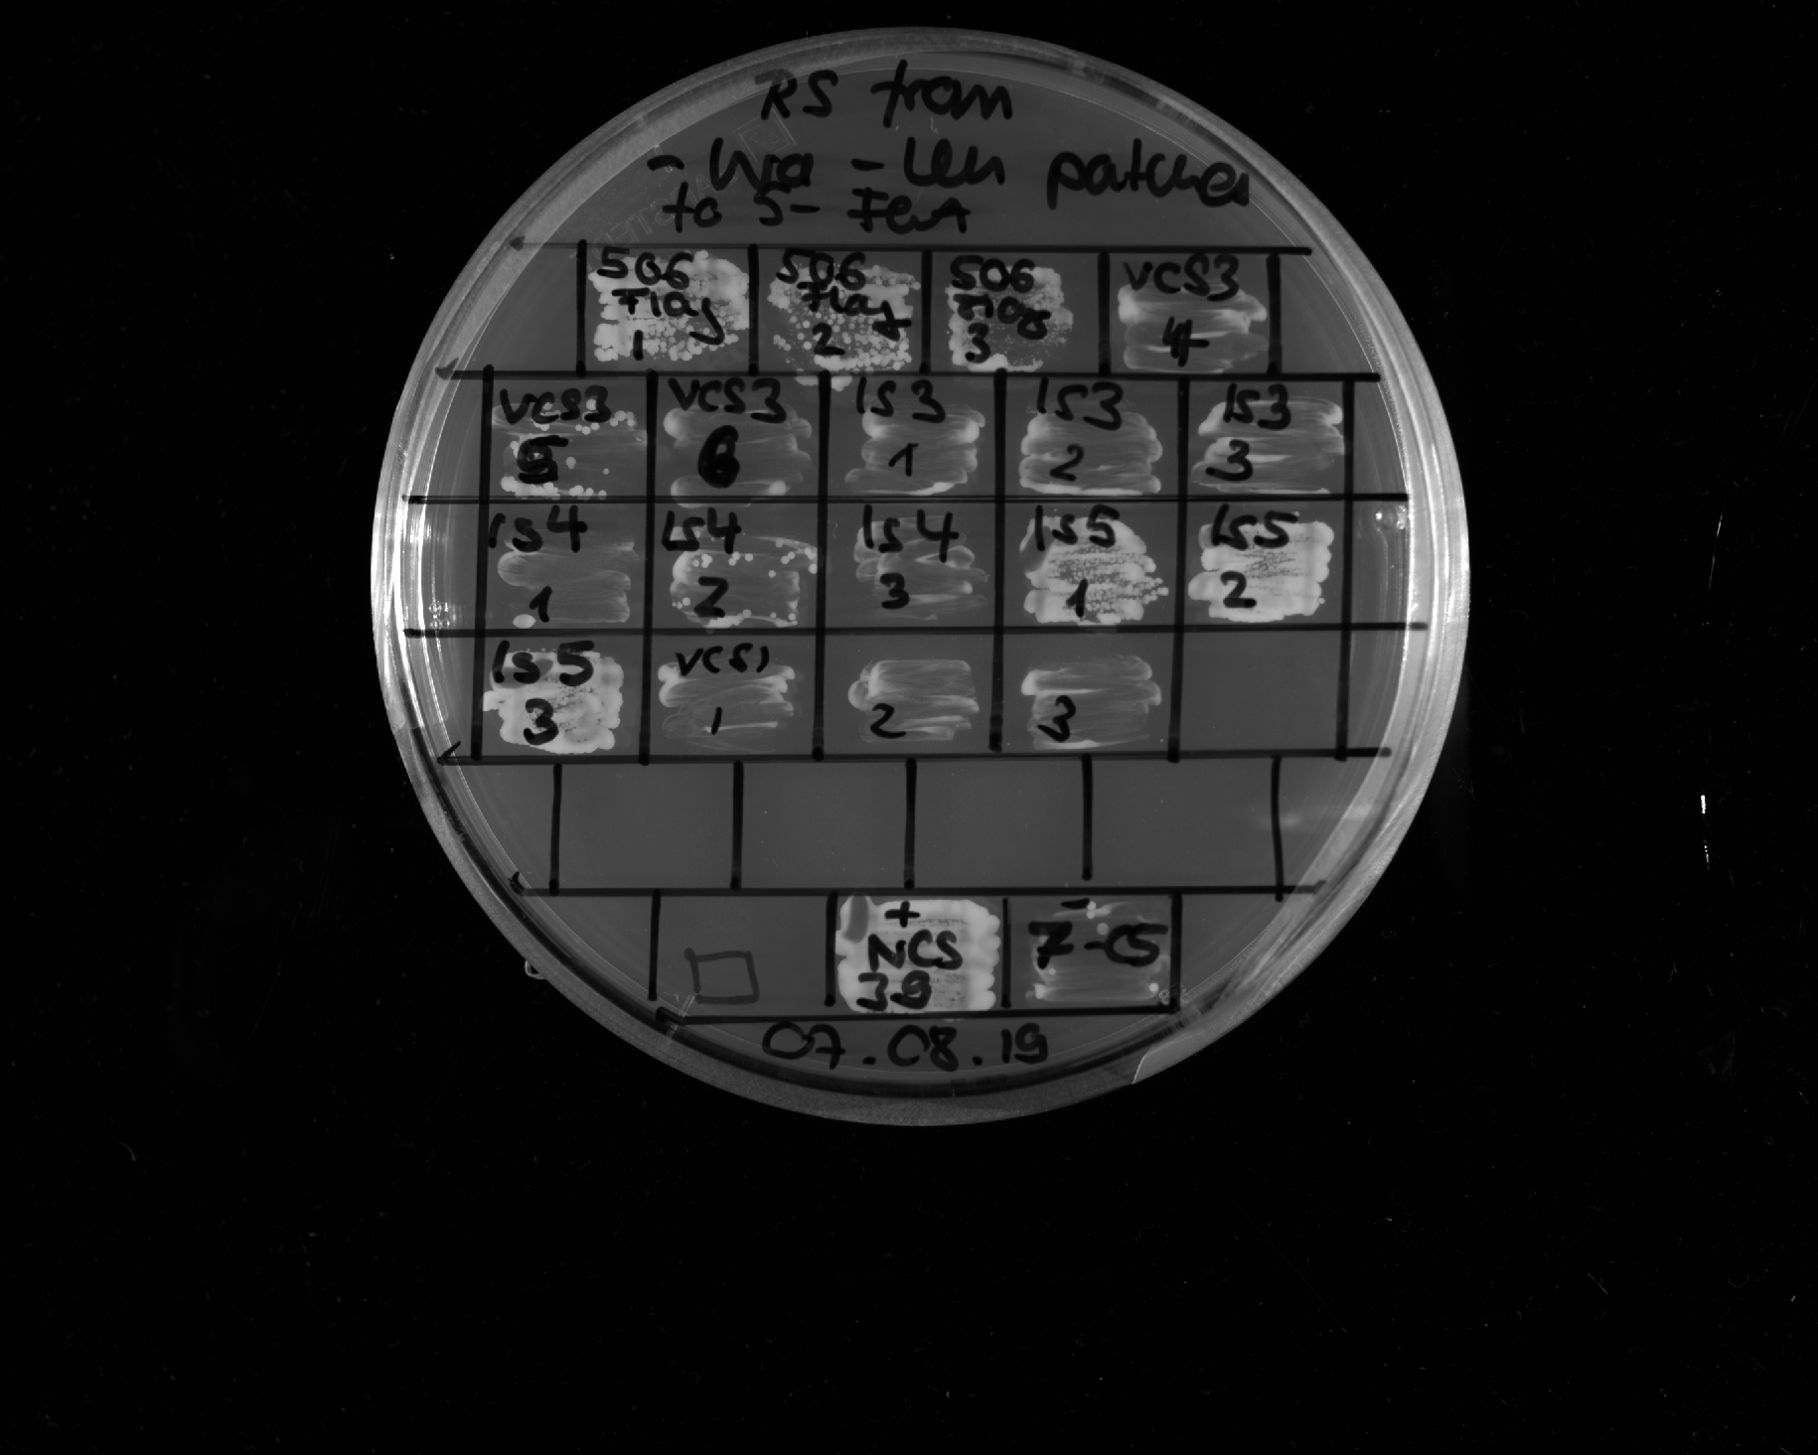
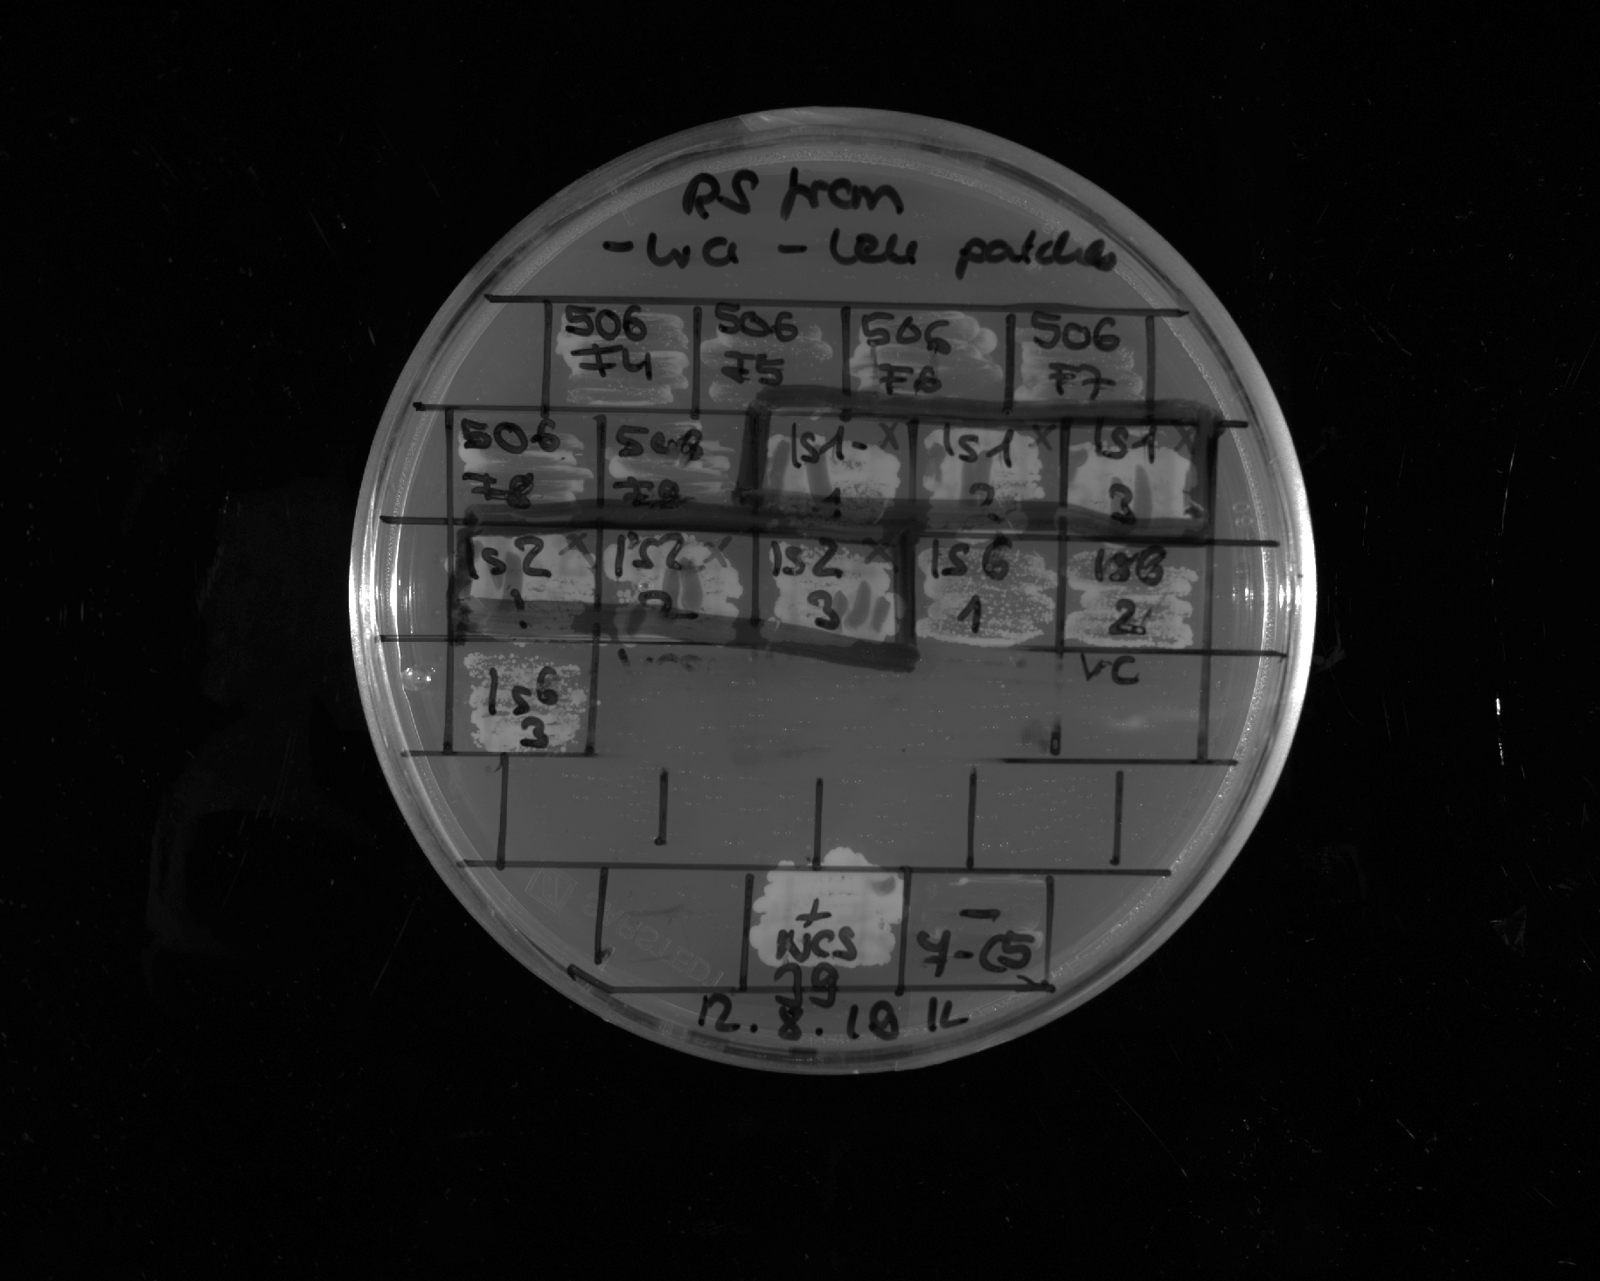
Shuffle 3
4
Shuffle 3
5
Shuffle 3
6
LS-5
1
LS-5
2
LS-5
3
LS-6
1
LS-6
2
LS-6
3
Shuffle 1
1
Shuffle 1
2
Shuffle 1
3
Restreak from YNB –ura –leu to 5-FOA –leu
Construct | Result regarding viability on 5-FOA | Number of (in)viable clones / total number of clones
Shuffle 3 | inviable | 3 out of 3 (in total 5 out ot 6, see also slide 3)
LS-5 | inviable | 3 out of 3
LS-6 | viable | 3 out of 3
Shuffle 1 | inviable | 3 out of 3
+ control
- control
LS-2
1
LS-2
2
LS-2
3
LS-3
1
LS-3
2
LS-3
3
LS-7
1
LS-7
2
LS-7
3
Restreak from YNB –ura –leu to 5-FOA –leu
+ control
- control
Construct | Result regarding viability on 5-FOA | Number of (in)viable clones / total number of clones
LS-2 | viable | 3 out of 3 (technical replicates, see also slide 6)
LS-3 | viable | 3 out of 3 (technical replicates, see also slide 6)
LS-7 | viable | 3 out of 3 (in total 8 out of 8, see also slide 5)

Slide 5
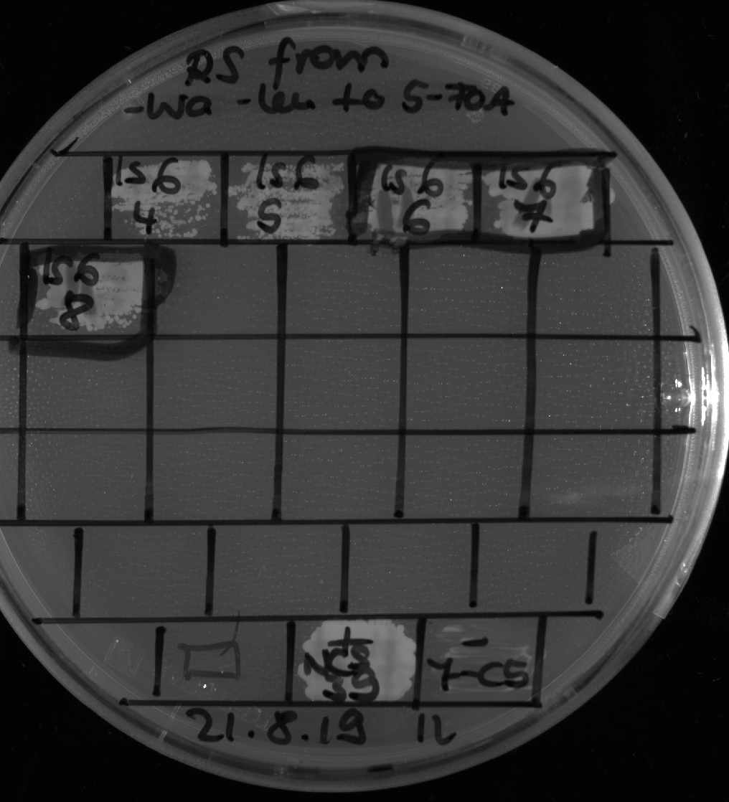
LS-7
4
LS-7
5
LS-7
6
LS-7
7
LS-7
8
Restreak from YNB –ura –leu to 5-FOA –leu
Construct | Result regarding viability on 5-FOA | Number of (in)viable clones / total number of clones
LS-7 | viable | 5 out of 5 (in total 8 out of 8, see also slide 4)
+ control
- control

Slide 6
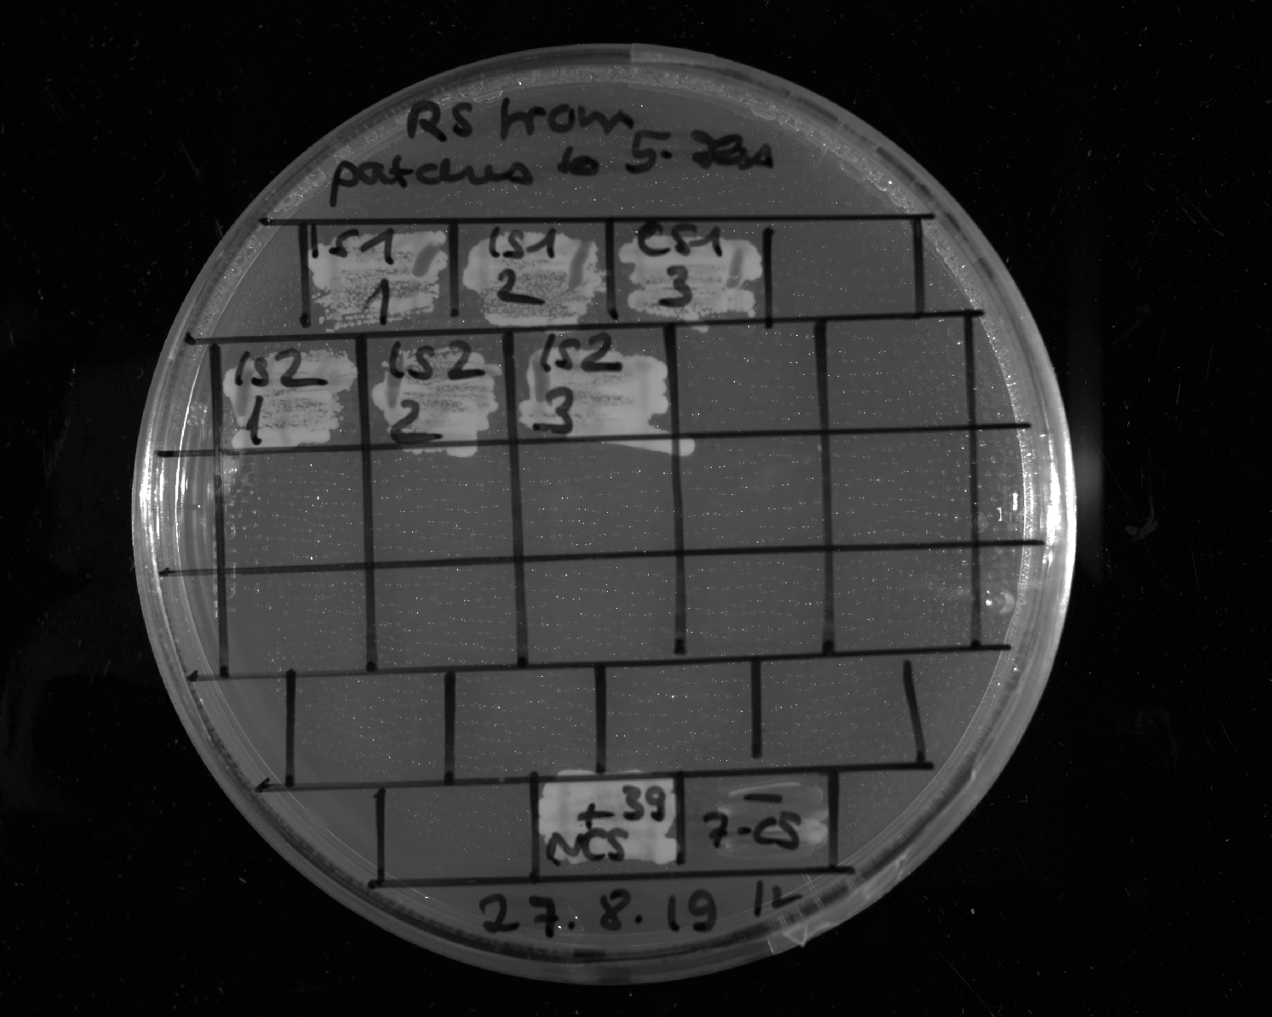
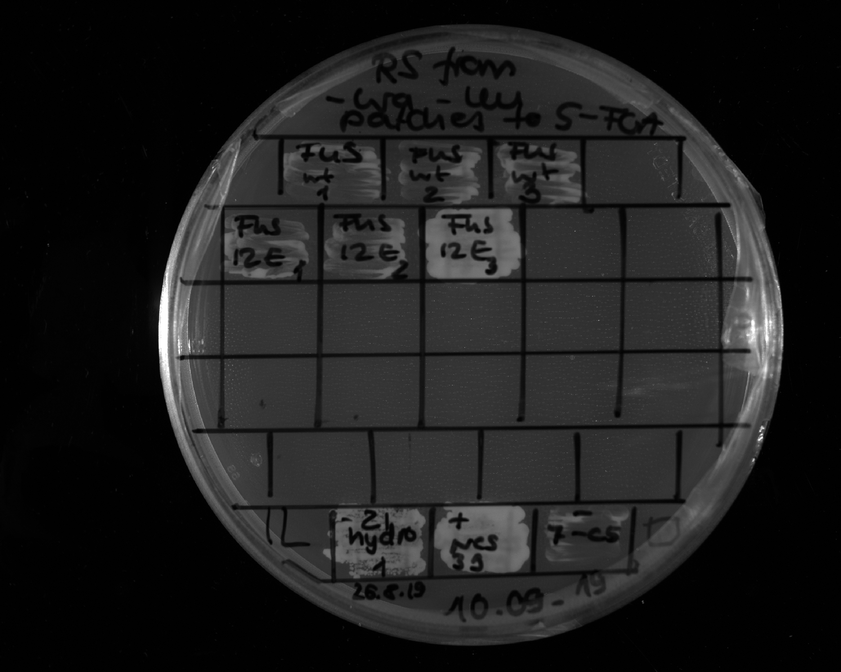
LS-2
1
LS-2
2
LS-2
3
LS-3
1
LS-3
2
LS-3
3
Restreak from YNB –ura –leu to 5-FOA –leu
Construct | Result regarding viability on 5-FOA | Number of (in)viable clones / total number of clones
LS-2 | viable | 3 out of 3 (technical replicates, see also slide 4)
LS-3 | viable | 3 out of 3 (technical replicates, see also slide 4)
+ control
- control
FUS_1_163_WT
1
FUS_1_163_WT
2
FUS_1_163_WT
3
FUS_1_163_12E
1
FUS_1_163_12E
2
FUS_1_163_12E
3
Restreak from YNB –ura –leu to 5-FOA –leu
+ control
- control
Construct | Construct | Number of (in)viable clones / total number of clones
FUS¹⁻¹⁶³ | inviable | 3 out of 3
FUS¹⁻¹⁶³12E | inviable | 2 out of 3 (in total: 8 out of 9, see also slides 7 and 14)

Slide 7
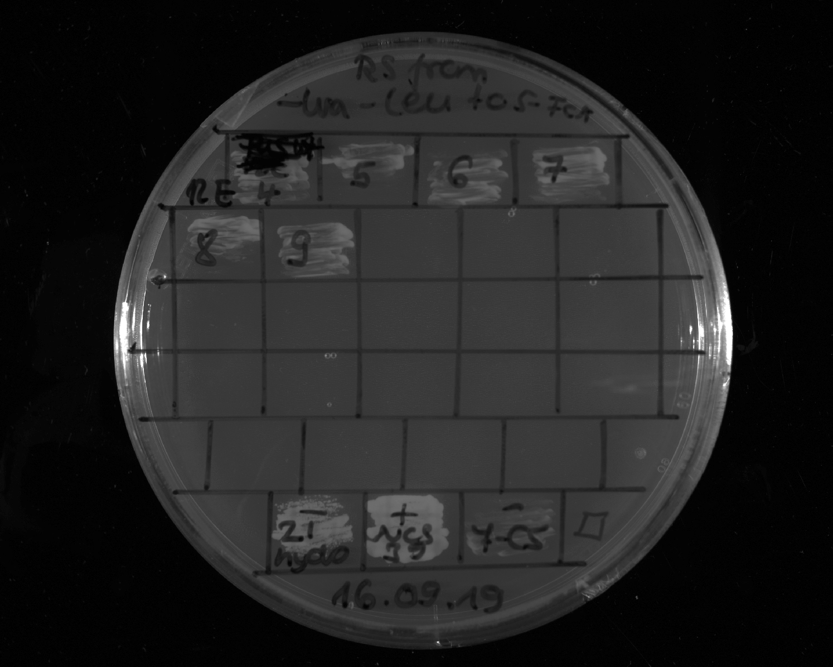
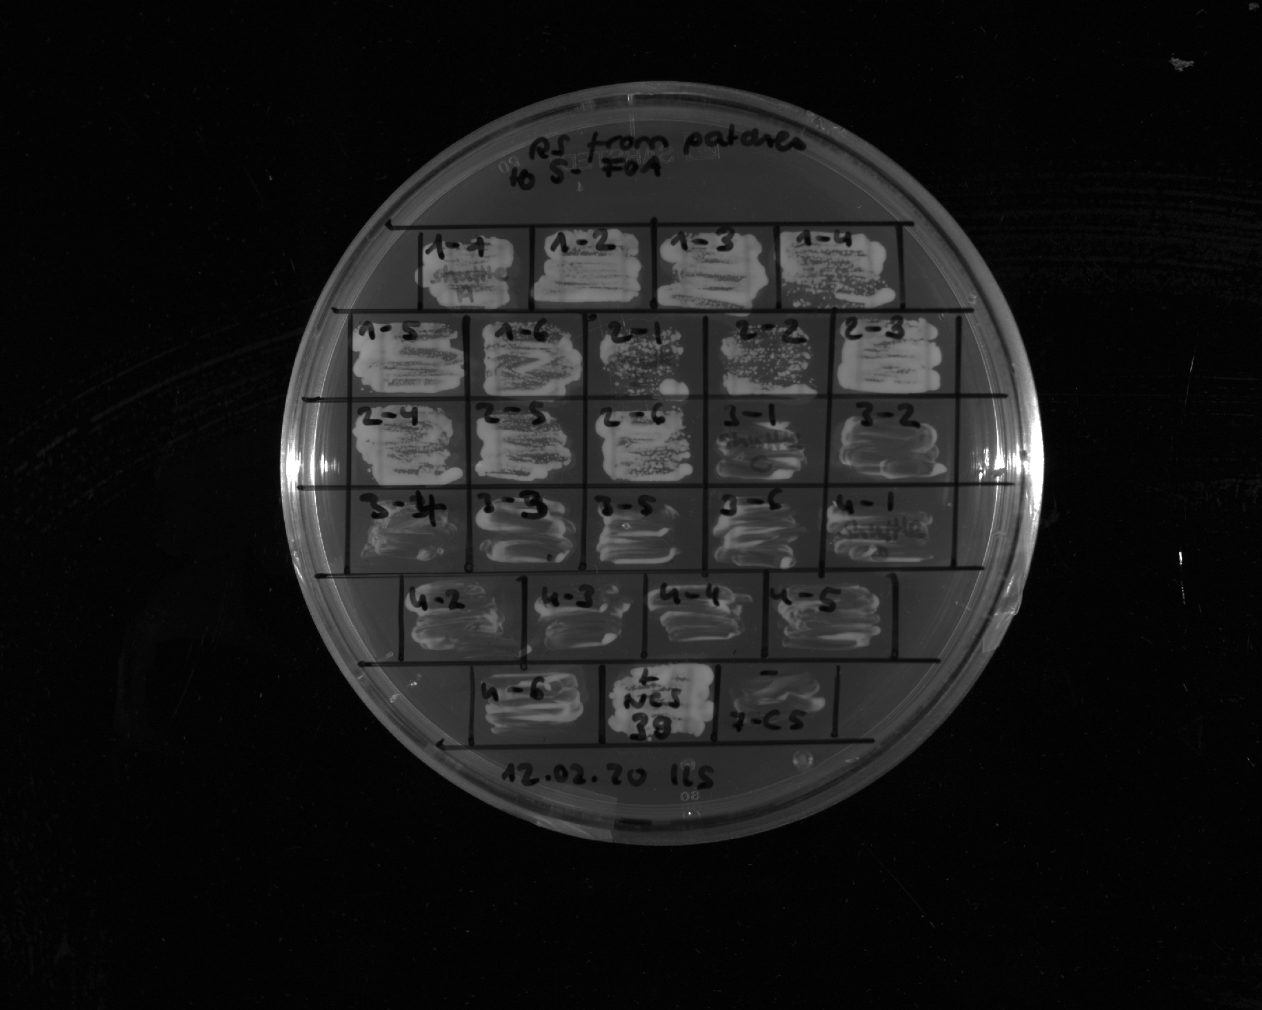
FUS_1_163_12E
4
FUS_1_163_12E
5
FUS_1_163_12E
6
FUS_1_163_12E
7
FUS_1_163_12E
8
FUS_1_163_12E
9
Restreak from YNB –ura –leu to 5-FOA –leu
Construct | Result regarding viability on 5-FOA | Number of (in)viable clones / total number of clones
FUS¹⁻¹⁶³12E | Inviable | 6 out of 6 ((in total 8 out of 9, see also slides 6 and 14)
+ control
- control
LS-9
1
LS-9
2
LS-9
3
LS-9
4
LS-9
5
LS-9
6
LS-10
1
LS-10
2
LS-10
3
LS-10
4
LS-10
5
LS-10
6
LS-11
1
LS-11
2
LS-11
3
LS-11
4
LS-11
5
LS-11
6
LS-12
1
Restreak from YNB –ura –leu to 5-FOA –leu
LS-12
2
LS-12
3
LS-12
4
LS-12
5
Construct | Result regarding viability on 5-FOA | Number of (in)viable clones / total number of clones
LS-9 | viable | 6 out of 6
LS-10 | viable | 6 out of 6
LS-11 | inviable | 6 out of 6
LS-12 | inviable | 6 out of 6
LS-12
6
+ control
- control

Slide 8
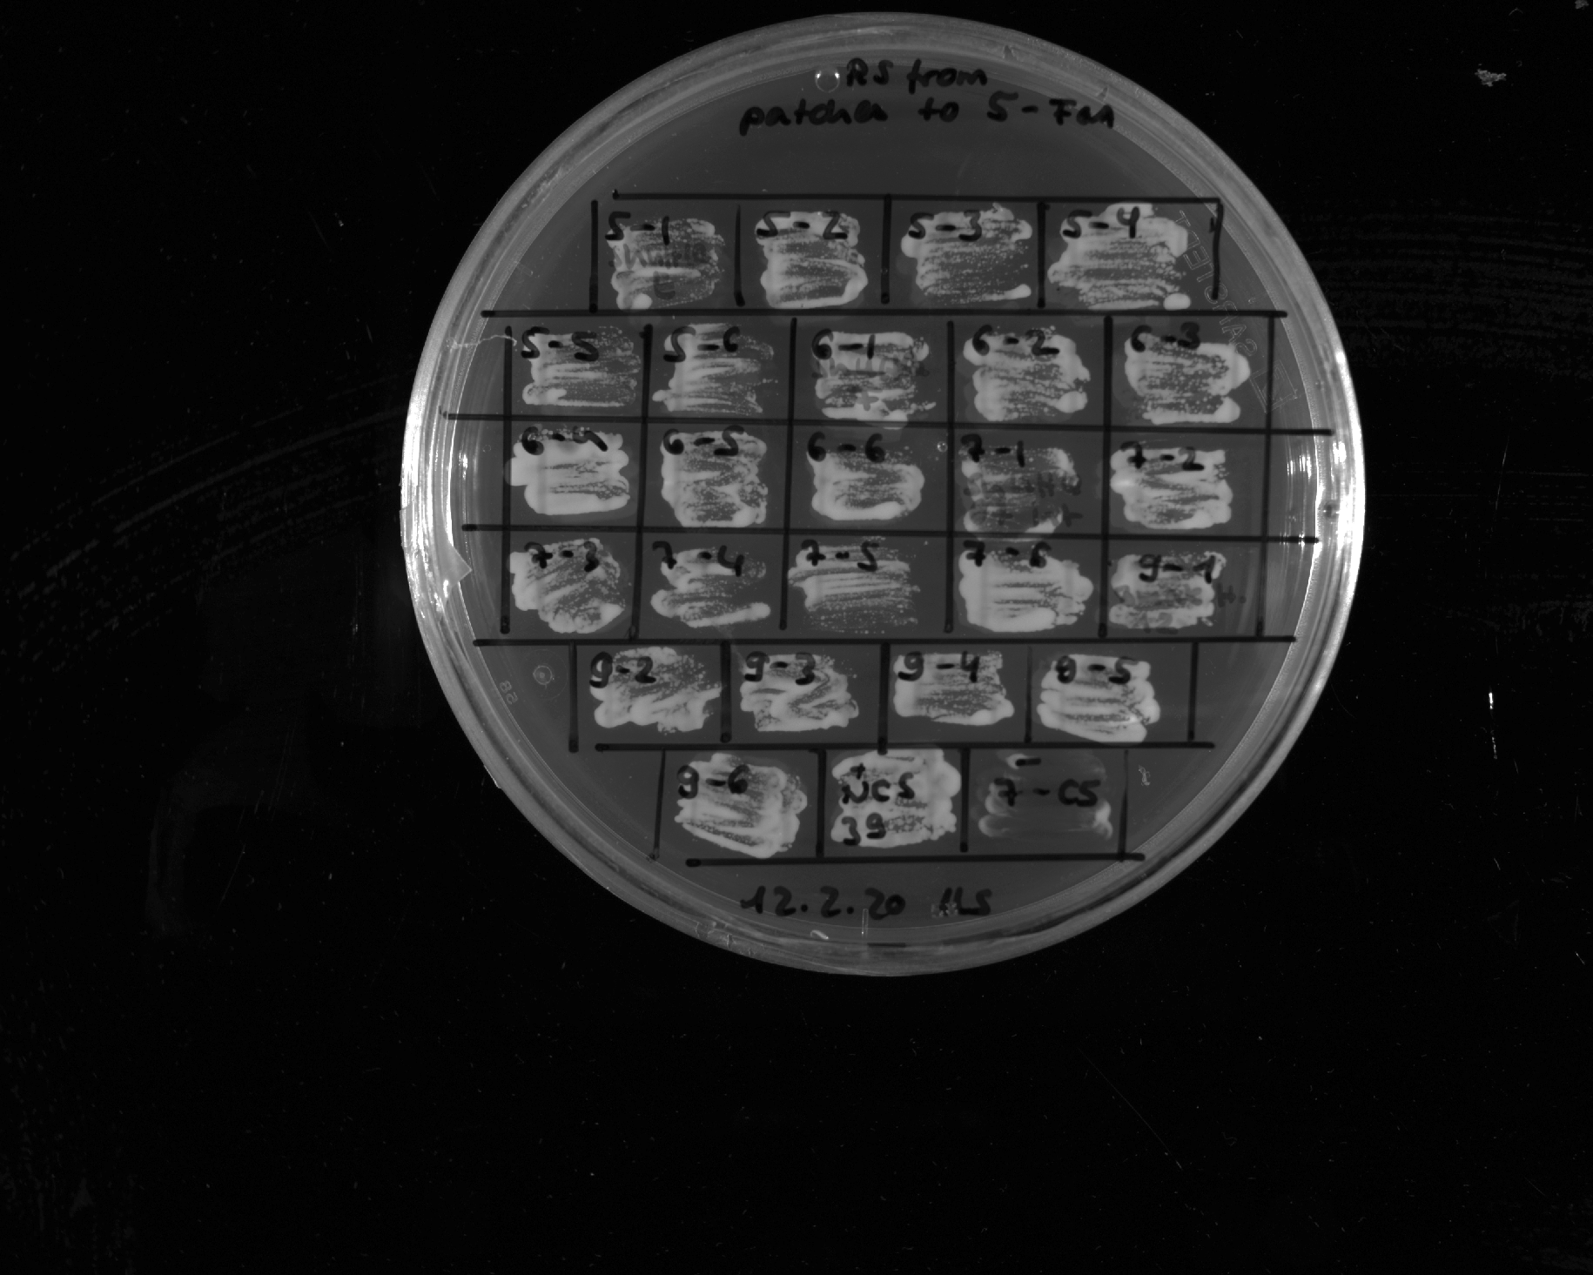
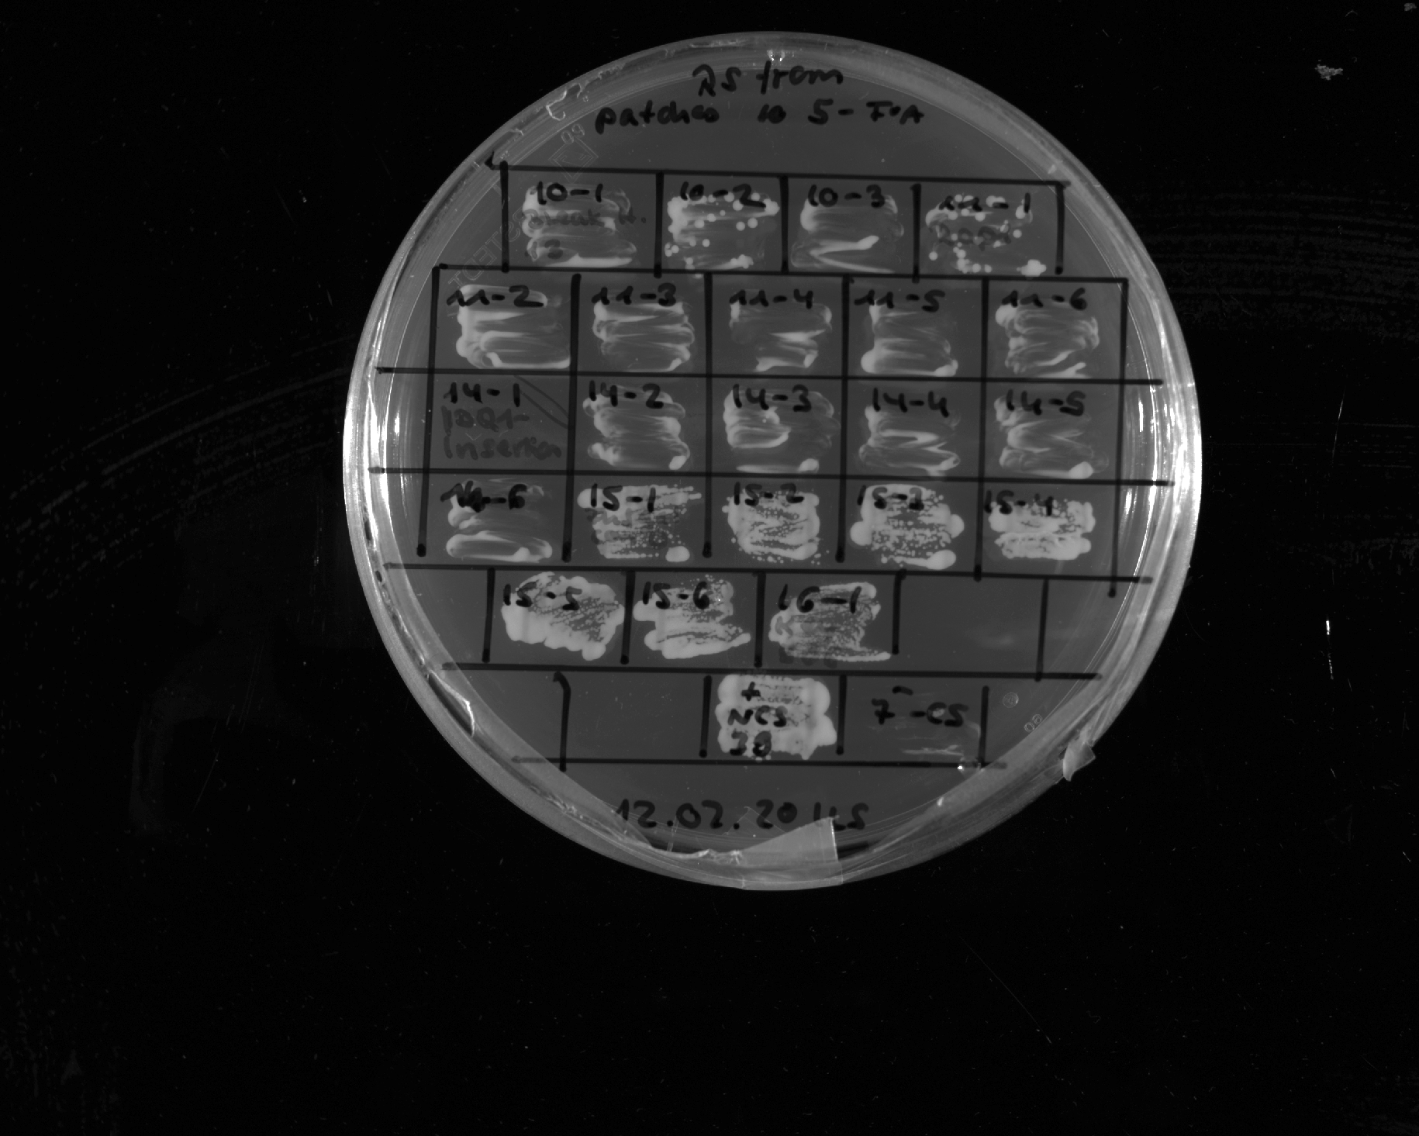
LS-13
1
LS-13
2
LS-13
3
LS-13
4
LS-13
5
LS-13
6
LS-14
1
LS-14
2
LS-14
3
LS-14
4
LS-14
5
LS-14
6
Restreak from YNB –ura –leu to 5-FOA –leu
+ control
- control
Construct | Construct | Number of (in)viable clones / total number of clones
LS-13 | viable | 6 out of 6
LS-14 | viable | 6 out of 6
Rap1 IDR 231-361
1
Rap1 IDR 231-361
2
Rap1 IDR 231-361
3
Rap1 IDR 231-361
4
Rap1 IDR 231-361
5
Rap1 IDR 231-361
6
Abf1 IDR 87-311
2
Abf1 IDR 87-311
3
Abf1 IDR 87-311
4
Abf1 IDR 87-311
5
Abf1 IDR 87-311
6
FUS 1-163 12E + Gal4 G4
1
FUS 1-163 12E + Gal4 G4
2
FUS 1-163 12E + Gal4 G4
3
FUS 1-163 12E + Gal4 G4
4
Restreak from YNB –ura –leu to 5-FOA –leu
FUS 1-163 12E + Gal4 G4
5
FUS 1-163 12E + Gal4 G4
6
Construct | Result regarding viability on 5-FOA | Number of (in)viable clones / total number of clones
Rap1²³¹⁻³⁶¹ | inviable | 6 out of 6
Abf1 IDR1⁸⁷⁻³¹¹ | inviable | 6 out of 6
FUS¹⁻¹⁶³12E + Gal4^{G4} | viable | 6 out of 6
+ control
- control

Slide 9
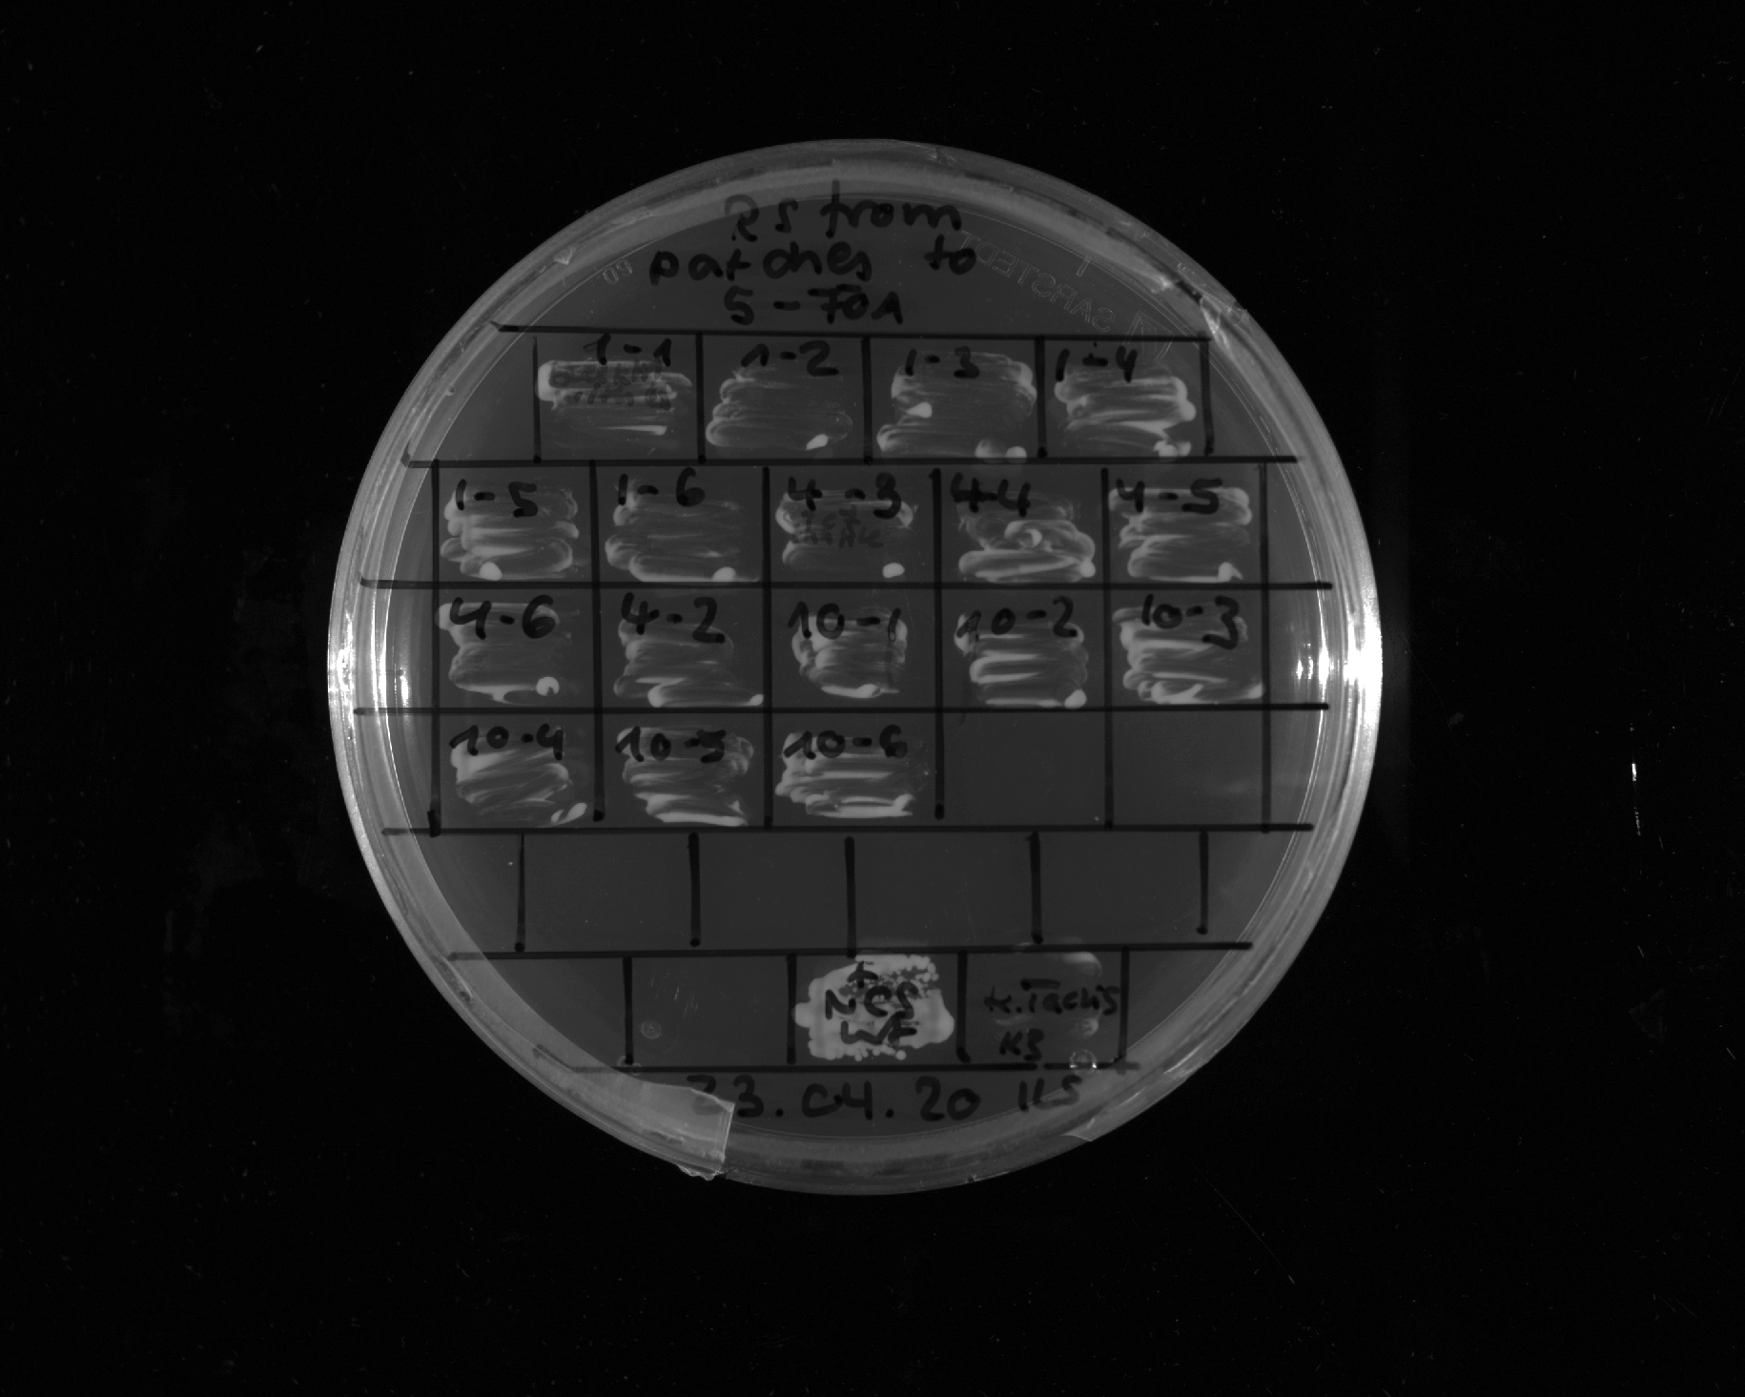
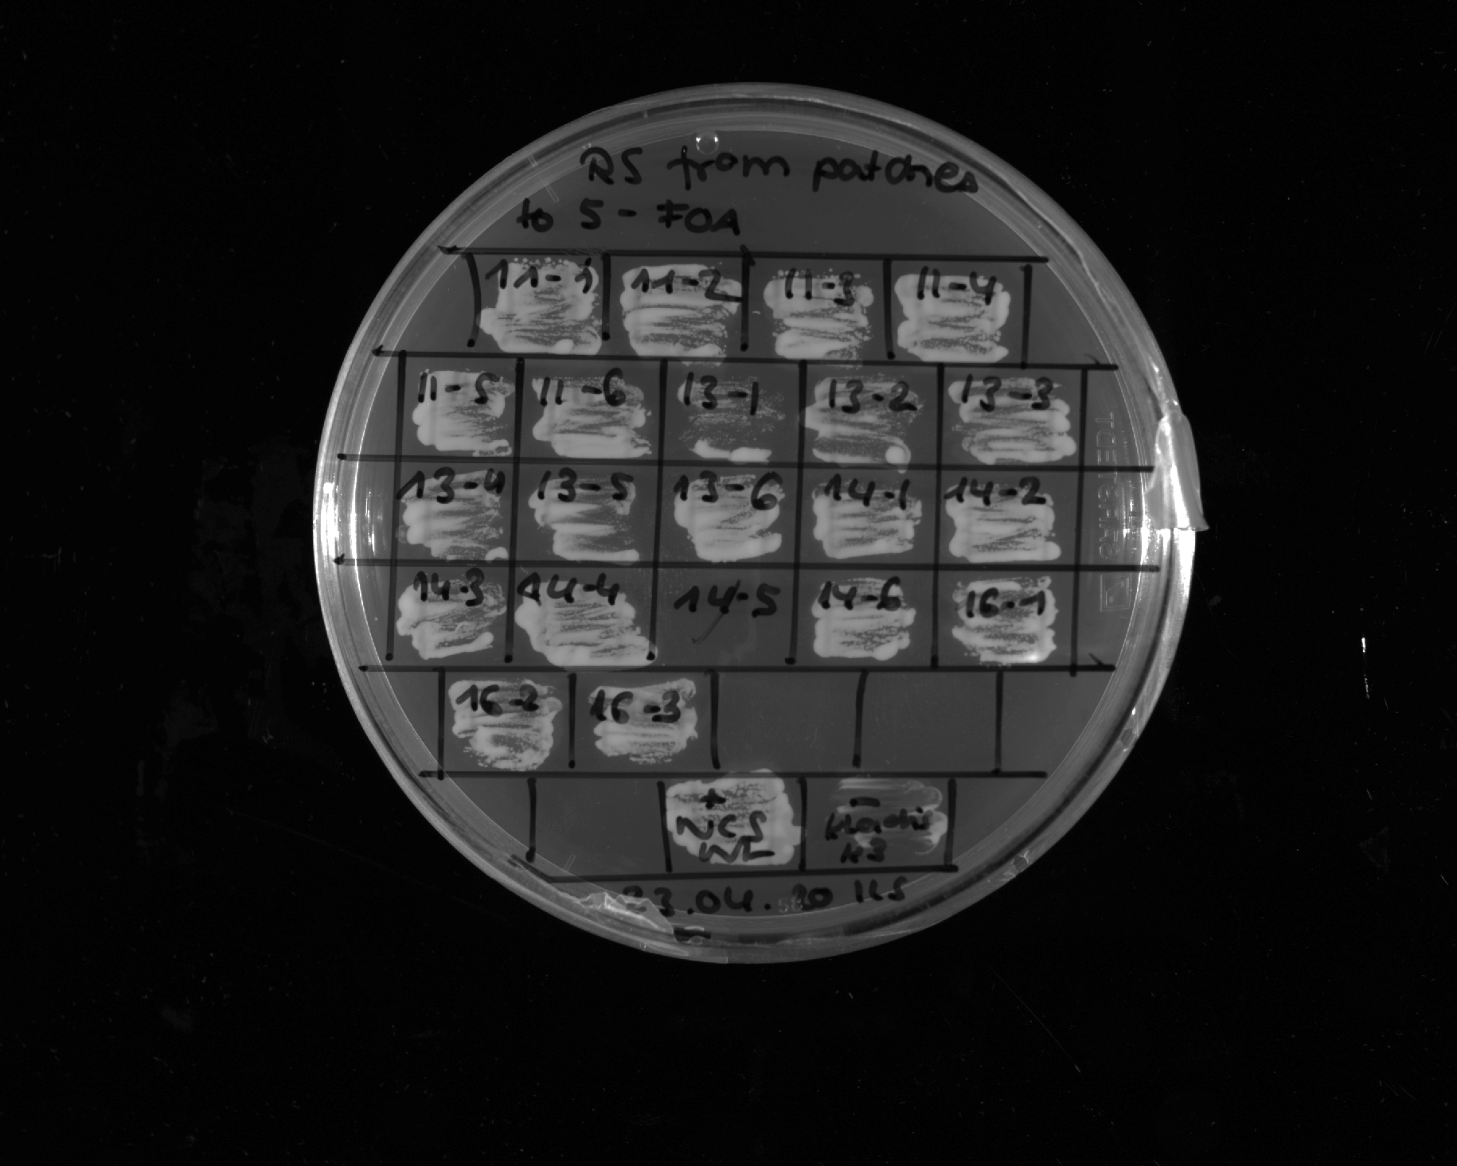
FUS 1-163 12E + Gal4 G4 motif (Y->S)
1
FUS 1-163 12E + Gal4 G4 motif (Y->S)
2
FUS 1-163 12E + Gal4 G4 motif (Y->S)
3
FUS 1-163
12E + Gal4 G4 motif (Y->S)
4
FUS 1-163
12E + Gal4 G4 motif (Y->S)
5
FUS 1-163
12E + Gal4 G4 motif (Y->S)
6
Restreak from YNB –ura –leu to 5-FOA –leu
+ control
- control
Construct | Construct | Number of (in)viable clones / total number of clones
FUS¹⁻¹⁶³12E + Gal4^{G4} Y→S in context | inviable | 6 out of 6
FUS¹⁻¹⁶³12E + Gal4^{G4} shuffle; 1
FUS¹⁻¹⁶³12E + Gal4^{G4} shuffle; 2
FUS¹⁻¹⁶³12E + Gal4^{G4} shuffle; 3
FUS¹⁻¹⁶³12E + Gal4^{G4} shuffle; 4
FUS¹⁻¹⁶³12E + Gal4^{G4} shuffle; 5
FUS¹⁻¹⁶³12E + Gal4^{G4} shuffle; 6
Altered valence 2
1
Altered valence 2
2
Altered valence 2
3
Altered valence 2
4
Altered valence 2
5
Altered valence 2
6
Rap1231-361 + Gal4 G4 motif
1
Rap1231-361 + Gal4 G4 motif
2
Rap1231-361 + Gal4 G4 motif
3
Rap1231-361 + Gal4 G4 motif
4
Rap1231-361 + Gal4 G4 motif
6
LS-8
1
LS-8
2
LS-8
3
Restreak from YNB –ura –leu to 5-FOA –leu
+ control
- control
Construct | Construct | Number of (in)viable clones / total number of clones
FUS¹⁻¹⁶³12E + Gal4^{G4} shuffle | viable | 6 out of 6
Altered valence 2 | viable | 5 out of 6 (in total 5 out of 6, see also slide 22)
Rap1²³¹⁻³⁶¹ + Gal4 G4 | viable | 5 out of 5
LS-8 | viable | 3 out of 3

Slide 10
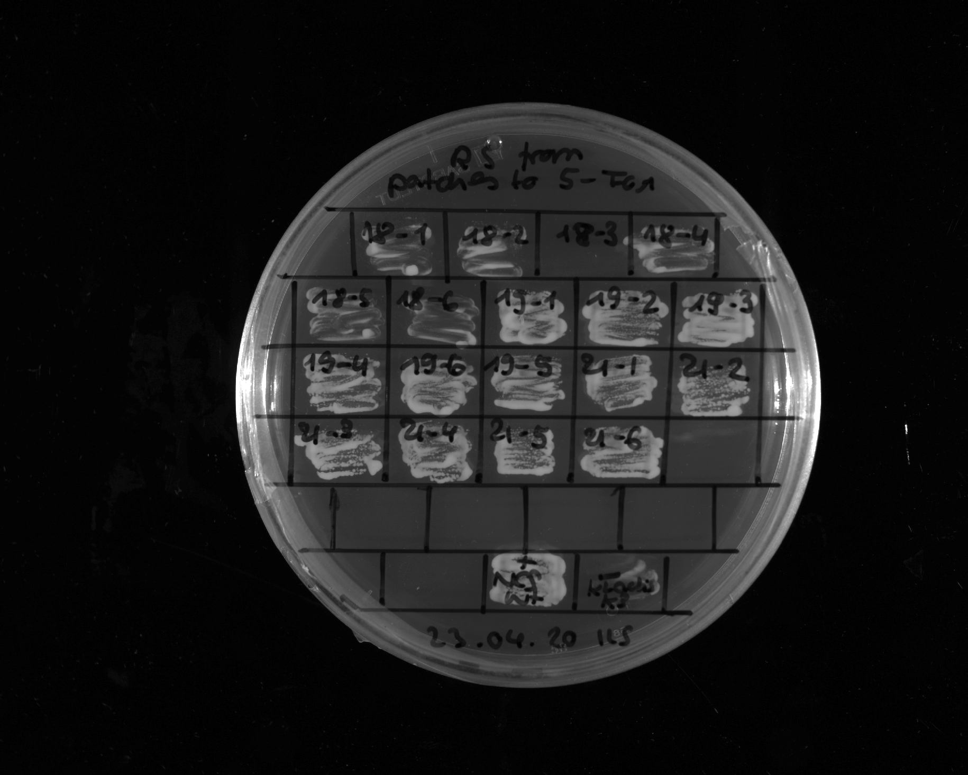
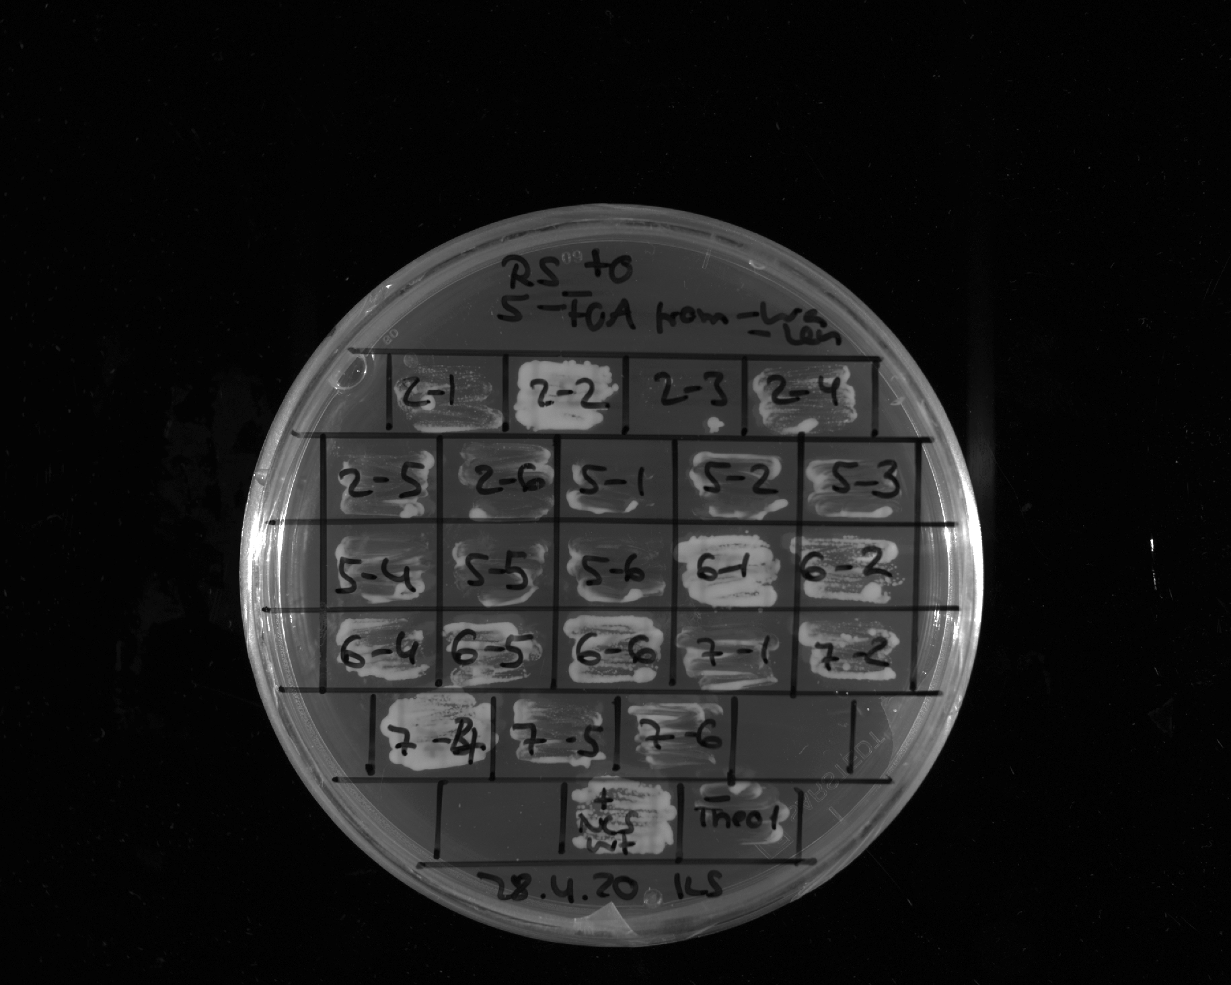
Sup35 1-131 + Gal4 G4 motif
1
Sup35 1-131 + Gal4 G4 motif
2
Sup35 1-131 + Gal4 G4 motif
3
Sup35 1-131 + Gal4 G4 motif
4
Sup35 1-131 + Gal4 G4 motif
6
Sup35 1-131 + Gal4 G4 motif
5
Tetrapisispora_phaffii
1
Tetrapisispora_phaffii
2
Tetrapisispora_phaffii
3
Tetrapisispora_phaffii
4
Tetrapisispora_phaffii
5
Tetrapisispora_phaffii
6
Restreak from YNB –ura –leu to 5-FOA –leu
Construct | Result regarding viability on 5-FOA | Number of (in)viable clones / total number of clones
Sup35¹⁻¹³¹ + Gal4^{G4} | viable | 6 out of 6
T. phaffii | viable | 6 out of 6
+ control
- control
C. glabrata
1
C. glabrata
2
C. glabrata
3
C. glabrata
4
C. glabrata
5
C. glabrata
6
FUS 1-163 12E + EM
1
FUS 1-163 12E + EM
2
FUS 1-163 12E + EM
4
FUS 1-163 12E + EM
5
FUS 1-163 12E + EM
6
FUS 1-163 12E + Abf1 G4 motif
1
FUS 1-163 12E + Abf1 G4 motif
2
Restreak from YNB –ura –leu to 5-FOA –leu
FUS 1-163 12E + Abf1 G4 motif
4
FUS 1-163 12E + Abf1 G4 motif
5
FUS 1-163 12E + Abf1 G4 motif
6
Construct | Result regarding viability on 5-FOA | Number of (in)viable clones / total number of clones
C. glabrata | inviable | 6 out of 6
FUS¹⁻¹⁶³12E + EM | viable | 5 out of 5 (in total 6 out of 6, see also slides 11, 22, 23)
FUS¹⁻¹⁶³12E + Abf1^{G4} | viable | 2 out of 5 (in total 2 out of 2, technical replicate, see also slide 11)
+ control
- control

Slide 11
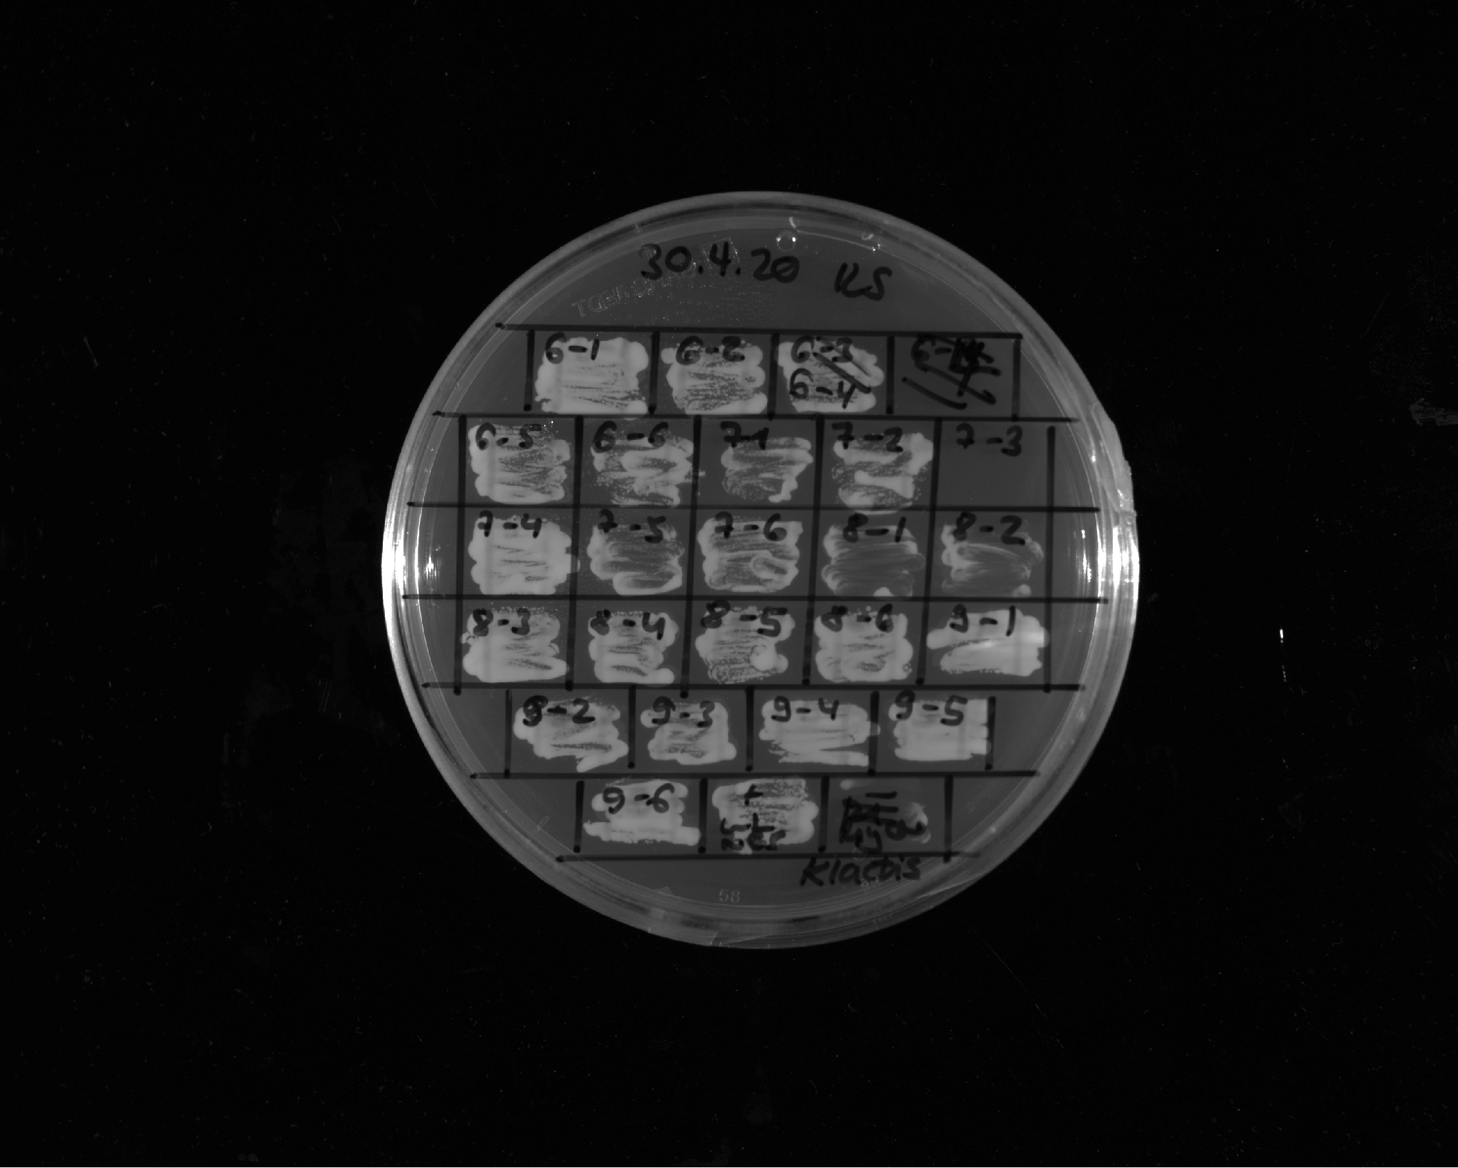
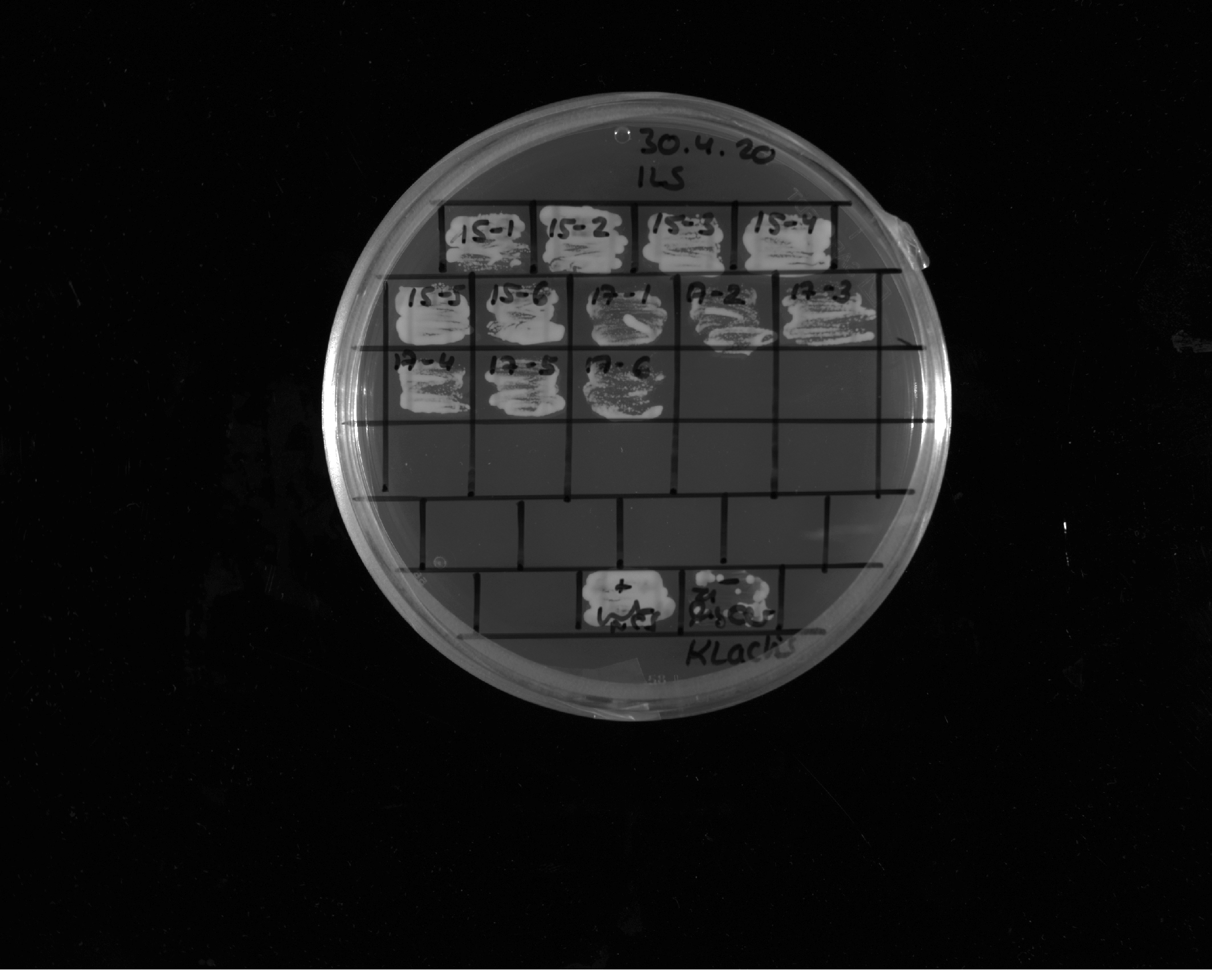
FUS 1-163 12E + EM
1
FUS 1-163 12E + EM
2
FUS 1-163 12E + EM
4
FUS 1-163 12E + EM
5
FUS 1-163 12E + EM
6
FUS 1-163 12E + Abf1 G4 motif
1
FUS 1-163 12E + Abf1 G4 motif
2
FUS 1-163 12E + Abf1 G4 motif
4
FUS 1-163 12E + Abf1 G4 motif
5
FUS 1-163 12E + Abf1 G4 motif
6
FUS¹⁻¹⁶³12E + Gal4^{G4} context DE/D
1
FUS¹⁻¹⁶³12E + Gal4^{G4} context ΔE/D
2
FUS¹⁻¹⁶³12E + Gal4^{G4} context ΔE/D
3
FUS¹⁻¹⁶³12E + Gal4^{G4} context ΔE/D
4
FUS¹⁻¹⁶³12E + Gal4^{G4} context ΔE/D
5
Restreak from YNB –ura –leu to 5-FOA –leu
FUS¹⁻¹⁶³12E + Gal4^{G4} context ΔE/D
6
+ control
- control
Construct | Construct | Number of (in)viable clones / total number of clones
FUS¹⁻¹⁶³12E + EM | viable | 5 out of 5 (in total 6 out of 6, see also slides 10, 22 and 23)
FUS¹⁻¹⁶³12E + Abf1^{G4} | viable | 5 out of 5 (in total 2out of 2, technical replicate, see also slide 10)
FUS¹⁻¹⁶³12E + Gal4^{G4} context ΔE/D | viable | 6 out of 6
Altered valence
1
Altered valence
2
Altered valence
3
Altered valence
4
Altered valence
5
Altered valence
6
Restreak from YNB –ura –leu to 5-FOA –leu
Construct | Result regarding viability on 5-FOA | Number of (in)viable clones / total number of clones
Altered valence 1 | viable | 6 out of 6
+ control
- control

Slide 12
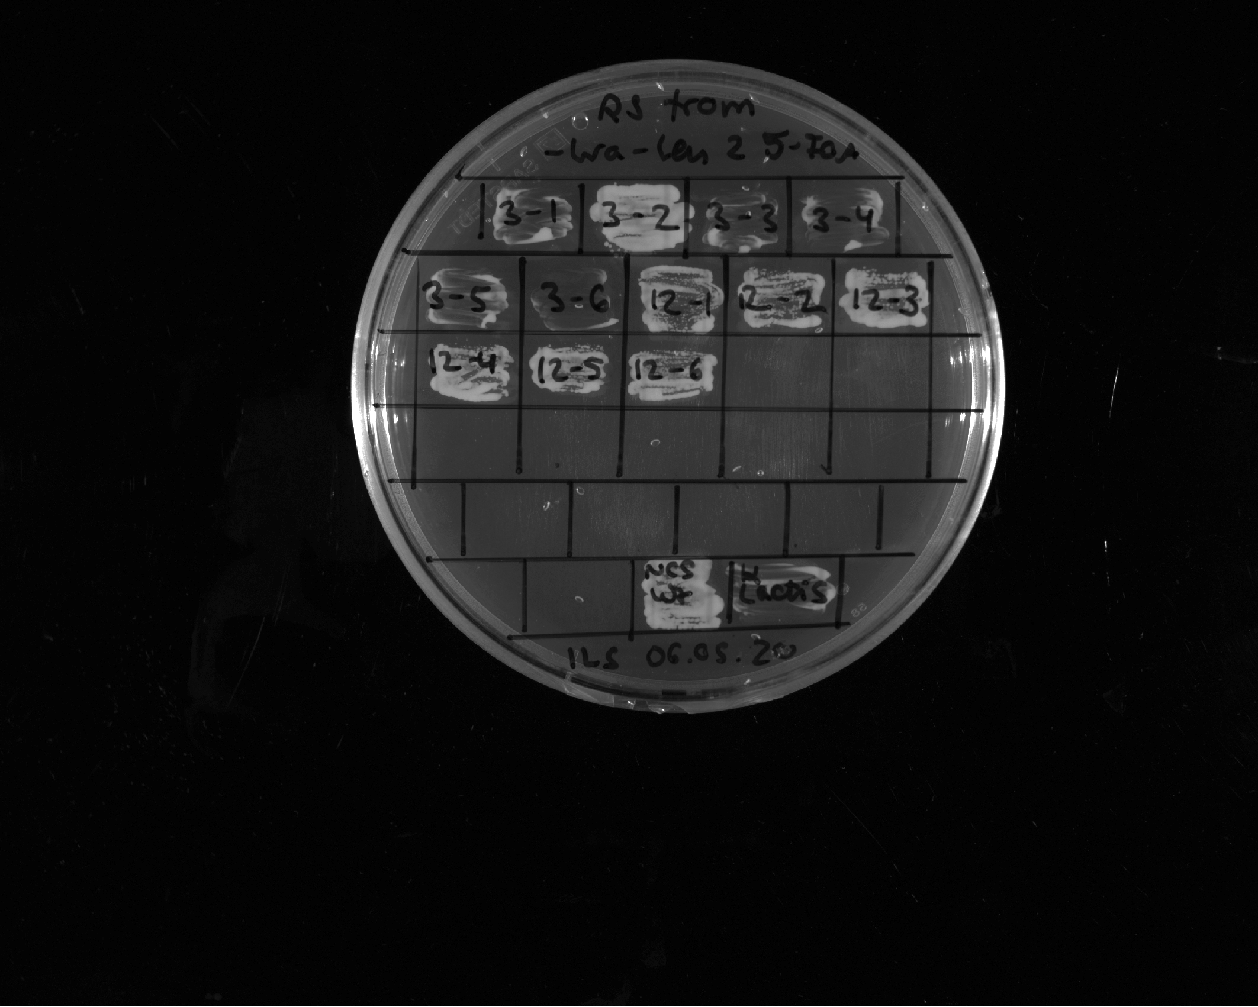
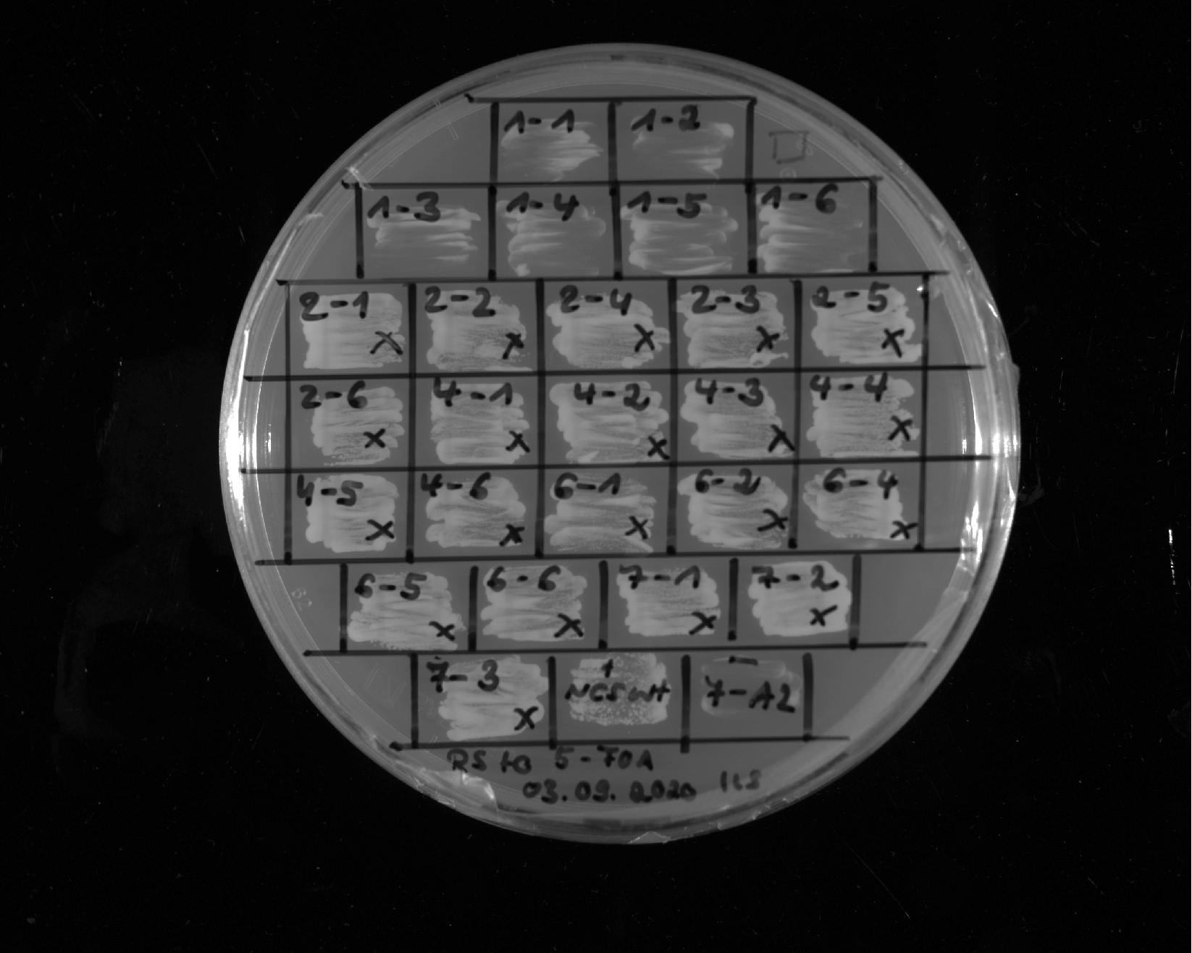
Abf1 IDR1 87-311 + Gal4 G4 motif
1
Abf1 IDR1 87-311 + Gal4 G4 motif
2
Abf1 IDR1 87-311 + Gal4 G4 motif
3
Abf1 IDR1 87-311 + Gal4 G4 motif
4
Abf1 IDR1 87-311 + Gal4 G4 motif
5
Abf1 IDR1 87-311 + Gal4 G4 motif
4
Restreak from YNB –ura –leu to 5-FOA –leu
+ control
- control
Construct | Construct | Number of (in)viable clones / total number of clones
Abf1 IDR1⁸⁷⁻³¹¹ + Gal4^{G4} | viable | 6 out of 6
FUS 1-163 12E + Gal4 M2
1
FUS 1-163 12E + Gal4 M2
2
FUS 1-163 12E + Gal4 M2
3
FUS 1-163 12E + Gal4 M2
4
FUS 1-163 12E + Gal4 M2
5
FUS 1-163 12E + Gal4 M2
6
FUS 1-163 12E + GR
1
FUS 1-163 12E + GR
2
FUS 1-163 12E + GR
3
FUS 1-163 12E + GR
4
FUS 1-163 12E + GR
5
FUS 1-163 12E + GR
6
FUS 1-163 12E + VP16
1
FUS 1-163 12E + VP16
2
FUS 1-163 12E + VP16
4
Restreak from YNB –ura –leu to 5-FOA –leu
FUS 1-163 12E + VP16
5
FUS 1-163 12E + VP16
6
FUS 1-163 12E + GCN4
1
FUS 1-163 12E + GCN4
2
Construct | Result regarding viability on 5-FOA | Number of (in)viable clones / total number of clones
FUS¹⁻¹⁶³12E+ Gal4^{M2} | viable | 6 out of 6
FUS¹⁻¹⁶³12E+ GR | viable | 6 out of 6
FUS¹⁻¹⁶³12E+ VP16 | viable | 5 out of 5
FUS¹⁻¹⁶³12E+ Gcn4 | viable | 3 out of 3 (in total 6 out of 6, see also slide 13)
FUS 1-163 12E + GCN4
3
+ control
- control

Slide 13
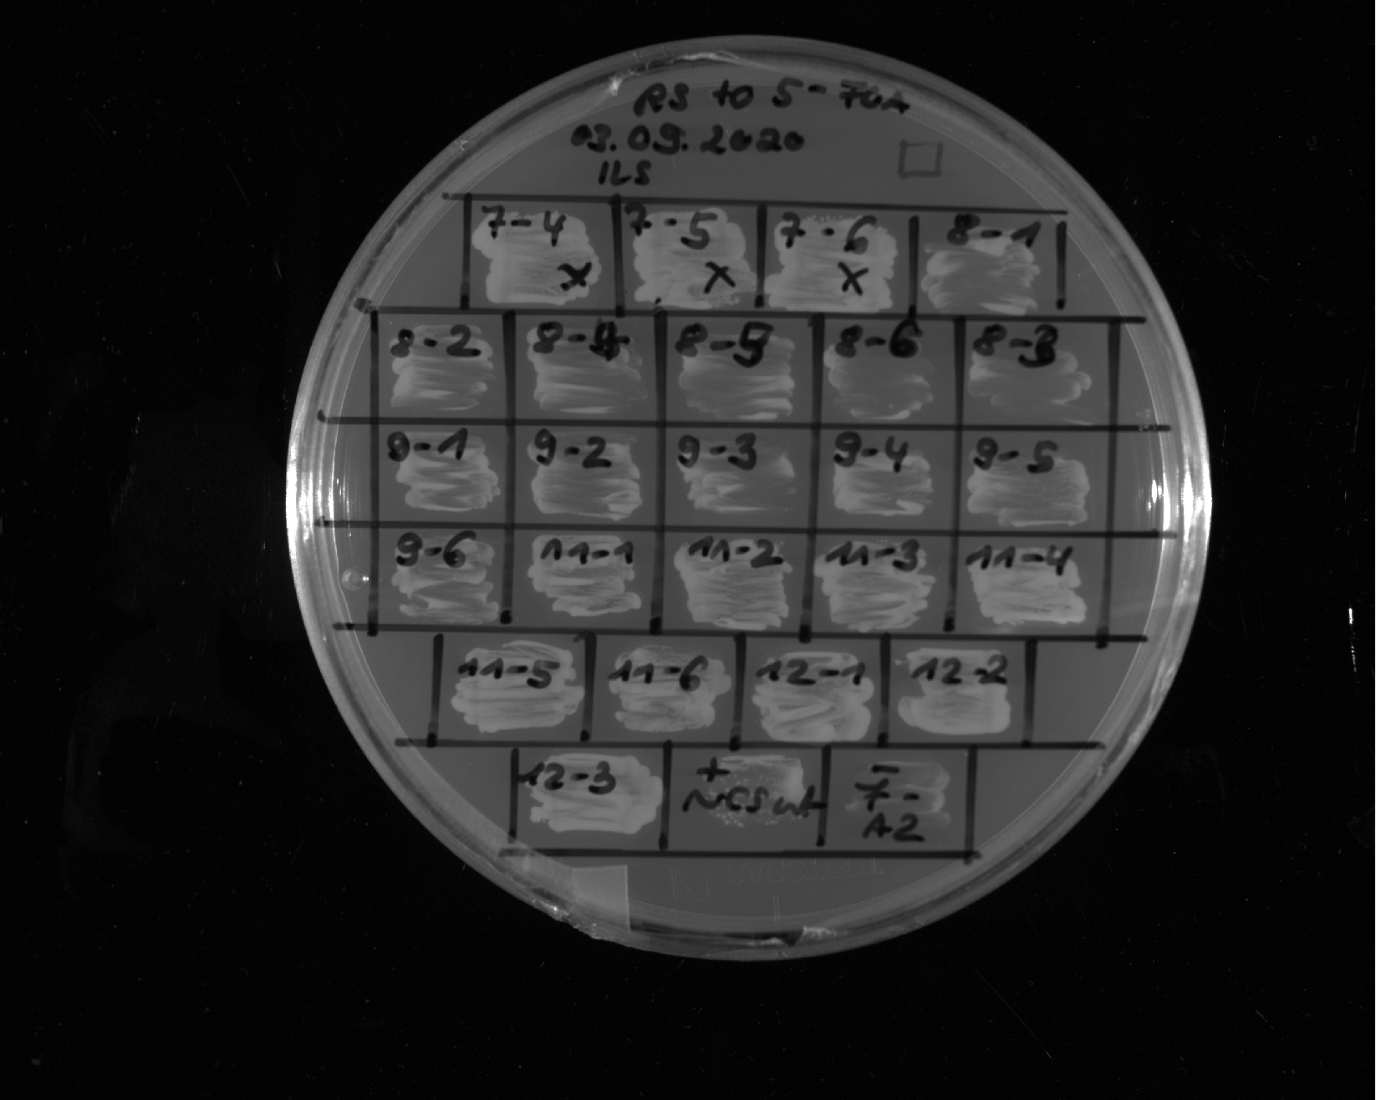
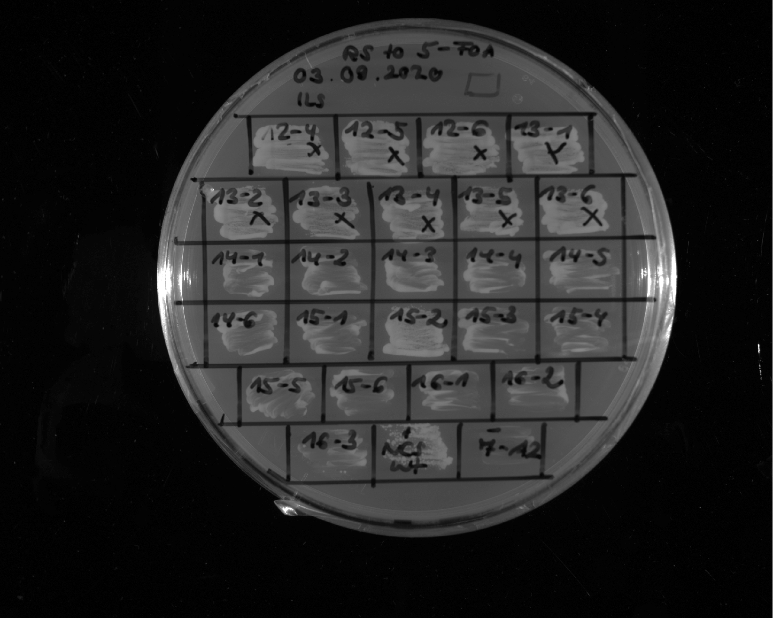
FUS 1-163 12E + GCN4
4
FUS 1-163 12E + GCN4
5
FUS 1-163 12E + GCN4
6
FUS 1-163 12E + Gal4 G4 motif (Y->L)
1
FUS 1-163 12E + Gal4 G4
motif (Y->L)
2
FUS 1-163 12E + Gal4 G4
motif (Y->L)
4
FUS 1-163 12E + Gal4 G4
motif (Y->L)
5
FUS 1-163 12E + Gal4 G4
motif (Y->L)
6
FUS 1-163 12E + Gal4 G4
motif (Y->L)
3
FUS 1-163 12E + Gal4 G4 motif distr.
1
FUS 1-163 12E + Gal4 G4 motif distr.
2
FUS 1-163 12E + Gal4 G4 motif distr.
3
FUS 1-163 12E + Gal4 G4 motif distr.
4
Restreak from YNB –ura –leu to 5-FOA –leu
FUS 1-163 12E + Gal4 G4 motif distr.
5
FUS 1-163 12E + Gal4 G4 motif distr.
6
Construct | Result regarding viability on 5-FOA | Number of (in)viable clones / total number of clones
FUS¹⁻¹⁶³12E + Gcn4 | viable | 3 out of 3 (in total 6 out of 6, see also slide 12)
FUS¹⁻¹⁶³12E + Gal4^{G4} Y→L in context | inviable | 6 out of 6
FUS¹⁻¹⁶³12E + Gal4^{G4} distr. | viable | 6 out of 6
+ control
- control
FUS_gal4_
motif_HYDRO_distributed
1
FUS_gal4_
motif_HYDRO_distributed
2
FUS_gal4_
motif_HYDRO_distributed
3
FUS_gal4_
motif_HYDRO_distributed
4
FUS_gal4_
motif_HYDRO_distributed
5
FUS_gal4_
motif_HYDRO_distributed
6
Sup35 1-131 + Gal4 G4 motif - all acidic residues
1
Sup35 1-131 + Gal4 G4 motif - all acidic residues
2
Sup35 1-131 + Gal4 G4 motif - all acidic residues
3
Sup35 1-131 + Gal4 G4 motif - all acidic residues
4
Restreak from YNB –ura –leu to 5-FOA –leu
Sup35 1-131 + Gal4 G4 motif - all acidic residues
5
Sup35 1-131 + Gal4 G4 motif - all acidic residues
6
Construct | Result regarding viability on 5-FOA | Number of (in)viable clones / total number of clones
FUS¹⁻¹⁶³12E + Gal4^{G4} motif hydro distr. | viable | 6 out of 6
Sup35¹⁻¹³¹ + Gal4^{G4} - all acidic residues | inviable | 5 out of 6
+ control
- control

Slide 14
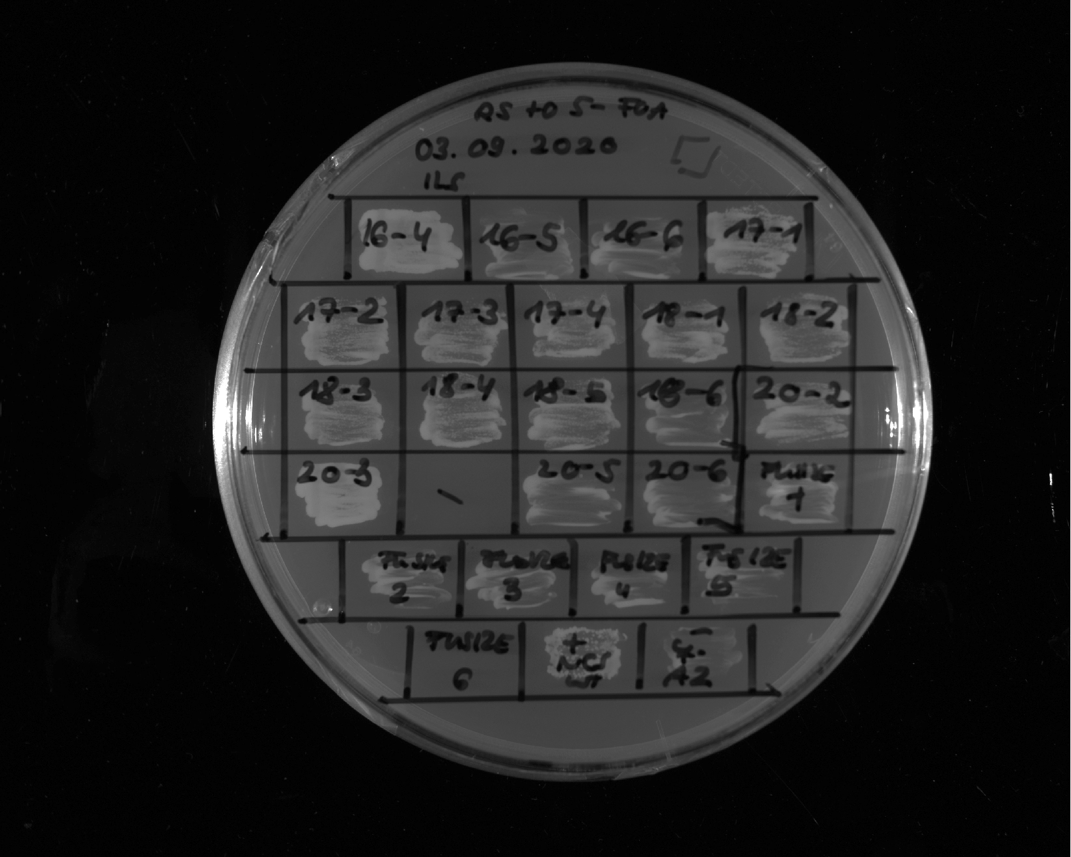
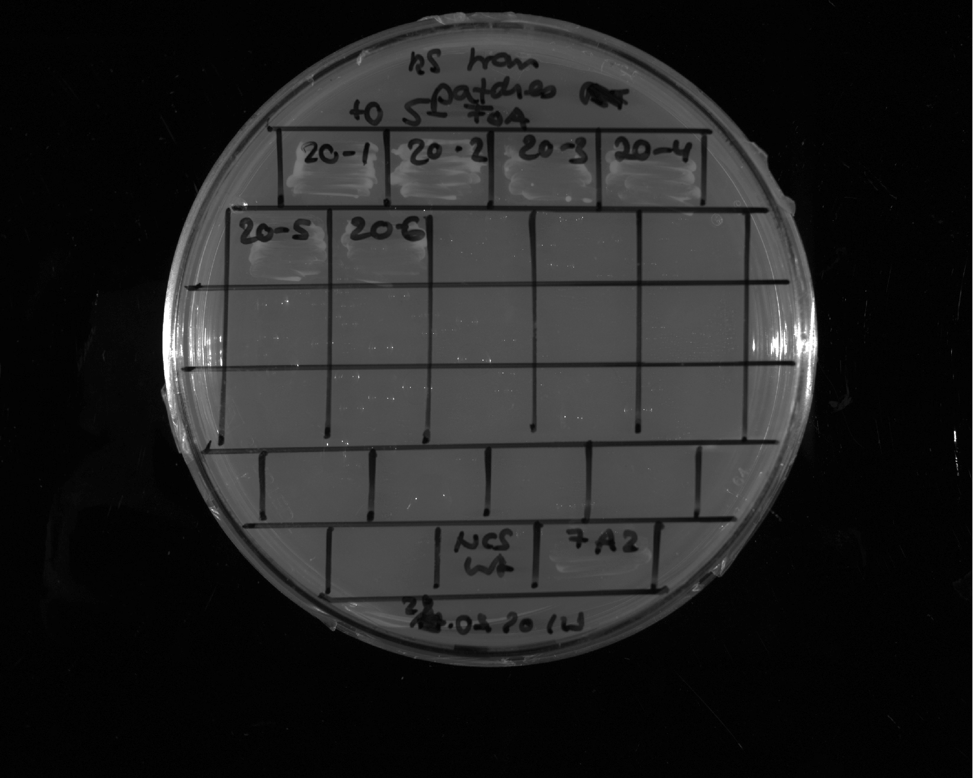
Ssn6 68-204 + Gal4 G4 motif
2
Ssn6 68-204 + Gal4 G4 motif
3
Ssn6 68-204 + Gal4 G4 motif
5
Ssn6 68-204 + Gal4 G4 motif
6
FUS_1_163_12E
1
Restreak from YNB –ura –leu to 5-FOA –leu
FUS_1_163_12E
2
FUS_1_163_12E
3
FUS_1_163_12E
4
FUS_1_163_12E
5
Construct | Result regarding viability on 5-FOA | Number of (in)viable clones / total number of clones
Ssn6⁶⁸⁻²⁰⁴ + Gal4^{G4} | inviable | 2 out of 4 (in total 4 out of 6 see plate below)
FUS¹⁻¹⁶³12E | inviable | 5 out of 5 (in total 8 out of 9, see also slides 6 and 7)
+ control
- control
Ssn6 68-204 + Gal4 G4 motif
1
Ssn6 68-204 + Gal4 G4 motif
2
Ssn6 68-204 + Gal4 G4 motif
3
Ssn6 68-204 + Gal4 G4 motif
4
Ssn6 68-204 + Gal4 G4 motif
5
Ssn6 68-204 + Gal4 G4 motif
6
Restreak from YNB –ura –leu to 5-FOA –leu
Construct | Result regarding viability on 5-FOA | Number of (in)viable clones / total number of clones
Ssn6⁶⁸⁻²⁰⁴ + Gal4^{G4} | inviable | 6 out of 6 (in total 4 out of 6 see plate above)
- control

Slide 15
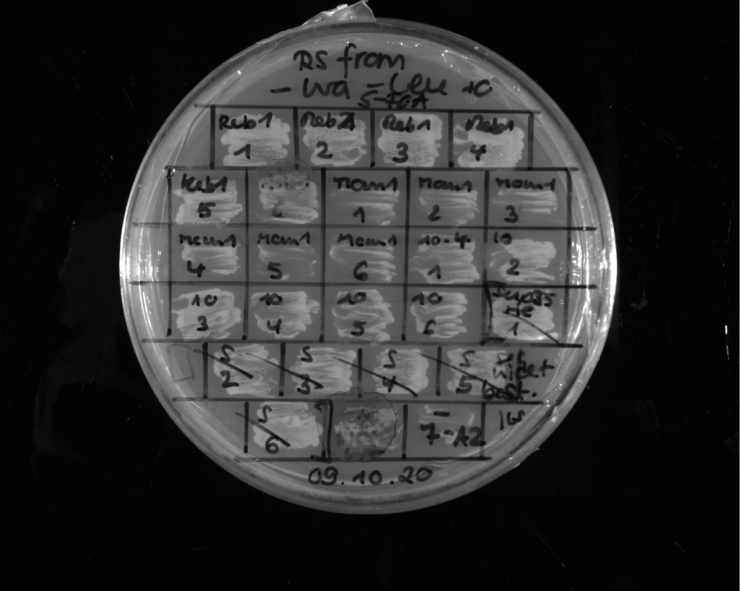
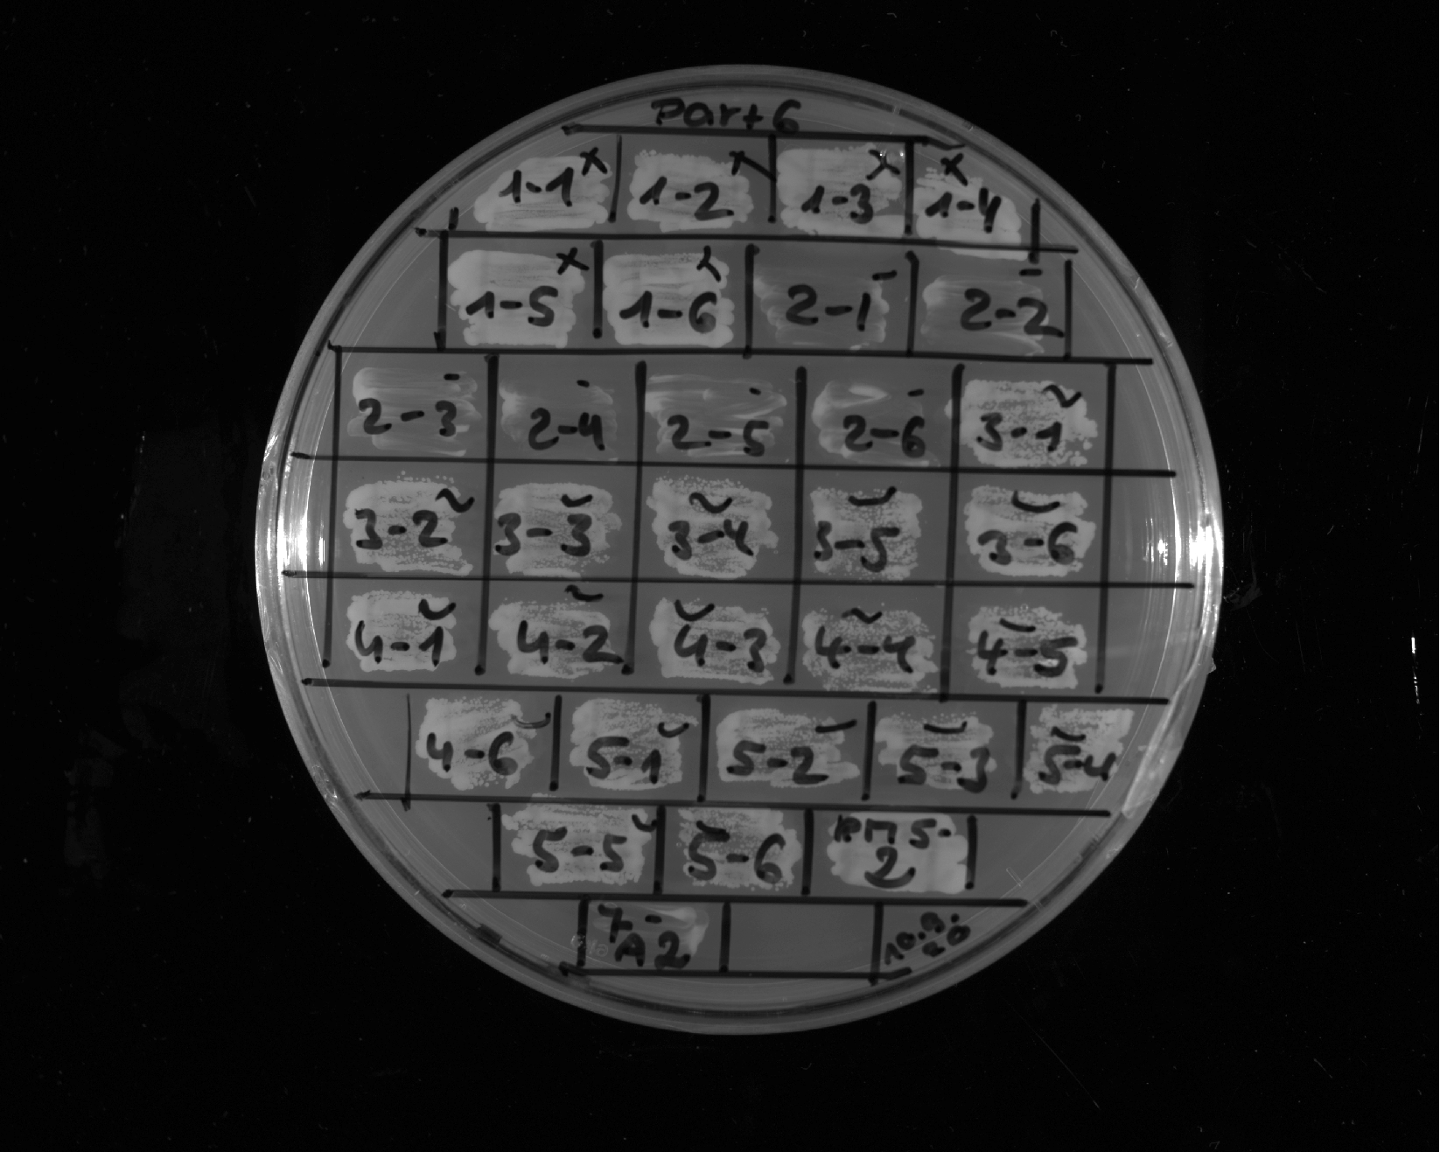
Reb1 1-120
1
Reb1 1-120
2
Reb1 1-120
3
Reb1 1-120
4
Reb1 1-120
5
Reb1 1-120
6
Mcm1 IDR 98-296
1
Mcm1 IDR 98-296
2
Mcm1 IDR 98-296
3
Mcm1 IDR 98-296
4
Mcm1 IDR 98-296
5
Mcm1 IDR 98-296
6
FUS 1-163 12E + Y/M
1
FUS 1-163 12E + Y/M
2
FUS 1-163 12E + Y/M
3
FUS 1-163 12E + Y/M
4
FUS 1-163 12E + Y/M
5
FUS 1-163 12E + Y/M
6
Restreak from YNB –ura –leu to 5-FOA –leu
Construct | Result regarding viability on 5-FOA | Number of (in)viable clones / total number of clones
Reb1^{1-120(+PKEEEEGGL)} | viable | 6 out of 6
Mcm1⁹⁸⁻²⁹⁶ | inviable | 6 out of 6
FUS¹⁻¹⁶³12E+ Y/M | viable | 6 out of 6
+ control
- control
FUS_1_163_12E_TDP43_helix
1
FUS_1_163_12E_TDP43_helix
2
FUS_1_163_12E_TDP43_helix
3
FUS_1_163_12E_TDP43_helix
4
FUS_1_163_12E_TDP43_helix
5
FUS_1_163_12E_TDP43_helix
6
FUS_1_163_12E_TDP43_helix_no_aro
1
FUS_1_163_12E_TDP43_helix_no_aro
2
FUS_1_163_12E_TDP43_helix_no_aro
3
FUS_1_163_12E_TDP43_helix_no_aro
4
FUS_1_163_12E_TDP43_helix_no_aro
5
FUS_1_163_12E_TDP43_helix_no_aro
6
Restreak from YNB –ura –leu to 5-FOA –leu
Construct | Result regarding viability on 5-FOA | Number of (in)viable clones / total number of clones
FUS¹⁻¹⁶³12E + TDP-43 | viable | 6 out of 6
FUS¹⁻¹⁶³12E + TDP-43 Y→S in context | inviable | 6 out of 6
+ control
- control

Slide 16
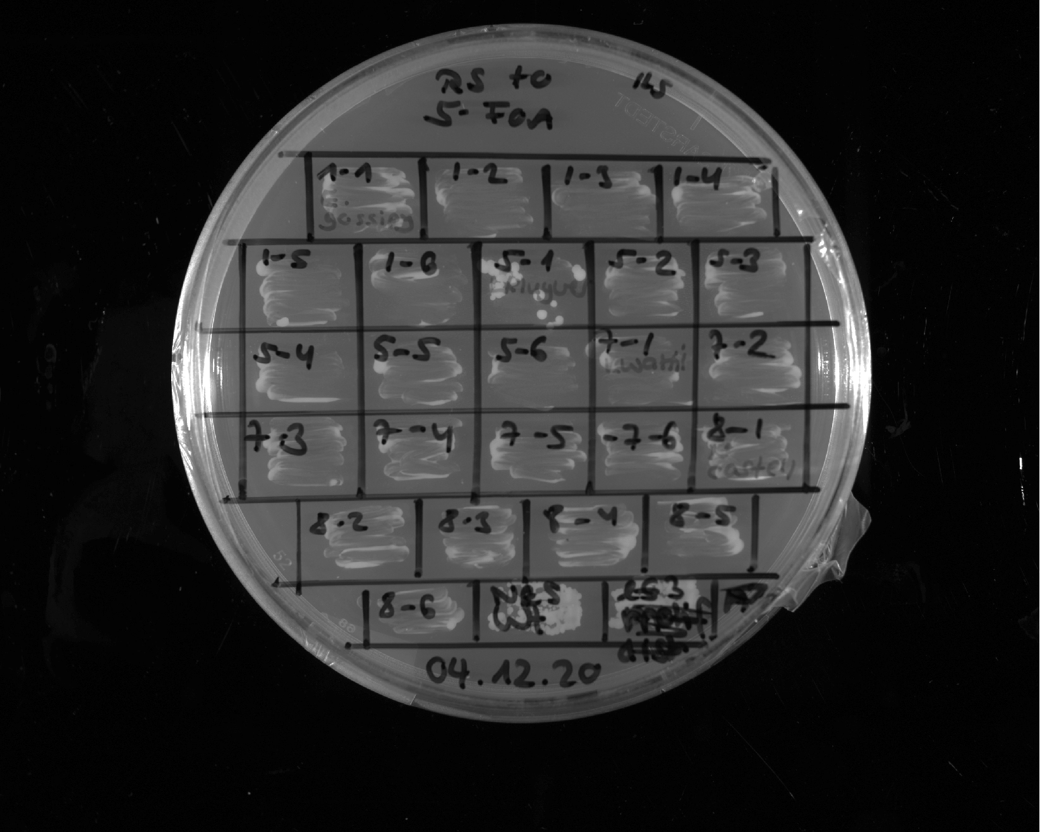
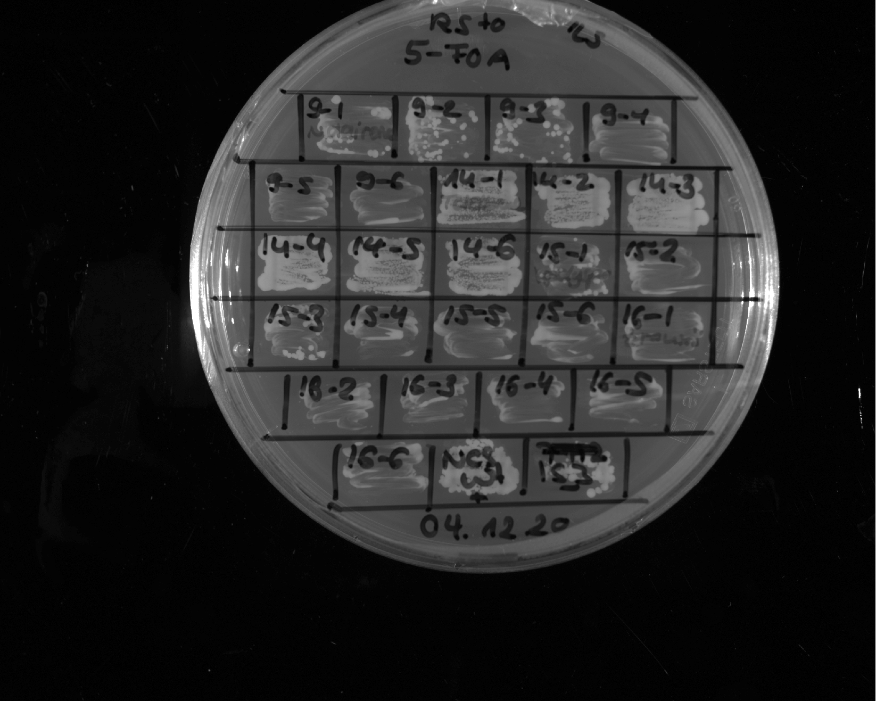
E. gossypi
1
E. gossypi
2
E. gossypi
3
E. gossypi
4
E. gossypi
5
E. gossypi
6
L. kluyveri
1
L. kluyveri
2
L. kluyveri
3
L. kluyveri
4
L. kluyveri
5
L. kluyveri
6
L. waltii
1
L. waltii
2
L. waltii
3
L. waltii
4
L. waltii
5
L. waltii
6
N. castelli
1
Restreak from YNB –ura –leu to 5-FOA –leu
N. castelli
2
N. castelli
3
N. castelli
4
N. castelli
5
Construct | Result regarding viability on 5-FOA | Number of (in)viable clones / total number of clones
E. gossypi | inviable | 6 out of 6
L. kluyveri | inviable | 6 out of 6
L. waltii | inviable | 6 out of 6
N. castelli | inviable | 6 out of 6
N. castelli
6
+ control
N. dairenensis
1
N. dairenensis
2
N. dairenensis
3
N. dairenensis
4
N. dairenensis
5
N. dairenensis
6
T. delbrueckii
1
T. delbrueckii
2
T. delbrueckii
3
T. delbrueckii
4
T. delbrueckii
5
T. delbrueckii
6
V.
polyspora
1
V.
polyspora
2
V.
polyspora
3
V.
polyspora
4
V.
polyspora
5
V.
polyspora
6
Z. rouxii
1
Restreak from YNB –ura –leu to 5-FOA –leu
Z. rouxii
2
Z. rouxii
3
Z. rouxii
4
Z. rouxii
5
Construct | Result regarding viability on 5-FOA | Number of (in)viable clones / total number of clones
N. dairenensis | inviable | 6 out of 6
T. delbrueckii | viable | 6 out of 6
V. polyspora | inviable | 6 out of 6 (in total 14 out of 14, see also slide 36)
Z. rouxii | inviable | 6 out of 6
Z. rouxii
6
+ control

Slide 17
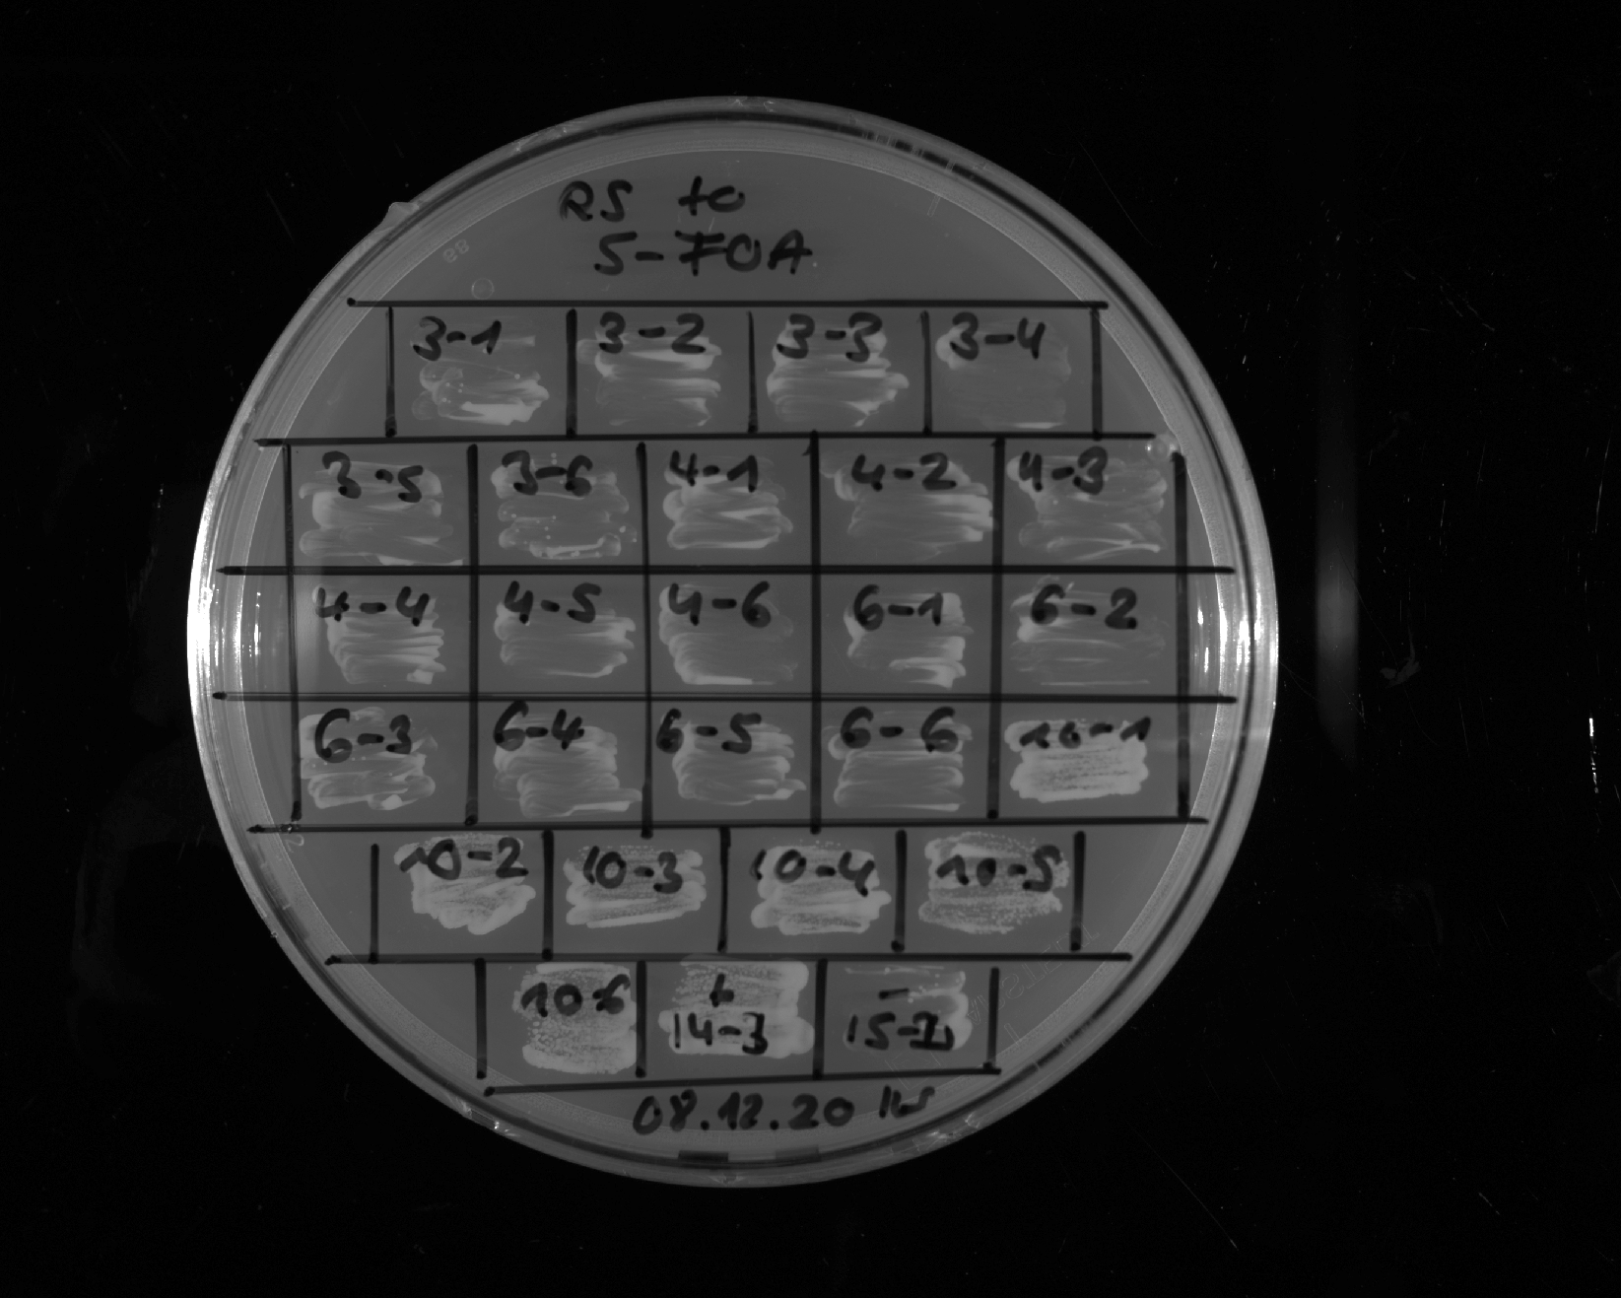
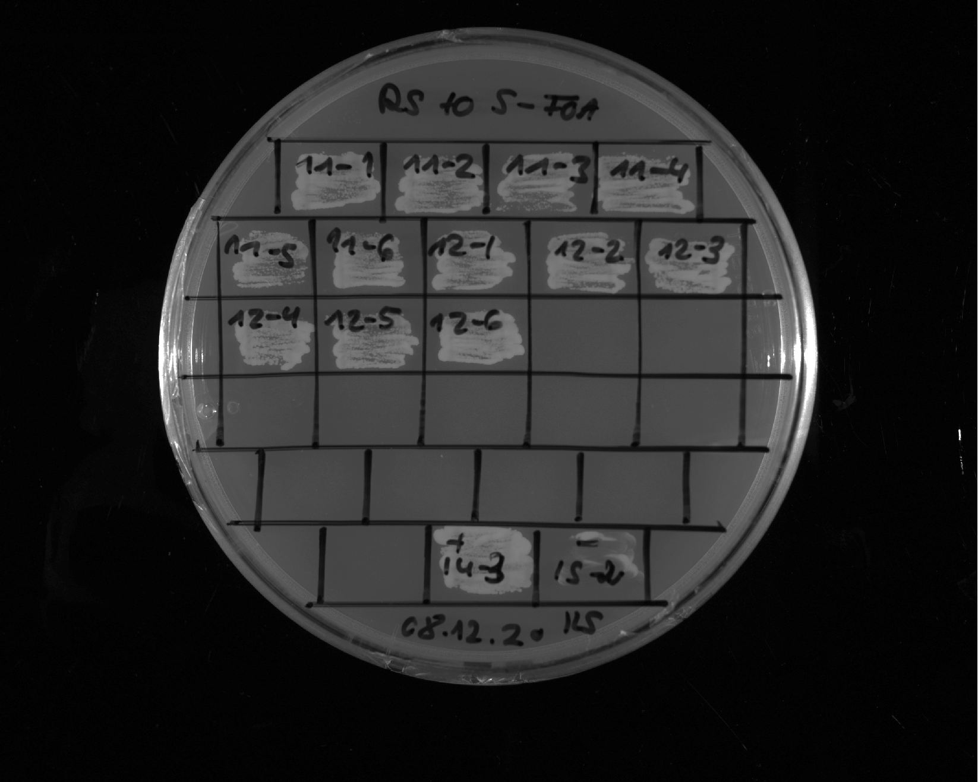
K. naganishii
1
K. naganishii
2
K. naganishii
3
K. naganishii
4
K. naganishii
5
K. naganishii
6
L. thermotolerans
1
L. thermotolerans
2
L. thermotolerans
3
L. thermotolerans
4
L. thermotolerans
5
L. thermotolerans
6
S. kudriavzevii
1
Restreak from YNB –ura –leu to 5-FOA –leu
S. kudriavzevii
2
S. kudriavzevii
3
S. kudriavzevii
4
S. kudriavzevii
5
Construct | Result regarding viability on 5-FOA | Number of (in)viable clones / total number of clones
K. naganishii | inviable | 6 out of 6
L. thermotolerans | inviable | 6 out of 6
S. kudriavzevii | viable | 6 out of 6
S. kudriavzevii
6
+ control
- control
S. mikatae
1
S. mikatae
2
S. mikatae
3
S. mikatae
4
S. mikatae
5
S. mikatae
6
S. uvarum
1
S. uvarum
2
S. uvarum
3
S. uvarum
4
S. uvarum
5
S. uvarum
6
Restreak from YNB –ura –leu to 5-FOA –leu
Construct | Result regarding viability on 5-FOA | Number of (in)viable clones / total number of clones
S. mikatae | viable | 6 out of 6
S. uvarum | viable | 6 out of 6
+ control
- control

Slide 18
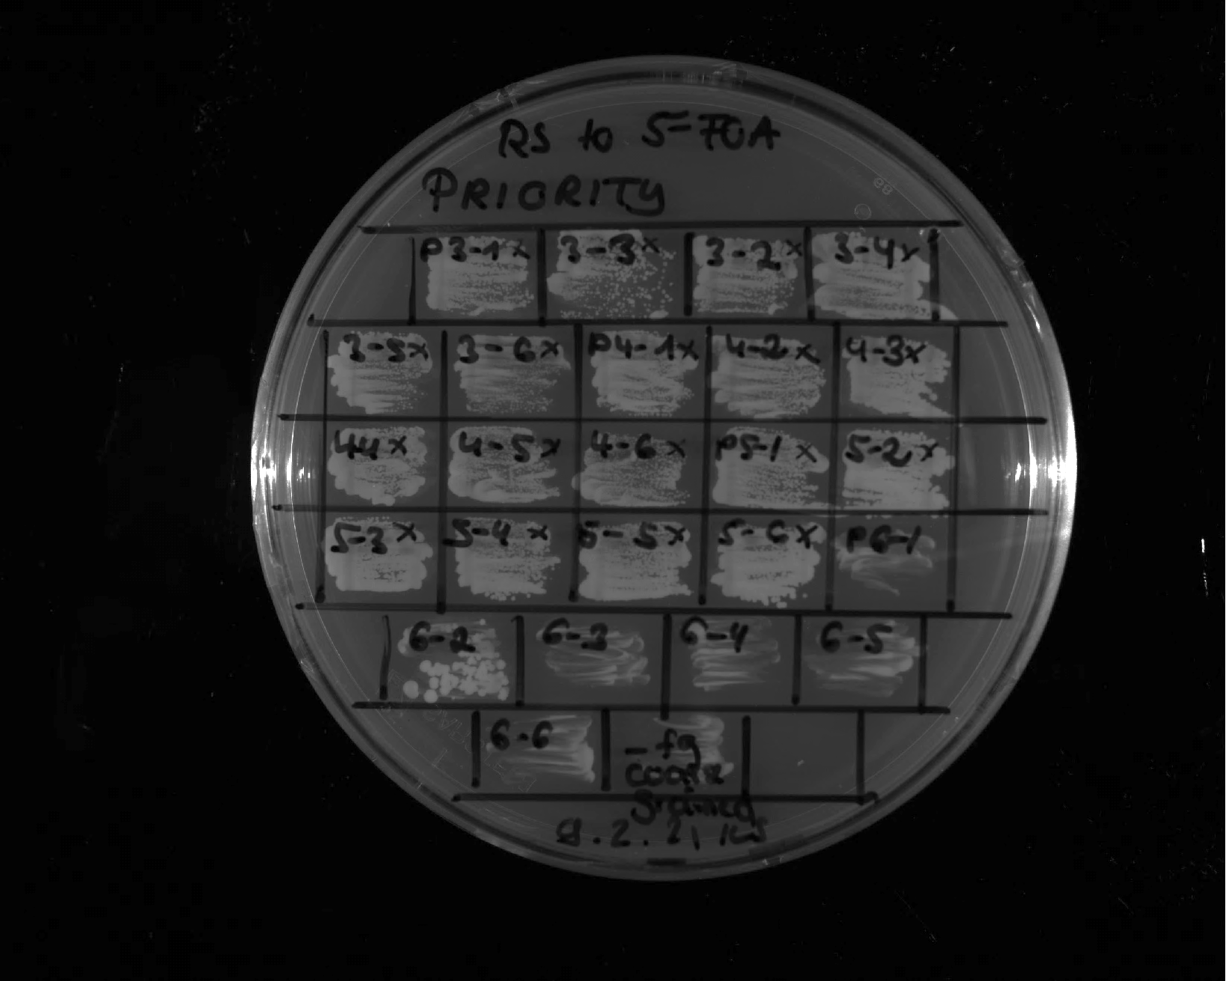
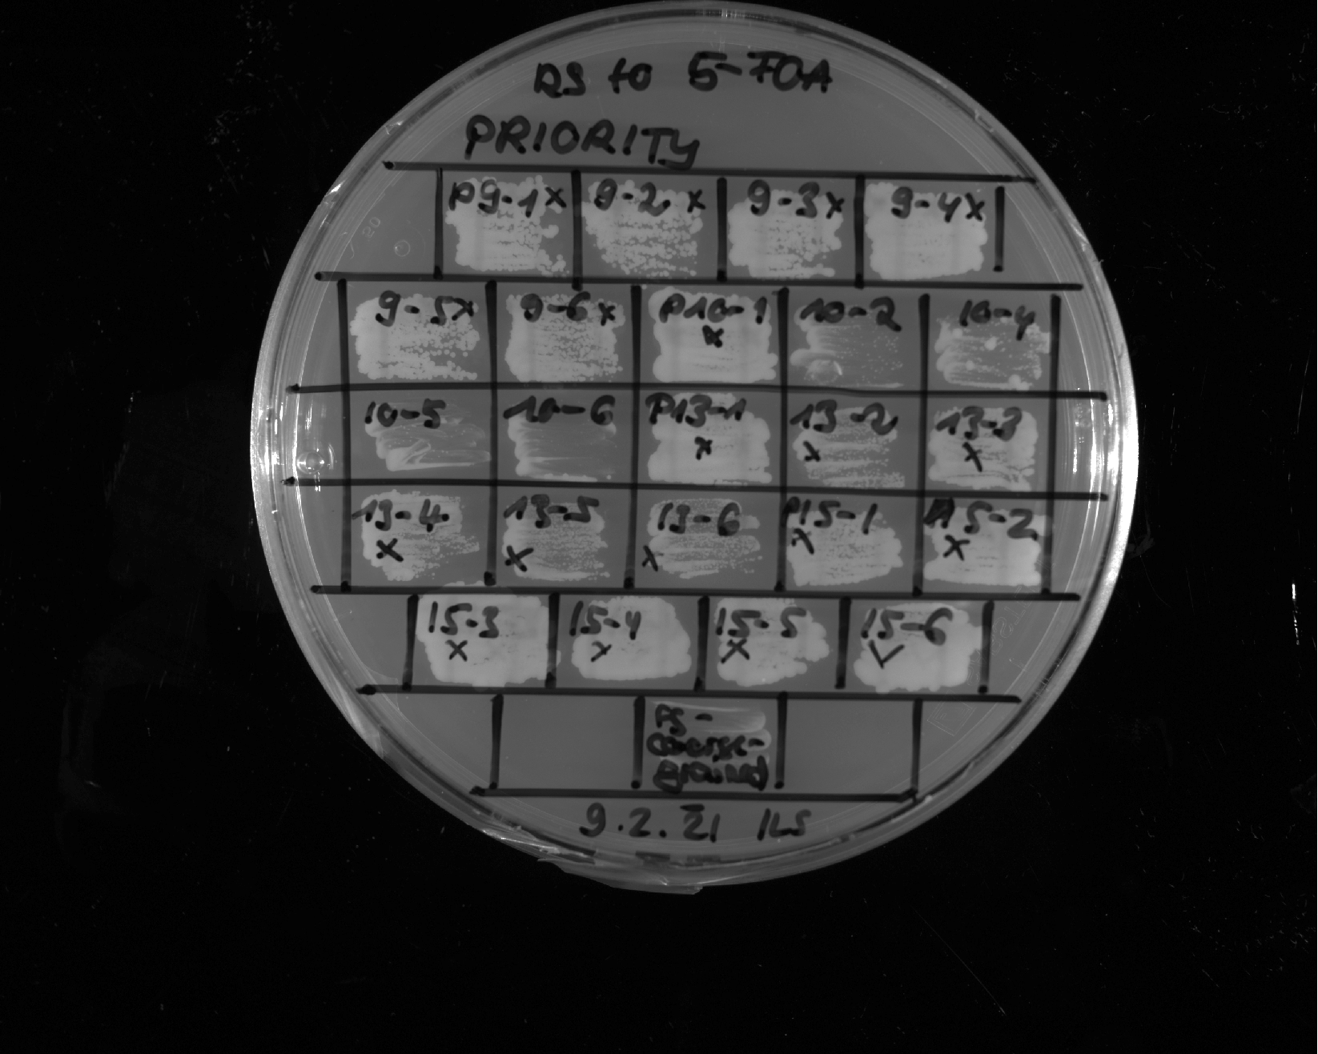
FUS 1-163 12E + Gal4 G4 + aromatic clusters
1
FUS 1-163 12E + Gal4 G4 + aromatic clusters
3
FUS 1-163 12E + Gal4 G4 + aromatic clusters
2
FUS 1-163 12E + Gal4 G4 + aromatic clusters
4
FUS 1-163 12E + Gal4 G4 + aromatic clusters
5
FUS 1-163 12E + Gal4 G4 + aromatic clusters
6
FUS 1-163 12E + GR distr.
1
FUS 1-163 12E + GR distr.
2
FUS 12E + GR distr.
3
FUS 1-163 12E + GR distr.
4
FUS 1-163 12E + GR distr.
5
FUS 1-163 12E + GR distr.
6
FUS 1-163 12E + p65 distr.
1
FUS 1-163 12E + p65 distr.
2
FUS 1-163 12E + p65 distr.
3
FUS 1-163 12E + p65 distr.
4
FUS 1-163 12E + p65 distr.
5
FUS 12E + p65 distr.
6
Synthethic 1_1
Restreak from YNB –ura –leu to 5-FOA –leu
Synthetic 1_2
Synthethic 1_3
Synthethic 1_4
Synthethic 1_5
Construct | Result regarding viability on 5-FOA | Number of (in)viable clones / total number of clones
FUS¹⁻¹⁶³12E + Gal4^{G4} aromatic clusters | viable | 6 out of 6 (technical replicate see slide 22)
FUS¹⁻¹⁶³12E + GR distr. | viable | 6 out of 6
FUS¹⁻¹⁶³12E + p65 distr. | viable | 6 out of 6
Synthetic 1 | inviable | 5 out of 6
Synthethic 1_6
- control
WT Abf1 IDR2 + EM (Hydro -> polar) 1
WT Abf1 IDR2 + EM (Hydro -> polar) 2
WT Abf1 IDR2 + EM (Hydro -> polar) 4
Sup35 + GR distr.
1
Sup35 + GR distr.
2
Sup35 + GR distr.
3
WT Abf1 IDR2 + EM (Hydro -> polar) 5
WT Abf1 IDR2 + EM (Hydro -> polar) 6
Sup35 + GR distr.
4
Sup35 + GR distr.
5
Sup35 + GR distr.
6
Sup35 + p65 distr.
1
Sup35 + p65 distr.
2
Restreak from YNB –ura –leu to 5-FOA –leu
Sup35 + p65 distr.
3
Sup35 + p65 distr.
4
Sup35 + p65 distr.
5
Sup35 + p65 distr.
6
Construct | Result regarding viability on 5-FOA | Number of (in)viable clones / total number of clones
IDR2 WT hydro→polar | inviable | 4 out of 5
Sup35¹⁻¹³¹ + GR distr. | viable | 6 out of 6
Sup35¹⁻¹³¹ + p65 distr. | viable | 6 out of 6
- control

Slide 19
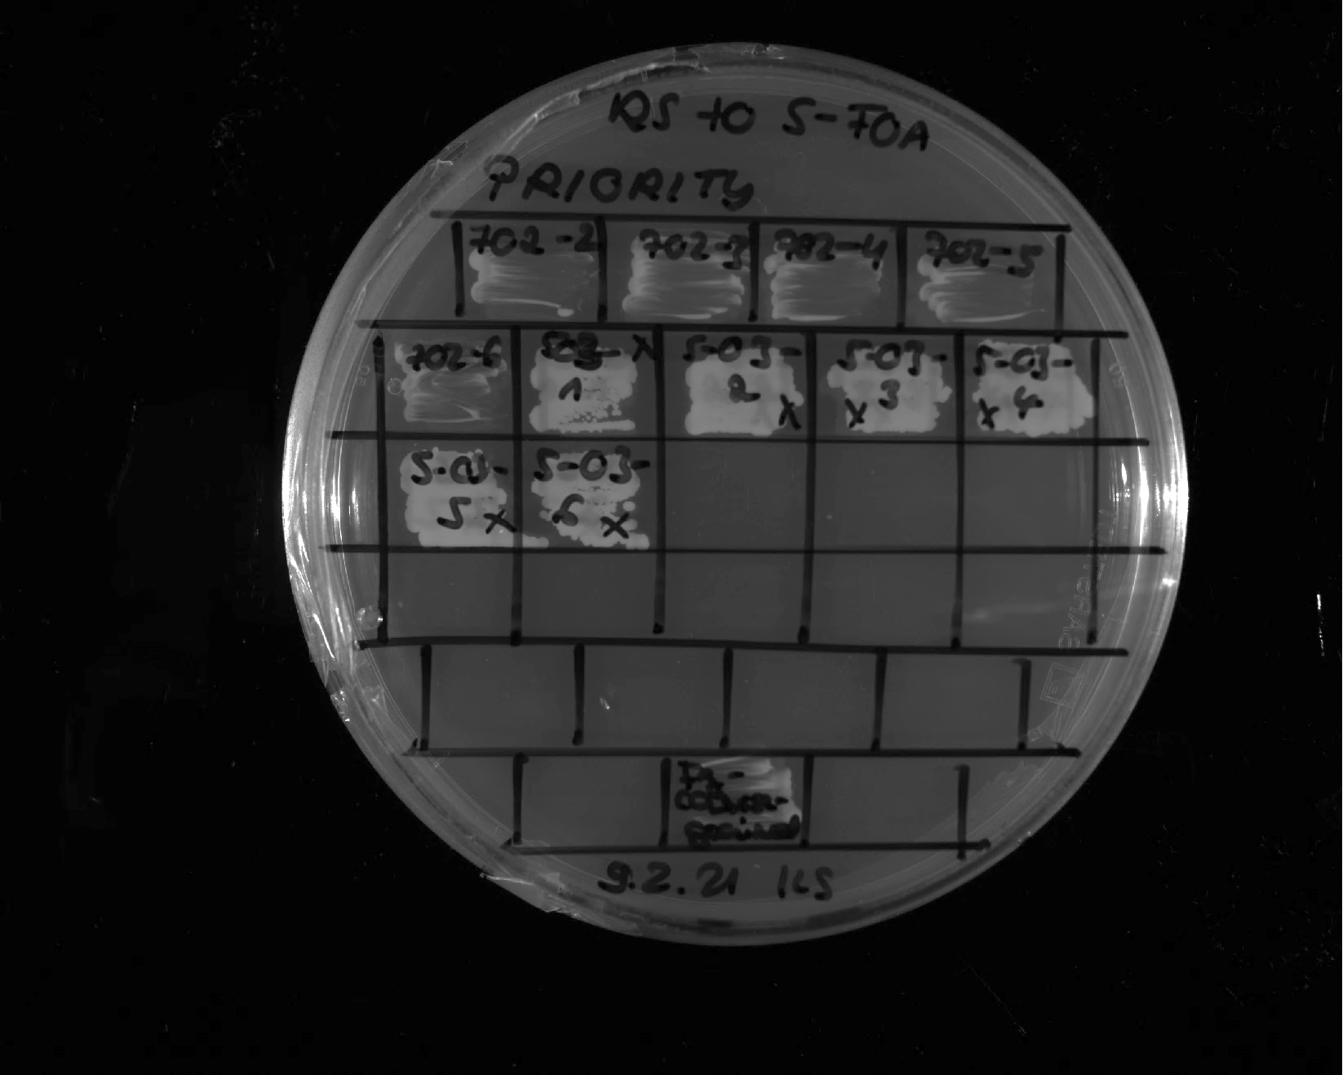
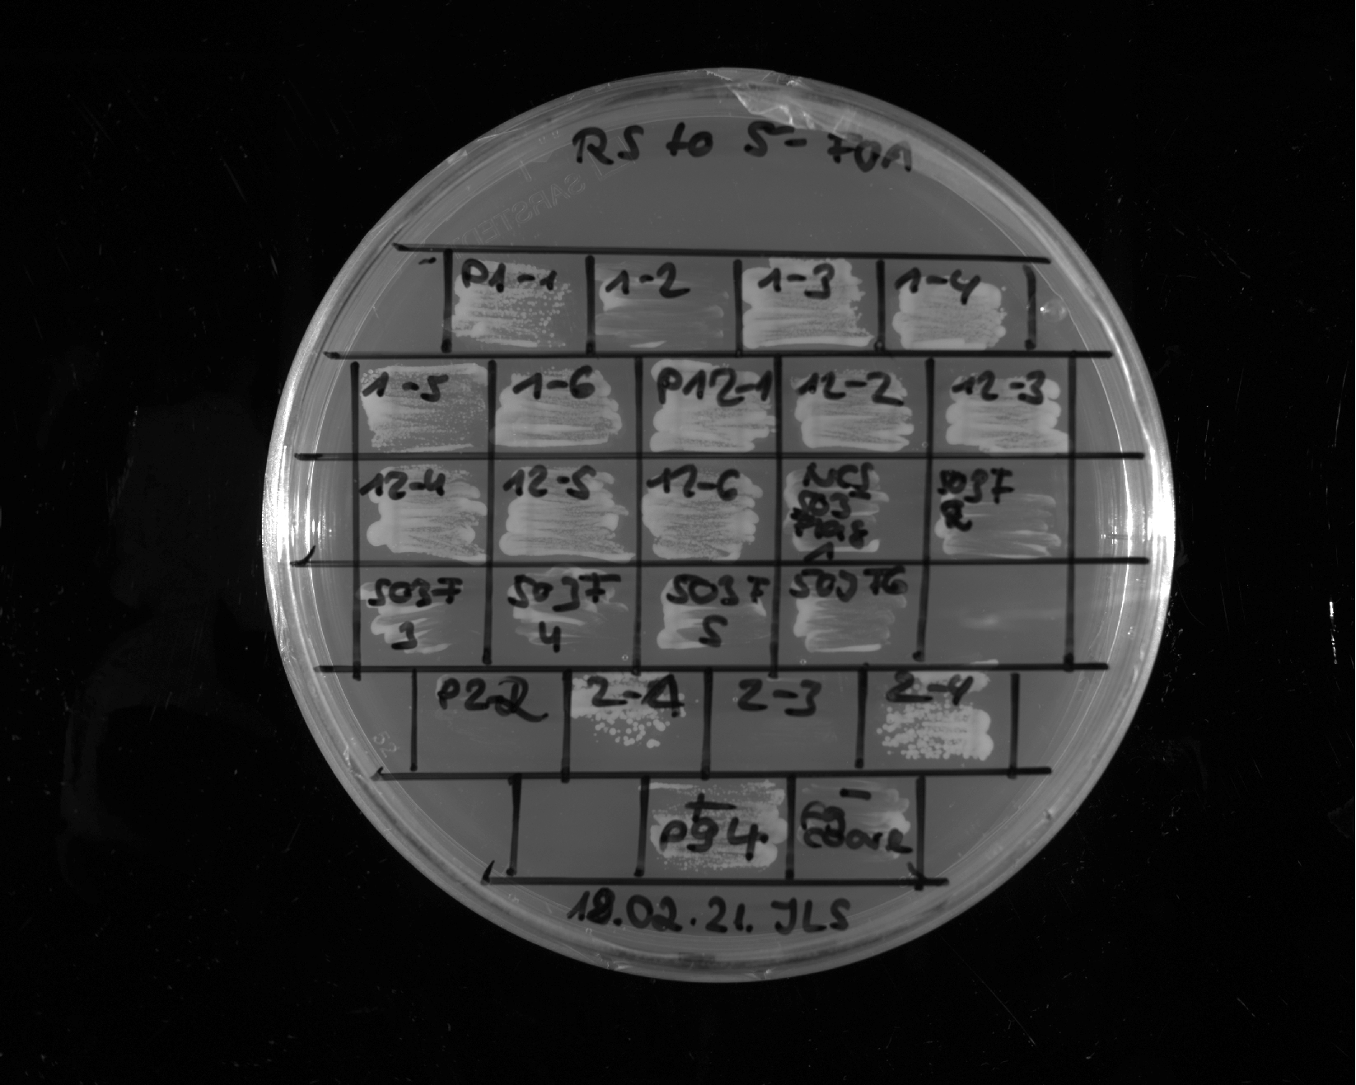
K. africana
2
K. africana
3
K. africana
4
K. africana
5
K. africana
6
FUS 1-163 12E + p65
1
FUS 1-163 12E + p65
2
FUS 1-163 12E + p65
3
FUS 1-163 12E + p65
4
FUS 1-163 12E + p65
5
FUS 1-163 12E + p65
6
Restreak from YNB –ura –leu to 5-FOA –leu
Construct | Result regarding viability on 5-FOA | Number of (in)viable clones / total number of clones
K. africana | inviable | 5 out of 5
FUS¹⁻¹⁶³12E + p65 | viable | 6 out of 6
- control
FUS_gal4_context_no_acidity
1
FUS_gal4_context_no_acidity
FUS_gal4_context_no_acidity
2
FUS_gal4_context_no_acidity
3
FUS_gal4_context_no_acidity
4
FUS_gal4_context_no_acidity
5
FUS_gal4_context_no_acidity
6
Sup35 + GR
1
Sup35 + GR
2
Sup35 + GR
3
Sup35 + GR
4
Sup35 + GR
5
Sup35 + GR
6
Restreak from YNB –ura –leu to 5-FOA –leu
Construct | Result regarding viability on 5-FOA | Number of (in)viable clones / total number of clones
FUS¹⁻¹⁶³12E + Gal4^{G4} context ΔE/D | viable | 5 out of 6
Sup35¹⁻¹³¹ + GR | viable | 6 out of 6
+ control
- control

Slide 20
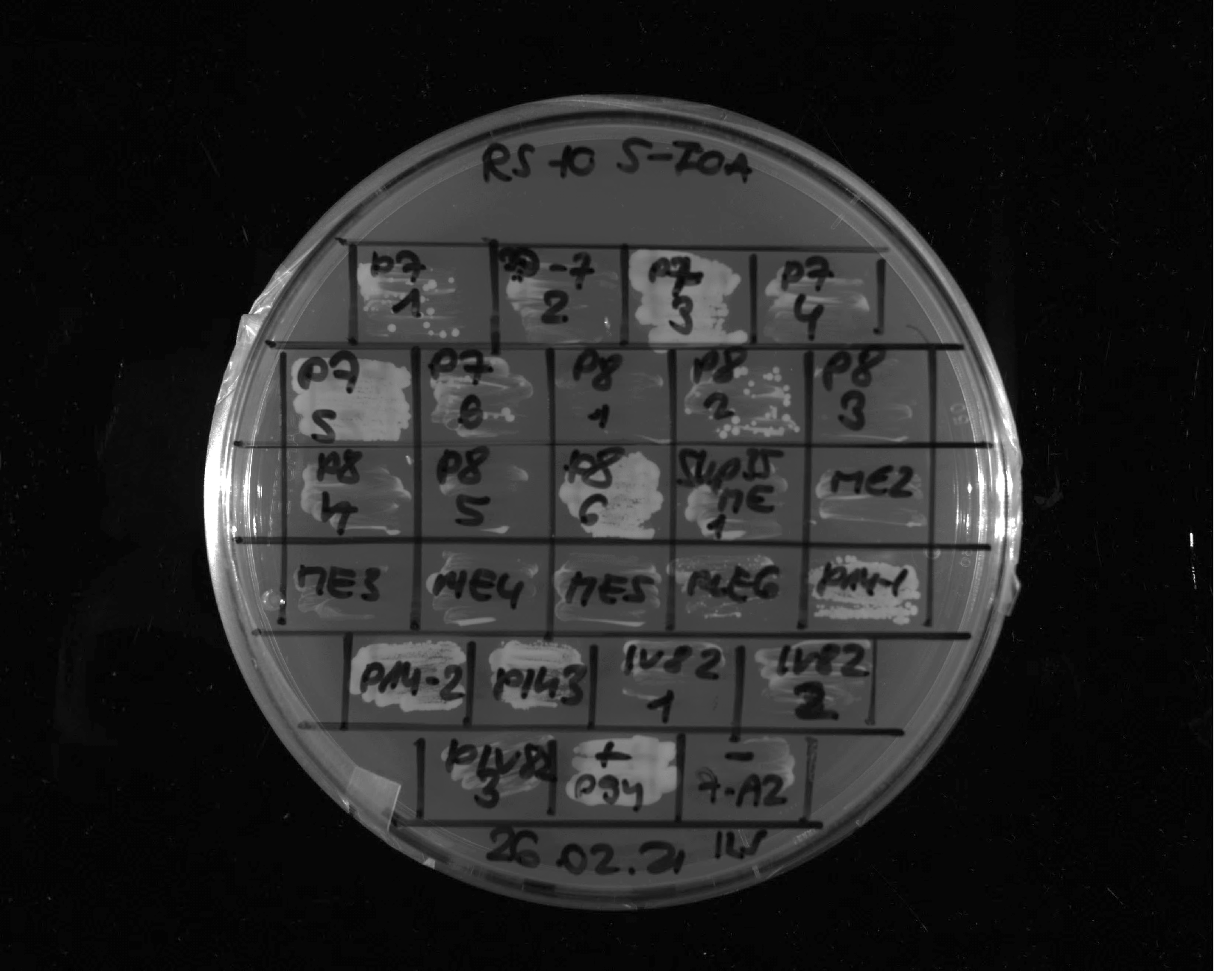
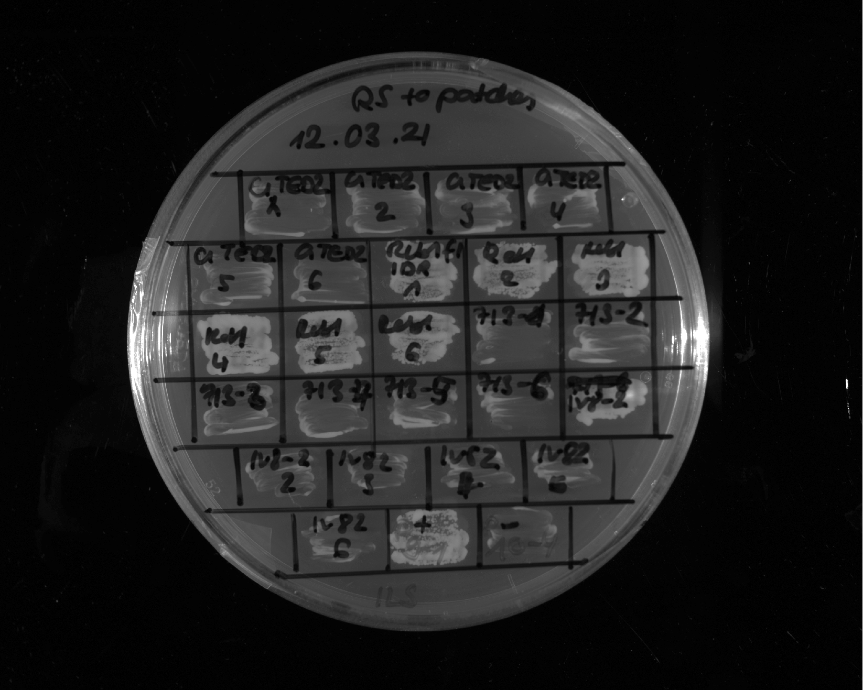
Synthethic 2_1
Synthethic 2_2
Synthetic 2_3
Synthethic 2_4
Synthetic 2_5
Synthethic 2_6
Sup35 1-131 + p65
1
Restreak from YNB –ura –leu to 5-FOA –leu
Sup35 1-131 + p65
2
Sup35 1-131 + p65
3
Construct | Result regarding viability on 5-FOA | Number of (in)viable clones / total number of clones
Synthetic 2 | inviable | 4 out of 6
Sup35¹⁻¹³¹ + p65 | viable | 3 out of 3
+ control
- control
Reb1_IDR_ 1_420
1
Reb1_IDR_ 1_420
2
Reb1_IDR_ 1_420
3
Reb1_IDR_ 1_420
4
Reb1_IDR_ 1_420
5
Reb1_IDR_ 1_420
6
T.blattae
1
T.blattae
2
T.blattae
3
T.blattae
4
T.blattae
5
T.blattae
6
Restreak from YNB –ura –leu to 5-FOA –leu
Construct | Result regarding viability on 5-FOA | Number of (in)viable clones / total number of clones
Reb1¹⁻⁴²⁰ | viable | 6 out of 6
T. blattae | inviable | 6 out of 6
+ control
- control

Slide 21
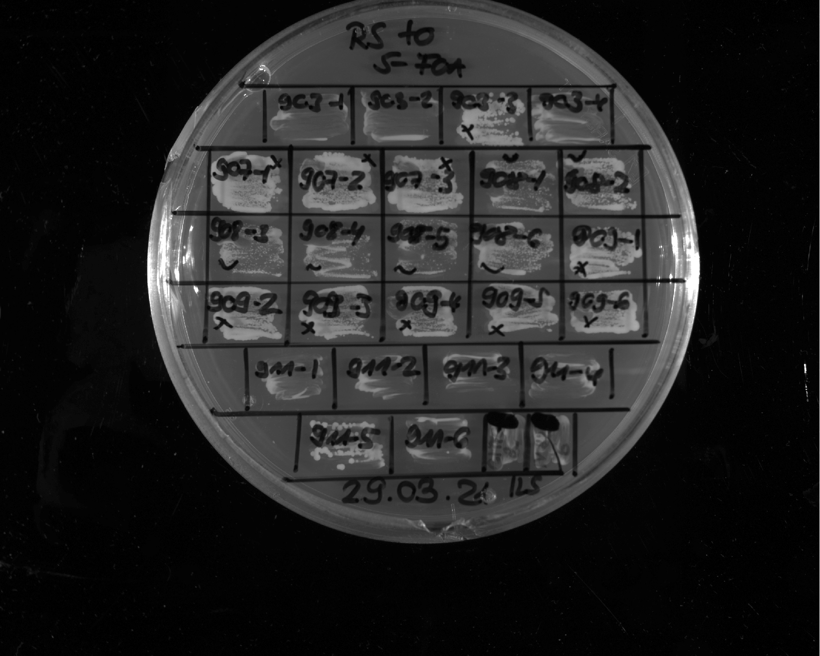
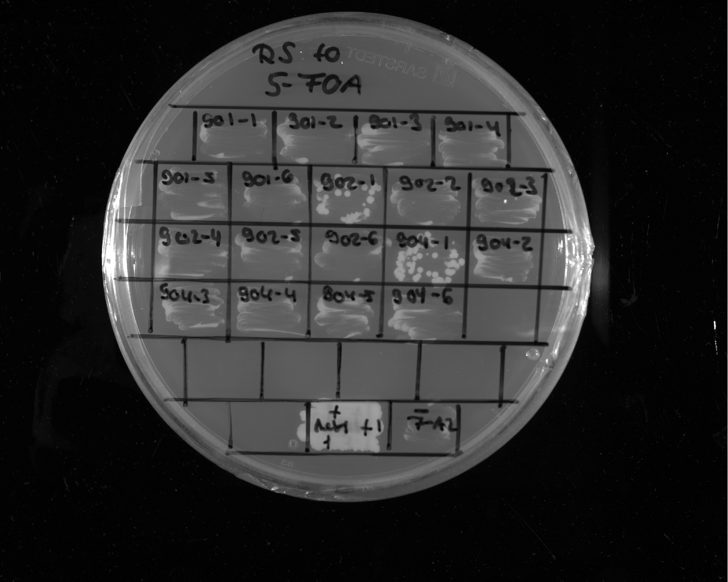
Rap1_IDR
1-120 & 230-361
3
Rap1_IDR
1-120 & 230-361
4
Restreak from YNB –ura –leu to 5-FOA –leu
Construct | Result regarding viability on 5-FOA | Number of (in)viable clones / total number of clones
Rap1^{1-120 & 230-361} | inviable | 1 out of 2 (in total 7 out of 8, see also slide 39)
- control
FUS 1-163 12E + distributed EM
1
FUS 1-163 12E + distributed EM
2
FUS 1-163 12E + distributed EM
3
FUS 1-163 12E + distributed EM
4
FUS 1-163 12E + distributed EM
5
FUS 1-163 12E + distributed EM
6
Rap1_IDR 1-120
1
Rap1_IDR 1-120
2
Rap1_IDR 1-120
3
Rap1_IDR 1-120
4
Rap1_IDR 1-120
5
Rap1_IDR 1-120
6
Sup35 + distributed EM
1
Sup35 + distributed EM
2
Sup35 + distributed EM
3
Sup35 + distributed EM
4
Sup35 + distributed EM
5
Sup35 + distributed EM
6
Restreak from YNB –ura –leu to 5-FOA –leu
Construct | Result regarding viability on 5-FOA | Number of (in)viable clones / total number of clones
FUS¹⁻¹⁶³12E + EM distr. | inviable | 6 out of 6
Rap1¹⁻¹²⁰ | inviable | 6 out of 6
Sup35¹⁻¹³¹ + EM distr. | inviable | 6 out of 6
+ control
- control

Slide 22
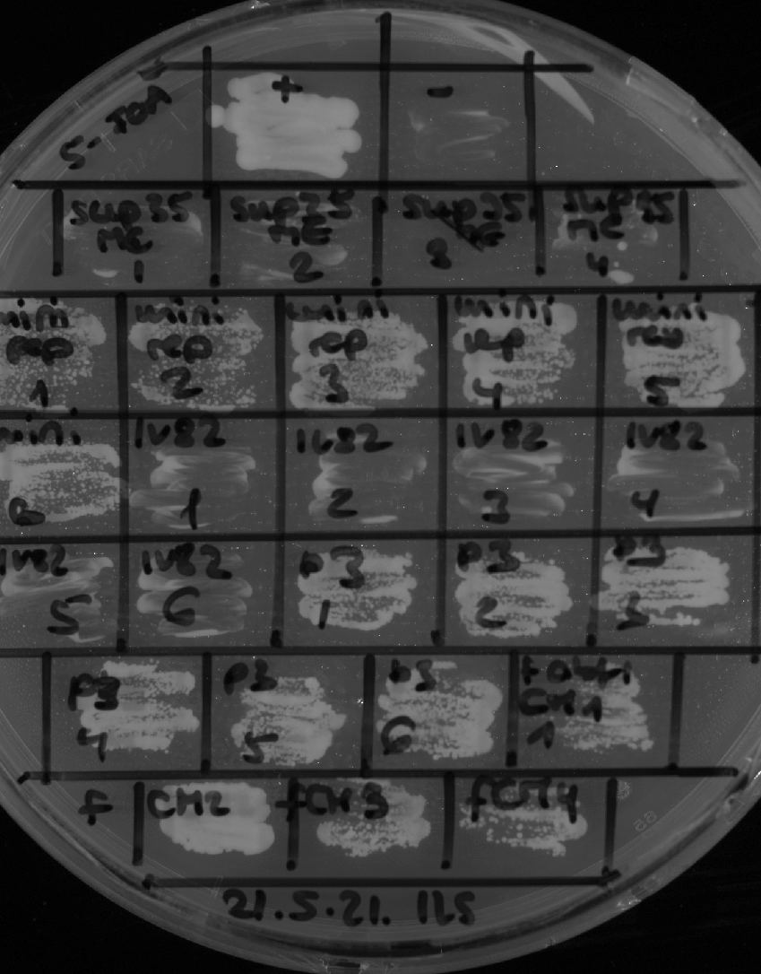
+ control
- control
Altered valence 2
1
Altered valence 2
2
Altered valence 2
3
Altered valence 2
4
Altered valence 2
5
Altered valence 2
6
FUS 1-163 12E + Gal4 G4 + aromatic clusters
1
FUS 1-163 12E + Gal4 G4 + aromatic clusters
2
FUS 1-163 12E + Gal4 G4 + aromatic clusters
3
Restreak from YNB –ura –leu to 5-FOA –leu
FUS 1-163 12E + Gal4 G4 + aromatic clusters
4
FUS 1-163 12E + Gal4 G4 + aromatic clusters
5
FUS 1-163 12E + Gal4 G4 + aromatic clusters
6
FUS 1-163 12E + EM
1
Construct | Result regarding viability on 5-FOA | Number of (in)viable clones / total number of clones
Altered valence 2 | viable | 6 out of 6 (in total 5 out of 6, see also slide 9)
FUS¹⁻¹⁶³12E + Gal4^{G4} aromatic clusters | viable | 6 out of 6 (technical replicate see slide 18)
FUS¹⁻¹⁶³12E + EM | viable | 4 out of 4 (in total 6 out of 6, see also slides 10, 11, 23)
FUS 1-163 12E + EM
2
FUS 1-163 12E + EM
3
FUS 1-163 12E + EM
4

Slide 23
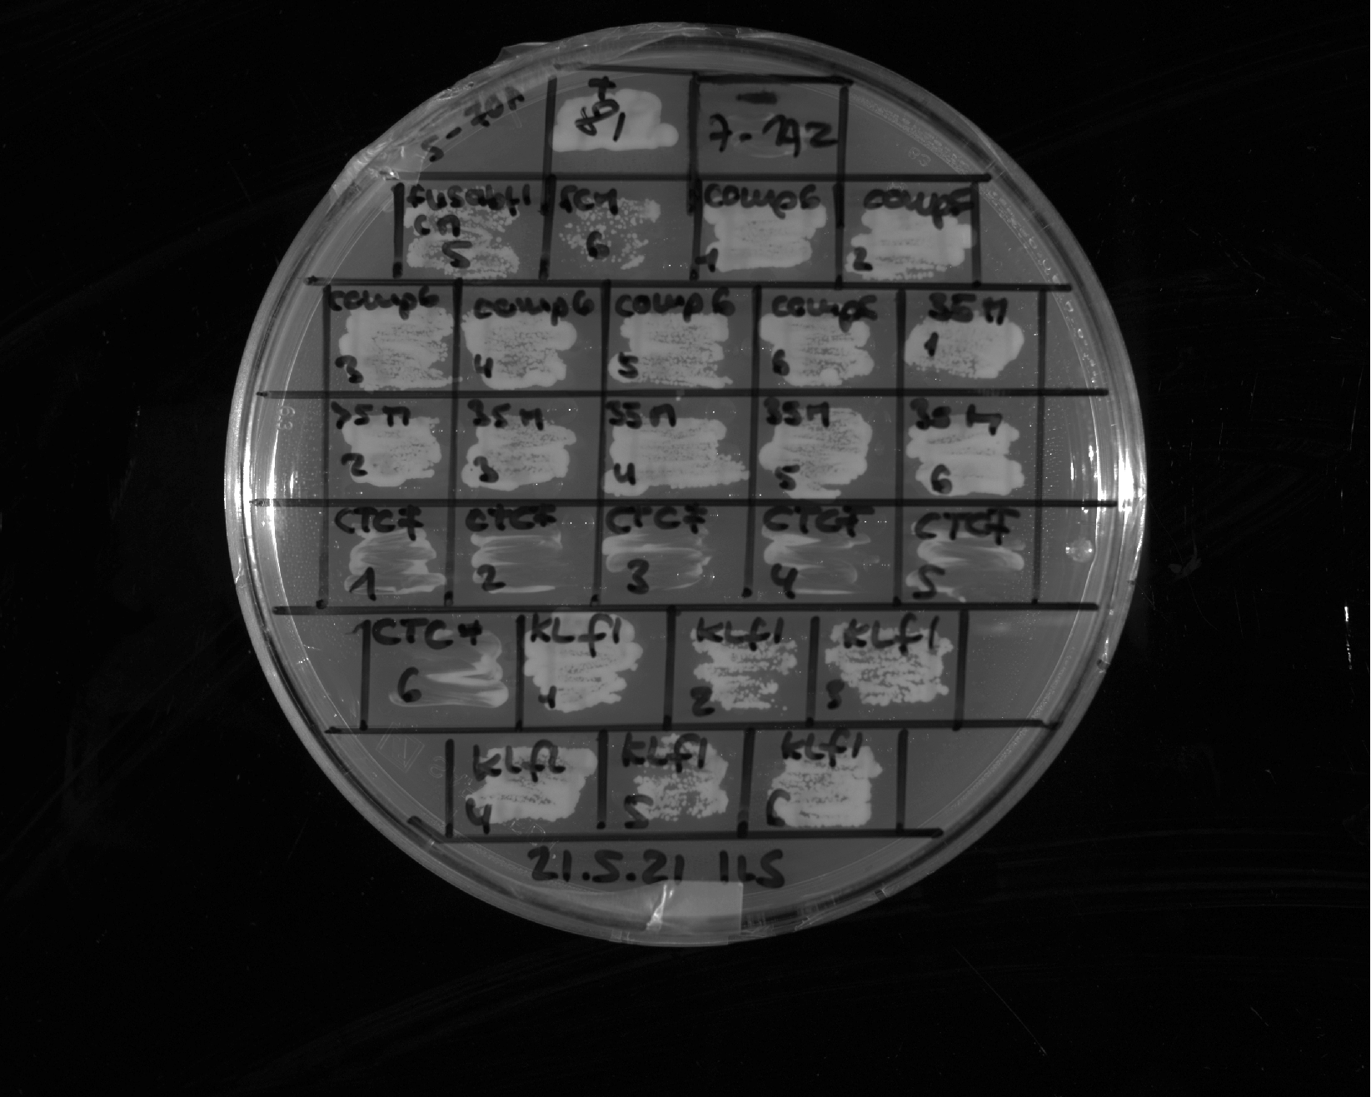
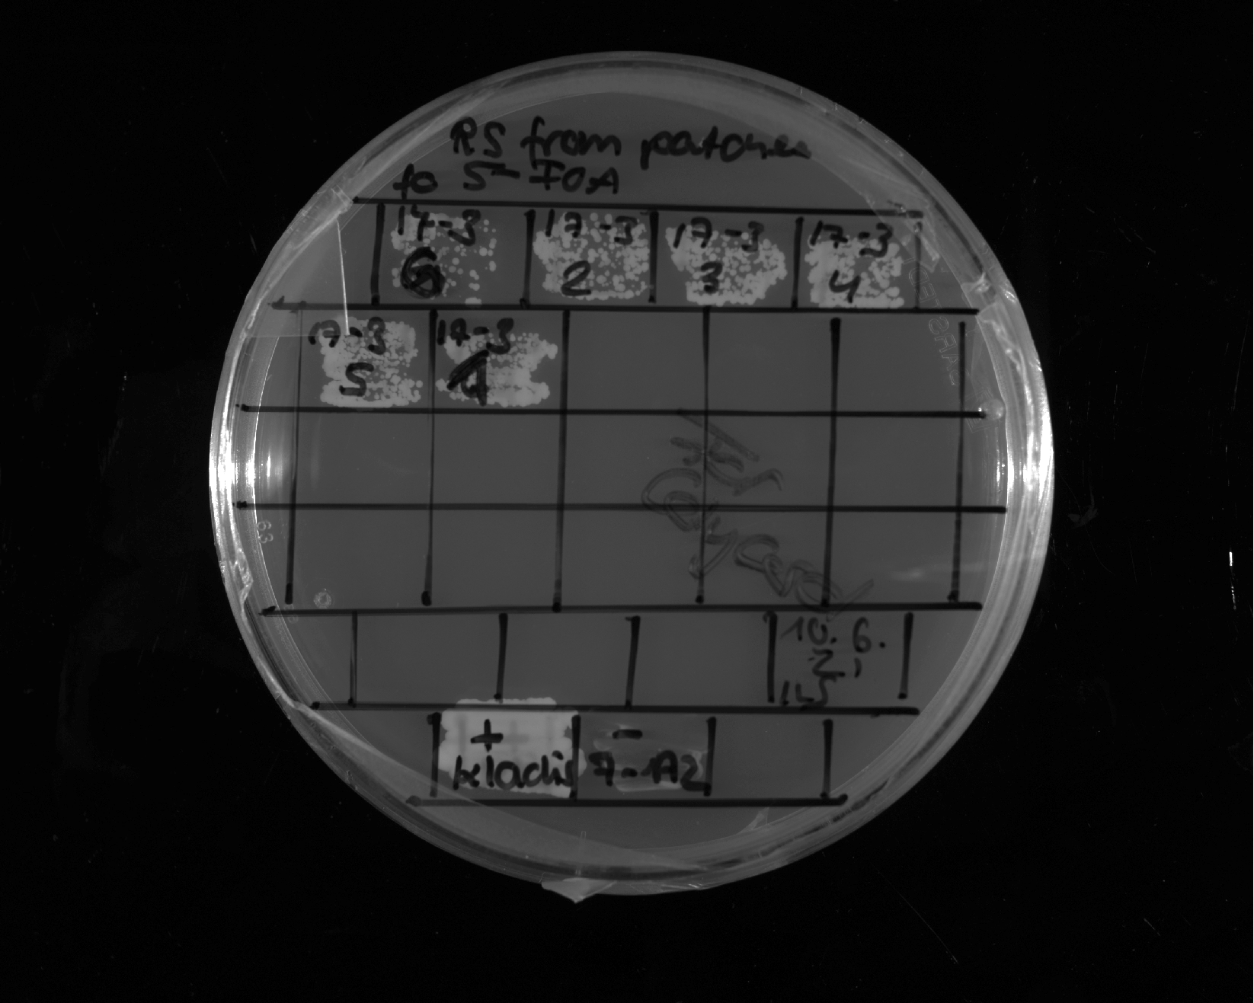
+ control
- control
FUS 1-163 12E + EM
5
FUS 1-163 12E + EM
6
Sup35 1-131 Gal4 G4
1
Sup35 1-131 Gal4 G4
2
Sup35 1-131 Gal4 G4
3
Sup35 1-131 Gal4 G4
4
Sup35 1-131 Gal4 G4
5
Sup35 1-131 Gal4 G4
6
CTCF IDR
578-727
1
CTCF IDR
578-727
2
CTCF IDR
578-727
3
CTCF IDR
578-727
4
CTCF IDR
578-727
5
Restreak from YNB –ura –leu to 5-FOA –leu
CTCF IDR
578-727
6
K. Lactis
1
K. Lactis
2
K. Lactis
3
Construct | Result regarding viability on 5-FOA | Number of (in)viable clones / total number of clones
FUS¹⁻¹⁶³12E + EM | viable | 2 out of 2 (in total 6 out of 6, see also slides 10, 11, 22)
Sup35¹⁻¹³¹ + Gal4^{G4} | viable | 6 out of 6
CTCF⁵⁷⁸⁻⁷²⁷ | inviable | 6 out of 6 (technical repliate, see slide 24)
K. Lactis | viable | 6 out of 6
K. Lactis
4
K. Lactis
5
K. Lactis
6
LS-15
6
LS-15
2
LS-15
3
LS-15
4
LS-15
5
LS-15
1
Restreak from YNB –ura –leu to 5-FOA –leu
Construct | Result regarding viability on 5-FOA | Number of (in)viable clones / total number of clones
LS-15 | viable | 6 out of 6 (in total 14 out of 14 clones, see also slide 36)
+ control
- control

Slide 24
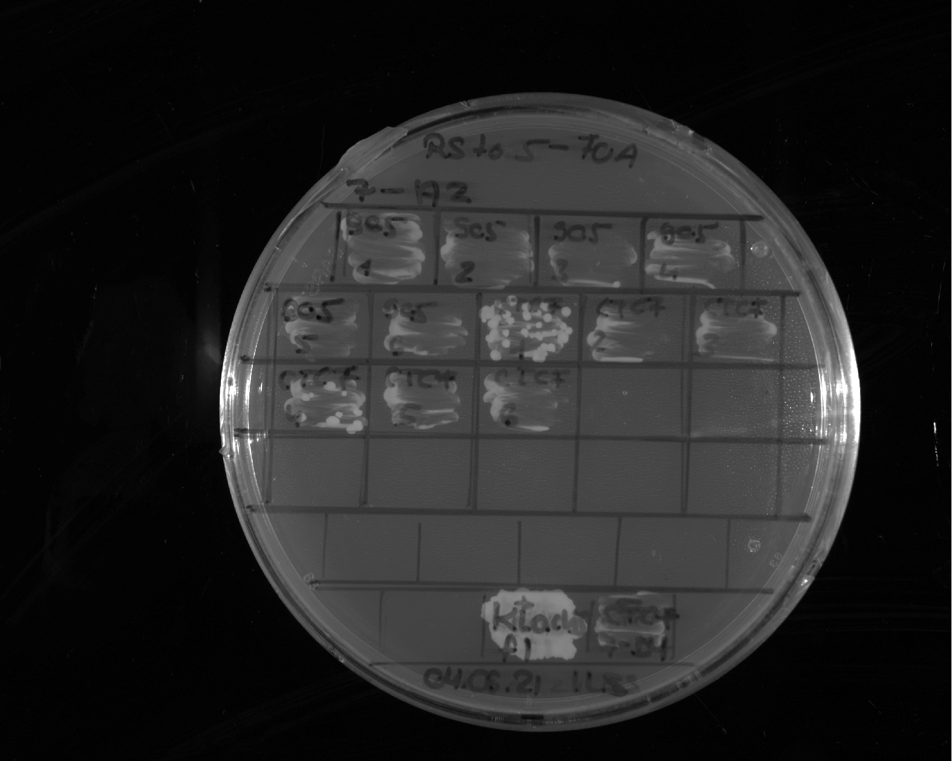
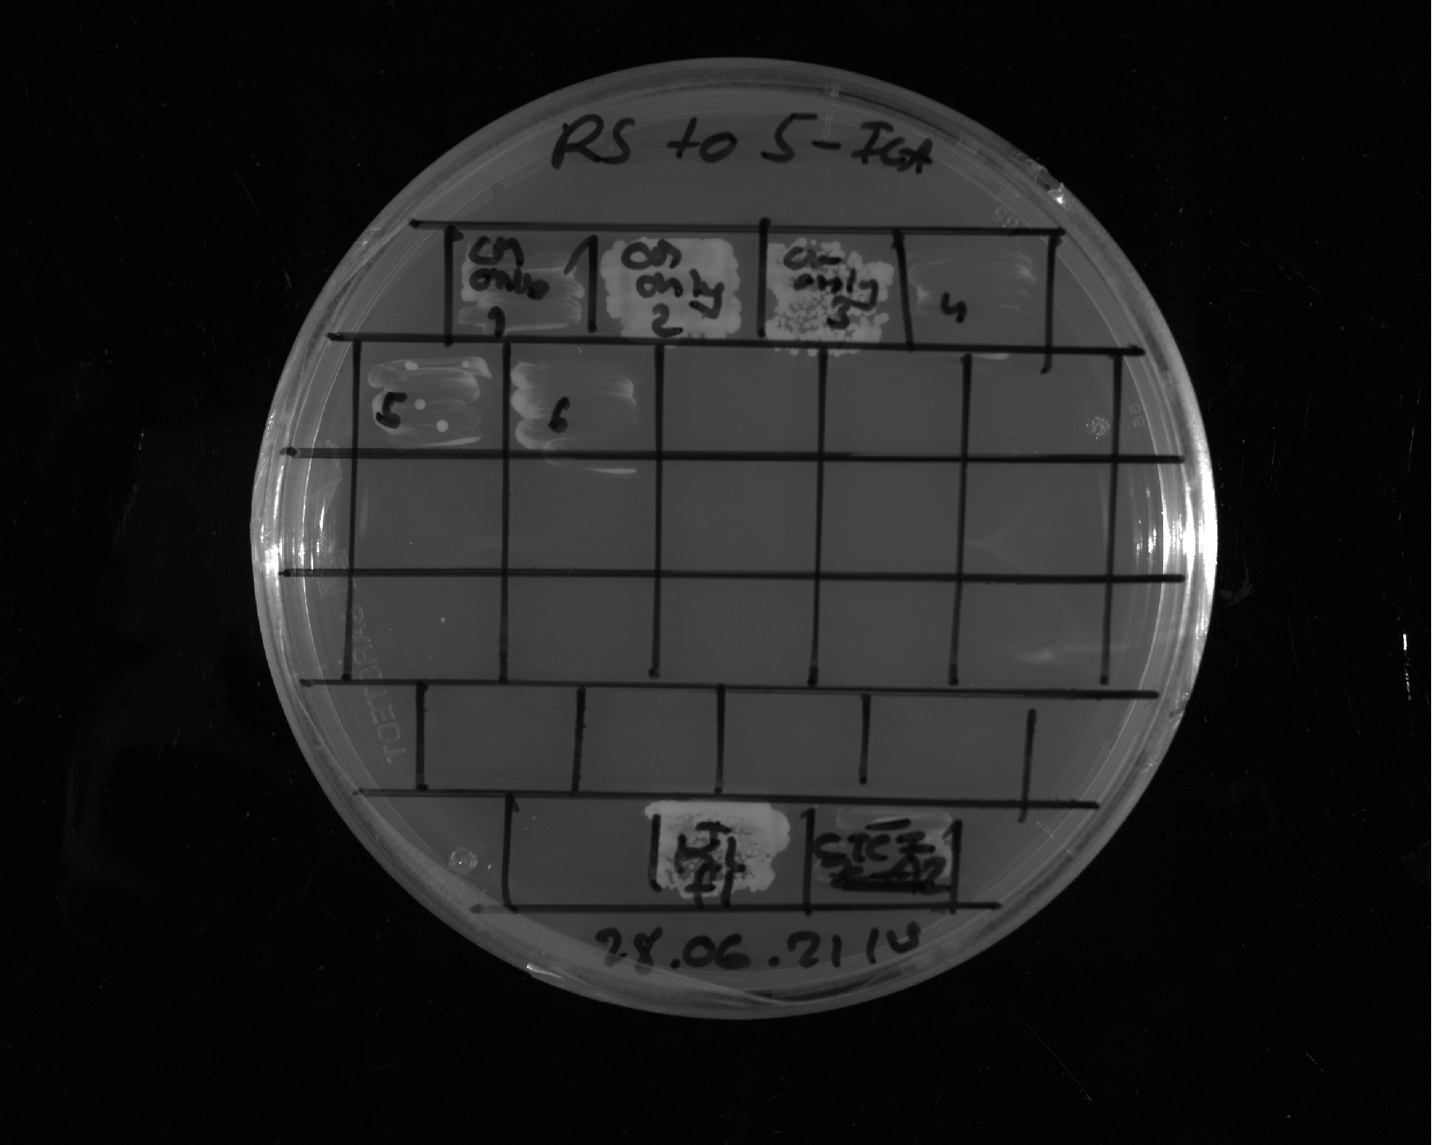
Sup35 1-131
1
Sup35 1-131
2
Sup35 1-131
3
Sup35 1-131
4
Sup35 1-131
5
Sup35 1-131
6
CTCF
1
CTCF
2
CTCF
3
CTCF
4
CTCF
5
CTCF
6
Restreak from YNB –ura –leu to 5-FOA –leu
Construct | Result regarding viability on 5-FOA | Number of (in)viable clones / total number of clones
Sup35¹⁻¹³¹ | inviable | 6 out of 6
CTCF⁵⁷⁸⁻⁷²⁷ | inviable | 5 out of 6 (technical repliate, see slide 23)
+ control
- control
EM only
1
EM only
2
EM only
3
EM only
4
EM only
5
EM only
6
Restreak from YNB –ura –leu to 5-FOA –leu
Construct | Result regarding viability on 5-FOA | Number of (in)viable clones / total number of clones
EM only | inviable | 4 out of 6 (in total: 10 out of 12, see also slide 25)
+ control
- control

Slide 25
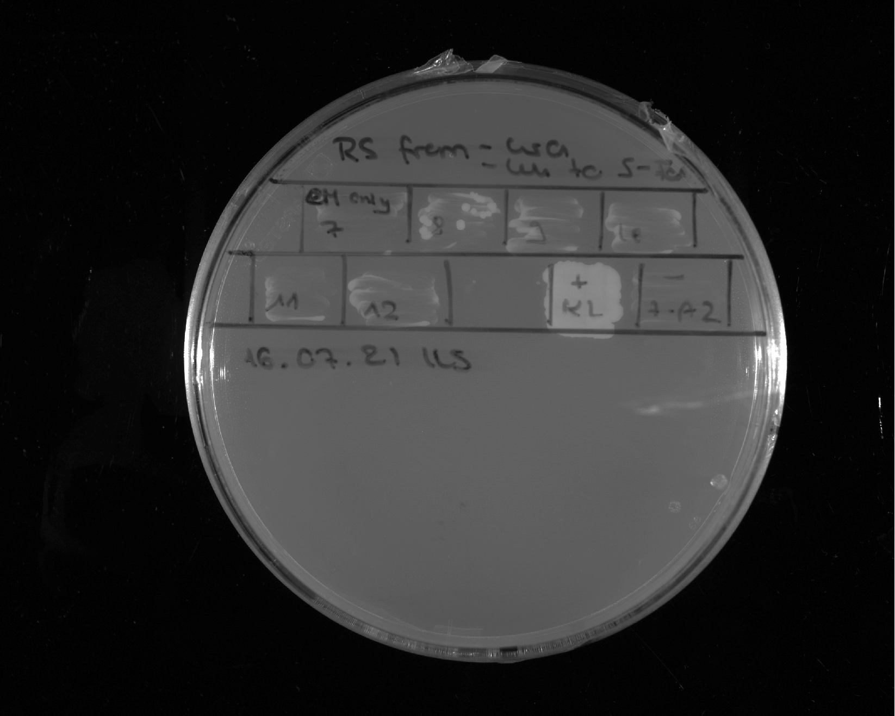
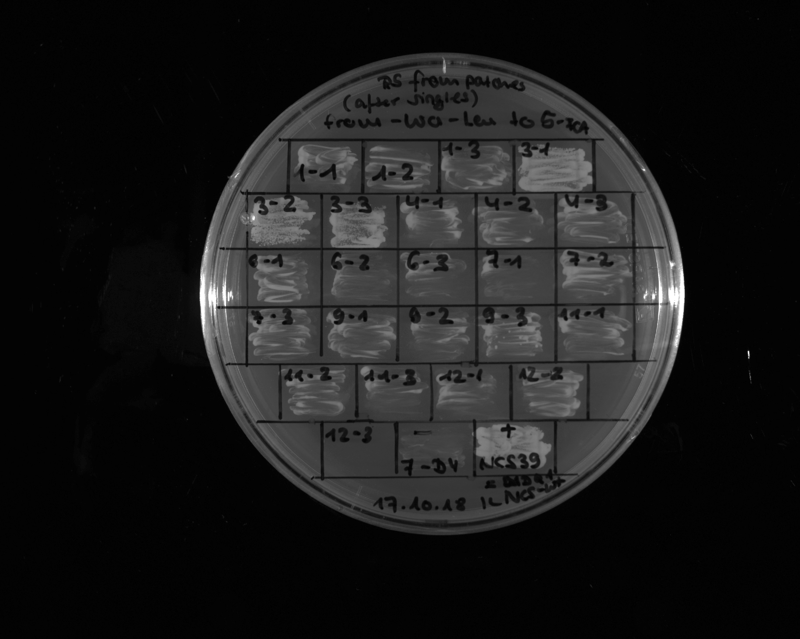
EM only
7
EM only
8
EM only
9
EM only
10
EM only
11
EM only
12
+ control
- control
Restreak from YNB –ura –leu to 5-FOA –leu
Construct | Result regarding viability on 5-FOA | Number of (in)viable clones / total number of clones
EM only | Inviable | 6 out of 6 (in total: 10 out of 12, see also slide 24)
NCS-1
1
NCS-1
2
NCS-1
3
NCS-3
1
NCS-3
2
NCS-3
3
NCS-4
1
NCS-4
2
NCS-4
3
NCS-6
1
NCS-6
2
NCS-6
3
NCS-7
1
NCS-7
2
NCS-7
3
NCS-9
1
NCS-9
2
NCS-9
3
NCS-11
1
Restreak from YNB –ura –leu to 5-FOA –leu
NCS-11
2
NCS-11
3
NCS-12
1
NCS-12
2
Construct | Result regarding viability on 5-FOA | Number of (in)viable clones / total number of clones
NCS-1 | inviable | 3 out of 3
NCS-3 | viable | 3 out of 3
NCS-4 | inviable | 3 out of 3
NCS-6 | inviable | 3 out of 3
NCS-7 | inviable | 3 out of 3
NCS-9 | inviable | 3 out of 3
NCS-11 | inviable | 3 out of 3
NCS-12 | inviable | 3 out of 3
NCS-12
3
- control
+ control

Slide 26
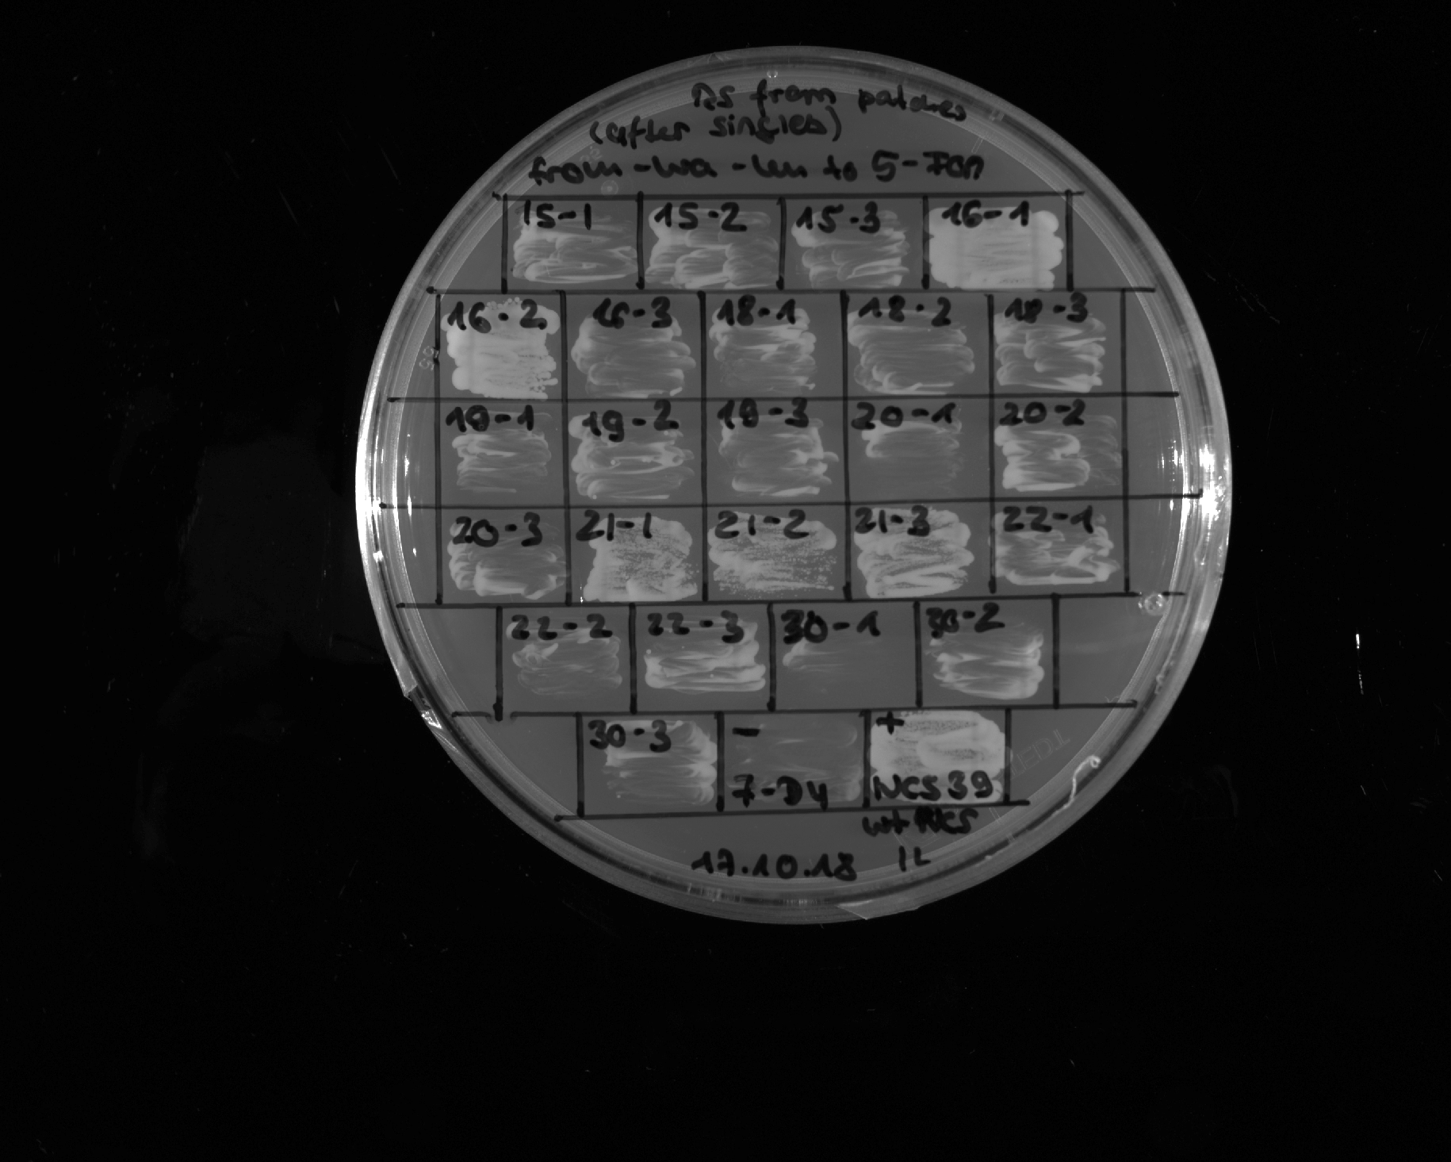
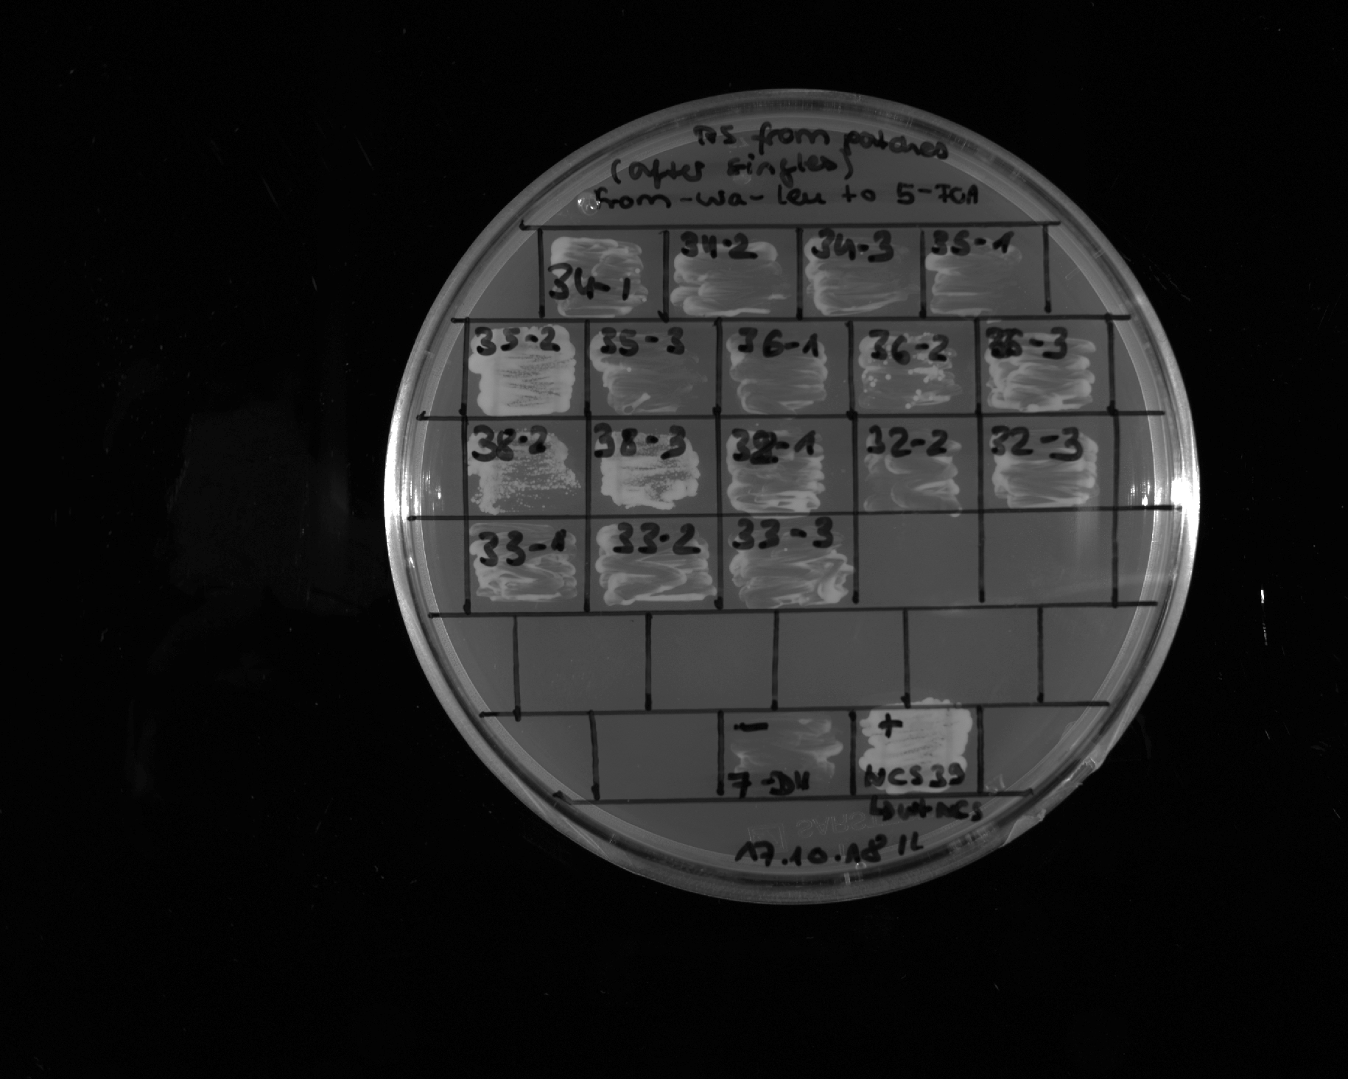
NCS-15
1
NCS-15
2
NCS-15
3
NCS-16
1
NCS-16
2
NCS-16
3
NCS-18
1
NCS-18
2
NCS-18
3
NCS-20
1
NCS-20
2
NCS-20
3
NCS-21
1
NCS-21
2
NCS-21
3
Restreak from YNB –ura –leu to 5-FOA –leu
NCS-30
1
NCS-30
2
Construct | Result regarding viability on 5-FOA | Number of (in)viable clones / total number of clones
NCS-15 | inviable | 3 out of 3
NCS-16 | inviable | 1 out of 3 (in total 4 out of 6, see slide 27)
NCS-18 | inviable | 3 out of 3
NCS-20 | inviable | 3 out of 3
NCS-21 | viable | 3 out of 3
NCS-30 | inviable | 3 out of 3
NCS-30
3
- control
+ control
NCS-35
1
NCS-35
2
NCS-35
3
NCS-38
2
NCS-38
3
NCS-32
1
NCS-32
2
NCS-32
3
NCS-33
1
NCS-33
2
NCS-33
3
Restreak from YNB –ura –leu to 5-FOA –leu
- control
+ control
Construct | Result regarding viability on 5-FOA | Number of (in)viable clones / total number of clones
NCS-35 | inviable | 2 out of 3 (in total 5 out of 6, see also slide 26)
NCS-38 | viable | 2 out of 2 (in total 5 out of 6, see also slide 26)
NCS-32 | inviable | 3 out of 3
NCS-33 | inviable | 3 out of 3

Slide 27
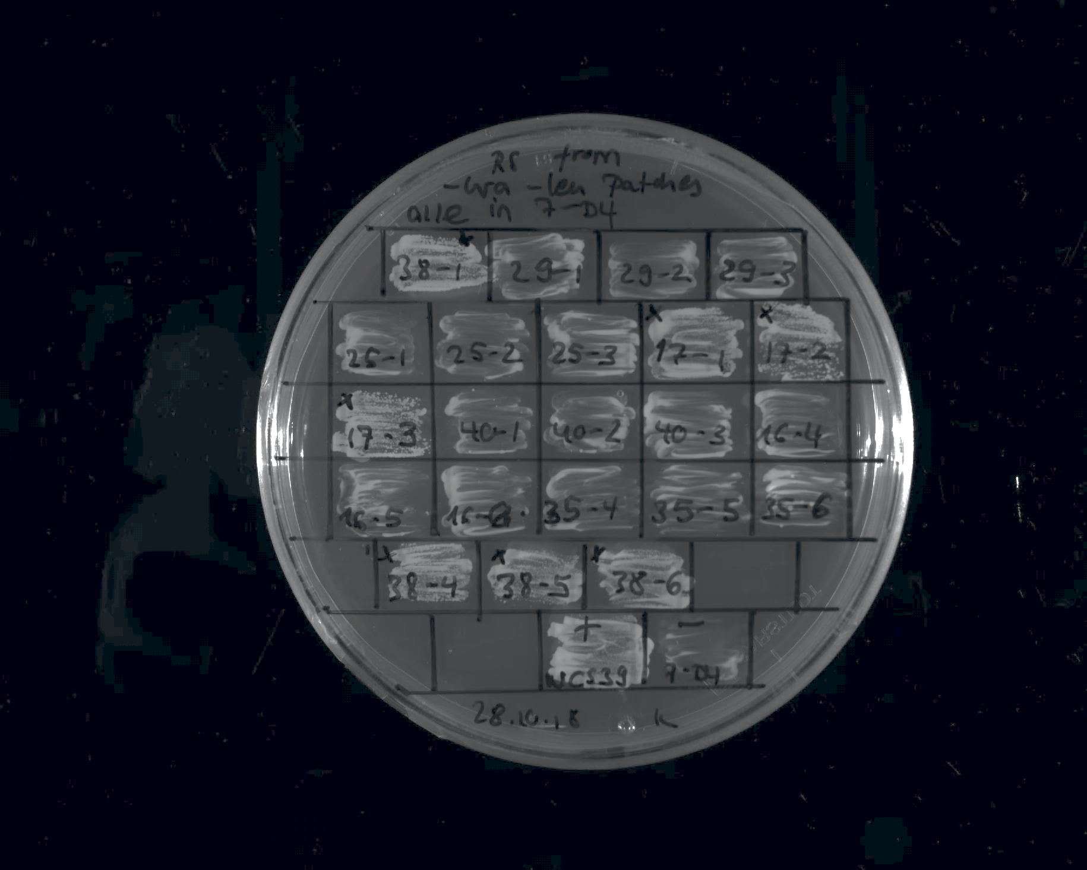
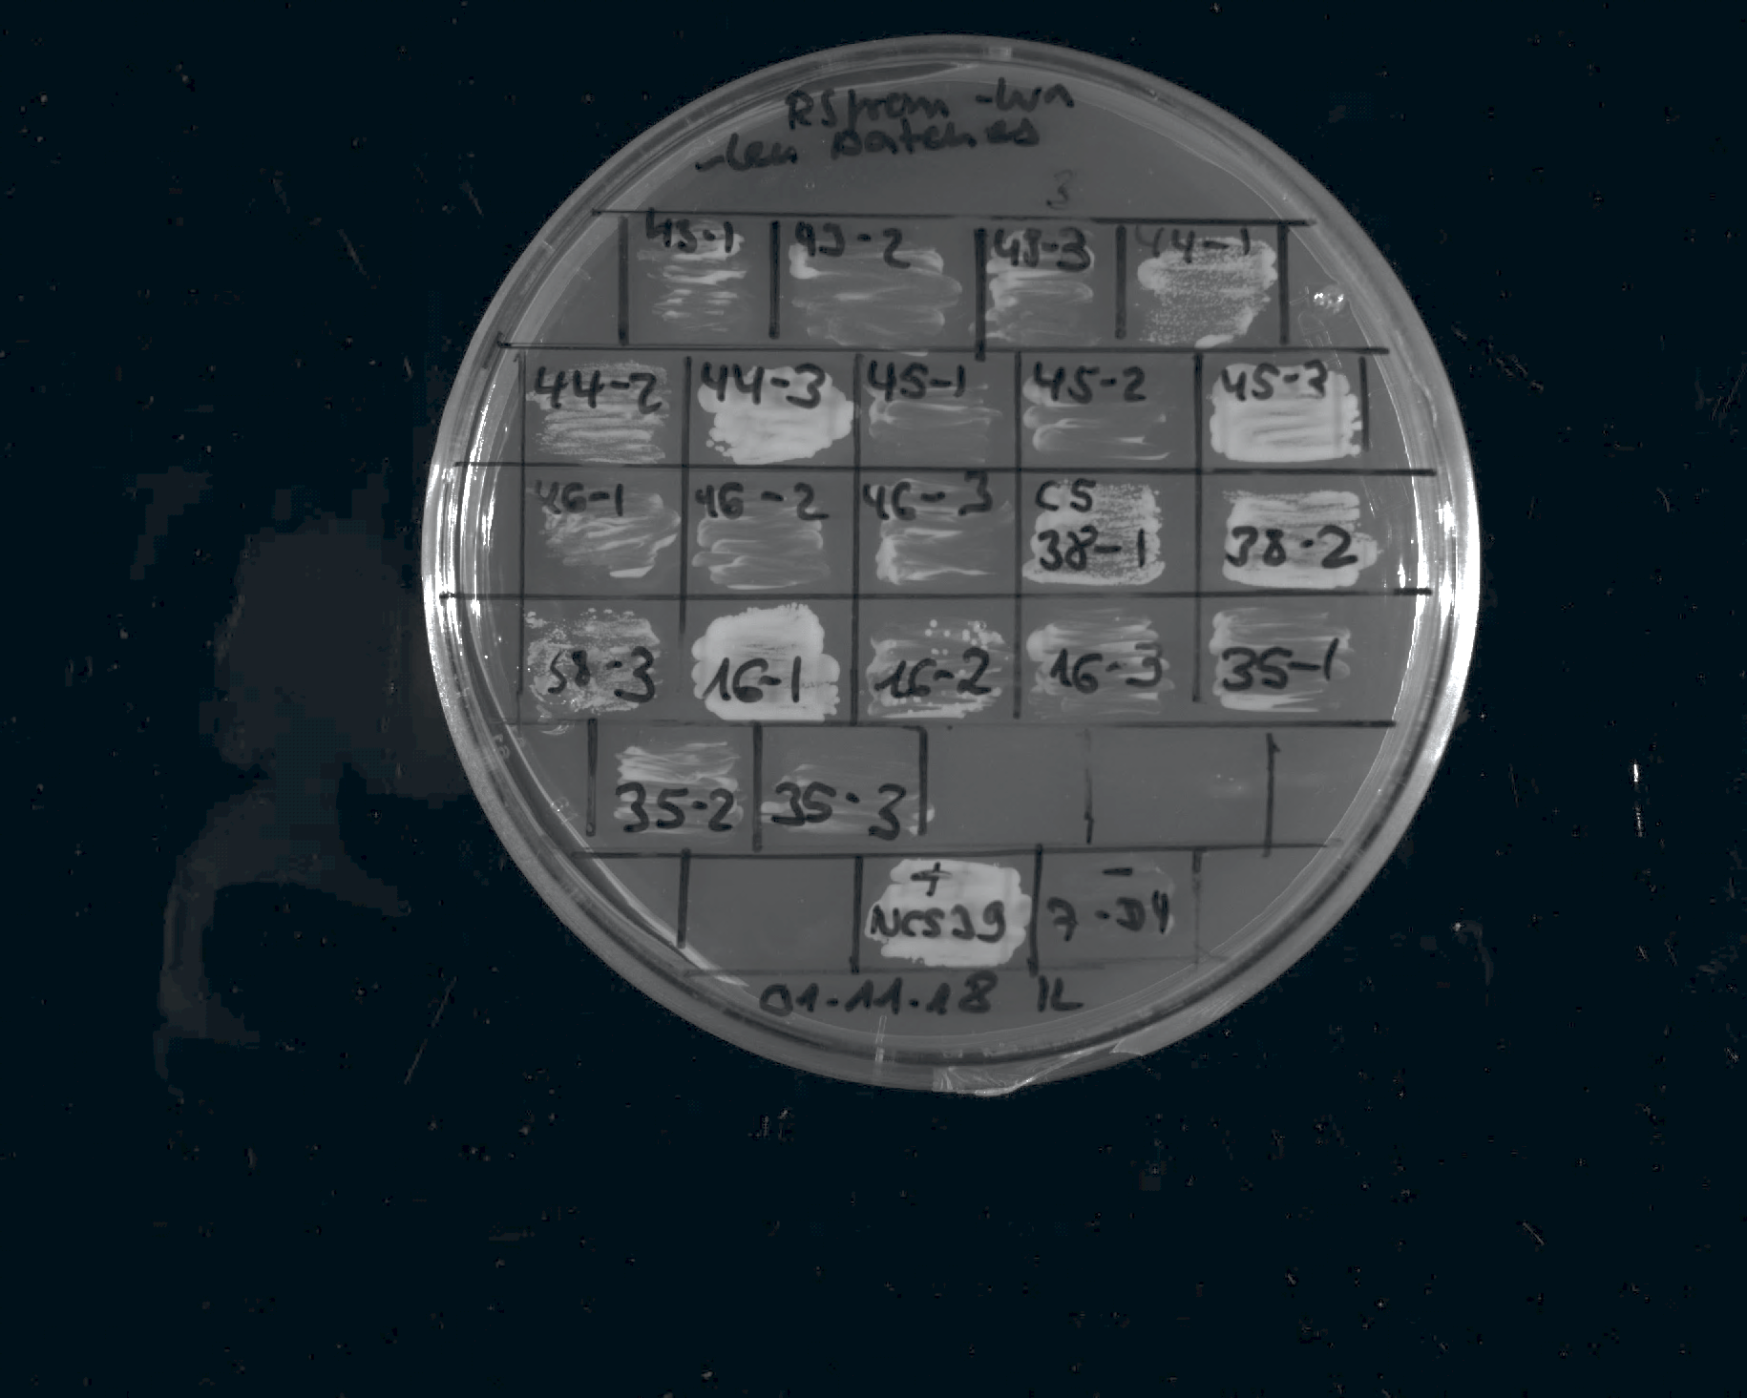
NCS-38
1
NCS-25
1
NCS-25
2
NCS-25
3
NCS-17
1
NCS-17
2
NCS-17
3
NCS-40
1
NCS-40
2
NCS-40
3
NCS-16
4
NCS-16
5
NCS-16
6
NCS-35
4
NCS-35
5
NCS-35
6
Restreak from YNB –ura –leu to 5-FOA –leu
NCS-38
4
NCS-38
5
NCS-38
6
Construct | Result regarding viability on 5-FOA | Number of (in)viable clones / total number of clones
NCS-38 | viable | 4 out of 4 (in total 5 out of 6, see also below and slide 26)
NCS-25 | inviable | 3 out of 3
NCS-17 | viable | 3 out of 3
NCS-40 | inviable | 3 out of 3
NCS-16 | inviable | 3 out of 3 (in total 4 out of 6, see below and slide 26)
NCS-35 | inviable | 3 out of 3 (in total 5 out of 6, see also below and slide 26)
- control
+ control
NCS-43
1
NCS-43
2
NCS-43
3
NCS-45
1
NCS-45
2
NCS-45
3
NCS-46
1
NCS-46
2
NCS-46
3
NCS-38
1
NCS-38
2
NCS-38
3
NCS-16
1
NCS-16
2
NCS-16
3
NCS-35
1
Restreak from YNB –ura –leu to 5-FOA –leu
NCS-35
2
NCS-35
3
Construct | Result regarding viability on 5-FOA | Number of (in)viable clones / total number of clones
NCS-43 | inviable | 3 out of 3
NCS-45 | inviable | 2 out of 3 (in total 5 out of 6, see also slide 29)
NCS-46 | inviable | 3 out of 3
NCS-38 | viable | 2 out of 3 (in total 5 out of 6, see also above and slide 26)
NCS-16 | inviable | 2 out of 3 (in total 4 out of 6, see above and slide 26)
NCS-35 | inviable | 3 out of 3 (in total 5 out of 6, see also above and slide 26)
- control
+ control

Slide 28


NCS-42
1
NCS-42
2
NCS-42
3
NCS-51
2
NCS-51
1
NCS-51
3
NCS-52
1
NCS-52
2
NCS-52
3
NCS-54
1
NCS-54
2
NCS-54
3
NCS-60
1
NCS-60
2
NCS-60
3
NCS-61
1
Restreak from YNB –ura –leu to 5-FOA –leu
NCS-61
2
NCS-61
3
Construct | Result regarding viability on 5-FOA | Number of (in)viable clones / total number of clones
NCS-42 | inviable | 3 out of 3
NCS-51 | inviable | 3 out of 3
NCS-52 | inviable | 2 out of 3 (in total 5 out of 6 see also below)
NCS-54 | inviable | 3 out of 3
NCS-60 | inviable | 3 out of 3
NCS-61 | inviable | 2 out of 3 (in total 5 out of 6 see also below)
+ control
-
control
NCS-61
5
NCS-61
6
NCS-52
4
NCS-52
5
NCS-52
6
Restreak from YNB –ura –leu to 5-FOA –leu
Construct | Result regarding viability on 5-FOA | Number of (in)viable clones / total number of clones
NCS-61 | inviable | 2 out of 2 (in total 5 out of 6 see also above)
NCS-52 | inviable | 3 out of 3 (in total 5 out of 6 see also above)
+ control
- control

Slide 29


NCS-44
4
NCS-44
5
NCS-44
6
NCS-45
4
NCS-45
5
NCS-45
6
Restreak from YNB –ura –leu to 5-FOA –leu
Construct | Result regarding viability on 5-FOA | Number of (in)viable clones / total number of clones
NCS-44 | viable | 3 out of 3 (in total 6 out of 6, technical replicate see also below)
NCS-45 | inviable | 3 out of 3 (in total 5 out of 6, see also slide 27)
+ control
- control
NCS-44
1
NCS-44
2
NCS-44
3
NCS-44
4
NCS-44
5
NCS-44
6
Restreak from 5-FOA – leu to 5-FOA –leu
Construct | Result regarding viability on 5-FOA | Number of (in)viable clones / total number of clones
NCS-44 | viable | 6 out of 6
+ control
- control

Slide 30


Abf1
1
Abf1
2
Abf1
3
NCS-
1007
1
NCS-
1007
2
NCS-1007
3
NCS-
1010
1
NCS-
1010
2
NCS-
1010
3
NCS-
1502
1
NCS-
1502
2
NCS-
1502
3
NCS-
1504
1
NCS-
1504
2
NCS-
1504
3
NCS-
1508
1
Restreak from YNB –ura –leu to 5-FOA –leu
NCS-
1508
2
NCS-
1508
3
NCS-
1510
1
NCS-
1510
2
Construct | Result regarding viability on 5-FOA | Number of (in)viable clones / total number of clones
WT Abf1 | viable | 3 out of 3
NCS-1007 | inviable | 3 out of 3
NCS-1010 | viable | 3 out of 3
NCS-1502 | viable | 3 out of 3
NCS-1504 | inviable | 3 out of 3
NCS-1508 | viable | 3 out of 3
NCS-1510 | inviable | 2 out of 3 (in total 12 out of 15, see also slides 31 and 32)
NCS-
1510
3
+ control
-
control
NCS-502
1
NCS-502
2
NCS-502
3
NCS-
503
1
NCS-
503
2
NCS-
503
3
NCS-
504
1
NCS-
504
2
NCS-504
3
NCS-
505
1
NCS-
505
2
NCS-
505
3
NCS-
507
1
NCS-
507
2
NCS-
507
3
NCS-
509
1
Restreak from YNB –ura –leu to 5-FOA –leu
NCS-
509
2
NCS-
509
3
NCS-
510
1
NCS-
510
2
Construct | Result regarding viability on 5-FOA | Number of (in)viable clones / total number of clones
NCS-502 | inviable | 3 out of 3
NCS-503 | inviable | 3 out of 3
NCS-504 | viable | 3 out of 3
NCS-505 | inviable | 3 out of 3
NCS-507 | inviable | 3 out of 3
NCS-509 | viable | 3 out of 3
NCS-510 | viable | 3 out of 3
NCS-
510
3
+ control
-
control

Slide 31


ΔIDR1-IDR2-449-662
1
ΔIDR1-IDR2-449-662
2
ΔIDR1-IDR2-449-662
3
Restreak from YNB –ura –leu to 5-FOA –leu
+ control
-
control
Construct | Result regarding viability on 5-FOA | Number of (in)viable clones / total number of clones
ΔIDR1 & IDR2⁴⁴⁹⁻⁶⁶² | viable | 3 out of 3
pRS315
1
pRS315
2
pRS315
3
NCS-
69
1
NCS-
69
2
NCS-
69
3
NCS-
71
1
NCS-
71
2
NCS-
71
3
NCS-
70
1
NCS-
79
1
NCS-
79
2
NCS-
79
3
NCS-
508
1
NCS-
508
2
NCS-
508
3
Restreak from YNB –ura –leu to 5-FOA –leu
NCS-
1510
1
NCS-
1510
2
NCS-
1510
3
Construct | Result regarding viability on 5-FOA | Number of (in)viable clones / total number of clones
pRS315 empty | inviable | 3 out of 3
NCS-69 | inviable | 3 out of 3
NCS-71 | inviable | 3 out of 3
NCS-70 | inviable | 1 out of 1 (in total 3 out of 3, see slide 32)
NCS-79 | inviable | 3 out of 3
NCS-508 | viable | 3 out of 3
NCS-1510 | inviable | 1 out of 3 (in total: 12 out of 15, see also slides 30 and 32)
+ control
-
control

Slide 32


NCS-1510
4
NCS-1510
5
NCS-1510
6
NCS-70
1
NCS-70
2
NCS-70
3
+ control
- control
Restreak from YNB –ura –leu to 5-FOA –leu
Construct | Result regarding viability on 5-FOA | Number of (in)viable clones / total number of clones
NCS-1510 | inviable | 2 out of 3 (in total 12 out of 15, see also slides 30 and 31 and below)
NCS-70 | inviable | 3 out of 3 (in total 3 out of 3, see slide 31)
w/o Flag
NCS-1510
7
NCS-1510
8
NCS-1510
9
NCS-1510
10
NCS-1510
11
NCS-1510
12
NCS-1510
13
NCS-1510
14
NCS-1510
15
Restreak from YNB –ura –leu to 5-FOA –leu
+ control
- control
Construct | Result regarding viability on 5-FOA | Number of (in)viable clones / total number of clones
NCS-1510 | inviable | 9 out of 9 (in total: 12 out of 15, see also slides 30 and 31 and above)

Slide 33


Abf1
1
Abf1
2
Abf1
3
ΔIDR2
1
ΔIDR2
2
ΔIDR2
3
Restreak from YNB –ura –leu to 5-FOA –leu
ΔIDR1/2
1
ΔIDR1/2
2
ΔIDR1/2
3
Construct | Result regarding viability on 5-FOA | Number of (in)viable clones / total number of clones
Abf1 (NLS) | viable | 3 out of 3 (technical replicate see below)
ΔIDR2 | inviable | 3 out of 3
ΔIDR1/2 | inviable | 3 out of 3
- control
Abf1
1
Abf1
2
Abf1
3
ΔIDR1
1
ΔIDR1
2
ΔIDR1
3
Restreak from YNB –ura –leu to 5-FOA –leu
Construct | Result regarding viability on 5-FOA | Number of (in)viable clones / total number of clones
Abf1 (NLS) | viable | 3 out of 3 (technical replicate see above)
ΔIDR1 | viable | 3 out of 3
- control

Slide 34


TDP-43 dist
1
TDP-43 dist
2
TDP-43 dist
3
TDP-43 dist
4
TDP-43 dist
5
5
TDP-43 dist
6
Gal4⁷⁶⁸⁻⁸⁸¹ shuffle 1_1
Gal4⁷⁶⁸⁻⁸⁸¹ shuffle 1_2
Gal4⁷⁶⁸⁻⁸⁸¹ shuffle 1_3
Gal4⁷⁶⁸⁻⁸⁸¹ shuffle 1_4
Gal4⁷⁶⁸⁻⁸⁸¹ shuffle 1_5
Gal4⁷⁶⁸⁻⁸⁸¹ shuffle 1_6
Gal4⁷⁶⁸⁻⁸⁸¹ shuffle 2_1
Gal4⁷⁶⁸⁻⁸⁸¹ shuffle 2_2
Gal4⁷⁶⁸⁻⁸⁸¹ shuffle 2_3
Gal4⁷⁶⁸⁻⁸⁸¹ shuffle 2_4
Gal4⁷⁶⁸⁻⁸⁸¹ shuffle 2_5
Gal4⁷⁶⁸⁻⁸⁸¹ shuffle 2_6
+ control
WT Abf1
1
+ control
WT Abf1
2
+ control
WT Abf1
3
- control
empty pRS315
1
- control
empty pRS315
2
-control
empty pRS315
3
Restreak from YNB –ura –leu to 5-FOA –leu
Construct | Result regarding viability on 5-FOA | Number of (in)viable clones / total number of clones
TDP-43 distr. | viable | 6 out of 6
Gal4⁷⁶⁸⁻⁸⁸¹ shuffle 1 | viable | 6 out of 6
Gal4⁷⁶⁸⁻⁸⁸¹ shuffle 2 | viable | 6 out of 6
Gal4⁷⁶⁸⁻⁸⁸¹ shuffle 3_1
Gal4⁷⁶⁸⁻⁸⁸¹ shuffle 3_2
Gal4⁷⁶⁸⁻⁸⁸¹ shuffle 3_3
Gal4⁷⁶⁸⁻⁸⁸¹ shuffle 3_4
Gal4⁷⁶⁸⁻⁸⁸¹ shuffle 3_5
Gal4⁷⁶⁸⁻⁸⁸¹ shuffle 3_6
Pho4¹⁻²⁴⁹(shuffle) 1
Pho4¹⁻²⁴⁹(shuffle) 2
Pho4¹⁻²⁴⁹(shuffle) 3
Pho4¹⁻²⁴⁹(shuffle) 4
Pho4¹⁻²⁴⁹(shuffle) 5
Pho4¹⁻²⁴⁹(shuffle) 6
EM broken helix 1
EM broken helix 2
EM broken helix 3
EM broken helix 4
EM broken helix 5
EM broken helix 6
+ control
WT Abf1
1
+ control
WT Abf1
2
+ control
WT Abf1
3
- control
empty pRS315
1
- control
empty pRS315
2
-control
empty pRS315
3
Restreak from YNB –ura –leu to 5-FOA –leu
Construct | Result regarding viability on 5-FOA | Number of (in)viable clones / total number of clones
Gal4⁷⁶⁸⁻⁸⁸¹ shuffle 3 | viable | 6 out of 6
Pho4¹⁻²⁴⁹ shuffle | inviable | 6 out of 6
IDR2 WT broken helix | inviable | 6 out of 6

Slide 35

ΔIDR2-Flag
1
ΔIDR2-Flag
2
ΔIDR2-Flag
3
+ control
WT Abf1
1
+ control
WT Abf1
2
+ control
WT Abf1
3
- control
empty pRS315
1
- control
empty pRS315
2
-control
empty pRS315
3
Restreak from YNB –ura –leu to 5-FOA –leu
Construct | Result regarding viability on 5-FOA | Number of (in)viable clones / total number of clones
ΔIDR2-Flag | inviable | 3 out of 3

Slide 36
AS3
AS2
AS1
AS8
AS7
AS6
AS5
AS4
NCS-506-Flag (clones AS1-AS8)
AS5
AS4
AS3
AS2
AS1
LS-15 (clones AS1-AS8)
AS8
AS7
AS6
+ control WT Abf1
- control empty pRS315
Restreak from YNB –ura –leu to 5-FOA –leu
Construct | Result regarding viability on 5-FOA | Number of (in)viable clones / total number of clones
NCS-506-Flag | viable | 8 out of 8
LS-15 | viable | 8 out of 8 (in total 14 out of 14, see also slide 23)
AS3
AS2
AS1
AS8
AS7
AS6
AS5
AS4
V. polyspora (clones AS1-AS8)
+ control WT Abf1
- control empty pRS315
Restreak from YNB –ura –leu to 5-FOA –leu
Construct | Result regarding viability on 5-FOA | Number of (in)viable clones / total number of clones
V. polyspora | inviable | 8 out of 8 (in total 14 out of 14, see also slide 16)

Slide 37
AS3
AS2
AS1
FUS¹⁻¹⁶³12E + Abf1^{G4} distr.
(clones AS1-AS8)
AS8
AS7
AS6
AS5
AS4
AS5
AS4
AS3
AS2
AS1
FUS¹⁻¹⁶³12E + EM shuffle
(clones AS1-AS8)
AS8
AS7
AS6
+ control WT Abf1
- control empty pRS315
Restreak from YNB –ura –leu to 5-FOA –leu
Construct | Result regarding viability on 5-FOA | Number of (in)viable clones / total number of clones
FUS¹⁻¹⁶³12E + Abf1^{G4} distr. | inviable | 8 out of 8 (in total 14 out of 14, see also slide 39)
FUS¹⁻¹⁶³12E + EM shuffle | inviable | 8 out of 8 (in total 14 out of 14, see also slide 39)
AS3
AS2
AS1
AS8
AS7
AS6
AS5
AS4
FUS¹⁻¹⁶³12E + Gal4^{G4} all ΔE/D (clones AS1-AS8)
AS5
AS4
AS3
AS2
AS1
NCS-21 hydro→polar
(clones AS1-AS8)
AS8
AS7
AS6
+ control WT Abf1
- control empty pRS315
Restreak from YNB –ura –leu to 5-FOA –leu
Construct | Result regarding viability on 5-FOA | Number of (in)viable clones / total number of clones
FUS¹⁻¹⁶³12E + Gal4^{G4} all ΔE/D | viable | 8 out of 8
NCS-21 hydro→polar | viable | 8 out of 8

Slide 38
AS6
AS5
AS4
AS3
AS2
AS1
Pho4¹⁻²⁴⁹ segmental shuffle (clones AS1-AS6)
Sup35¹⁻¹³¹ + EM (clones AS1-AS6)
AS6
AS5
AS4
AS3
AS2
AS1
+ control WT Abf1
- control empty pRS315
Restreak from YNB –ura –leu to 5-FOA –leu
Construct | Result regarding viability on 5-FOA | Number of (in)viable clones / total number of clones
Pho4¹⁻²⁴⁹ segmental shuffle | inviable | 6 out of 6
Sup35¹⁻¹³¹ + EM | viable | 5 out of 6
AS6
AS5
AS1
AS4
AS3
AS2
FUS¹⁻¹⁶³12E + Gal4^{G4} distr. II (clones AS1-AS6)
+ control WT Abf1
- control empty pRS315
Restreak from YNB –ura –leu to 5-FOA –leu
Construct | Result regarding viability on 5-FOA | Number of (in)viable clones / total number of clones
FUS¹⁻¹⁶³12E Gal4^{G4} distr. II | viable | 6 out of 6

Slide 39
AS1
AS6
AS5
AS4
AS3
AS2
Rap1 IDR¹⁻¹²⁰ & IDR²³⁰⁻³⁶¹ (clones AS1-AS6)
AS14
AS13
AS12
AS11
AS10
AS9
FUS¹⁻¹⁶³12E + Abf1^{G4} distr. (clones AS9-AS14)
AS14
AS13
AS12
AS11
AS10
AS9
FUS¹⁻¹⁶³12E + EM shuffle (clones AS9-AS14)
+ control WT Abf1
- control empty pRS315
Restreak from YNB –ura –leu to 5-FOA –leu
Construct | Result regarding viability on 5-FOA | Number of (in)viable clones / total number of clones
Rap1^{1-120 & 230-361} | inviable | 6 out of 6 (in total 7 out of 8, see also slide 21)
FUS¹⁻¹⁶³12E + Abf1^{G4} distr. | inviable | 6 out of 6 (in total 14 out of 14, see also slide 37)
FUS¹⁻¹⁶³12E + EM shuffle | inviable | 6 out of 6 (in total 14 out of 14, see also slide 37)
39

